Slide 1
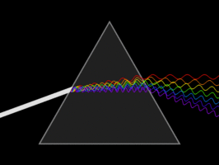
AP Physics
Chapter 13: Vibrations and Waves

Slide 2
What is a wave?
A disturbance in a medium that transfers energy from one point to another without transferring matter.
The transport of energy without the transport of matter.

Slide 3
What is a wave?
There are many different types of waves.
We will be looking into the types of waves that exist.
All waves are mathematically represented by sine and cosine functions. (We will get more into this later)

Slide 4
Periodic Motion – It’s a wave
Periodic Motion - A physical motion that has a repeating pattern in repeating intervals of time.
There are two types of periodic motion
Simple Harmonic Motion
Anharmonic Motion

Slide 5
Simple Harmonic Motion
A periodic motion where the amplitude of the force acting on our object is proportional to the displacement of the object.
Anything that obeys Hooke’s Law
$F=kx$

Slide 6
Simple Harmonic Motion
Another way to think about this is that it is a repeating motion where the amplitude and frequency of our displacement does not change.

Slide 7
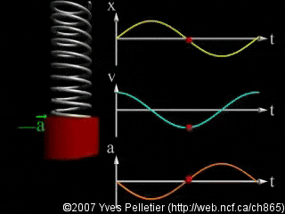
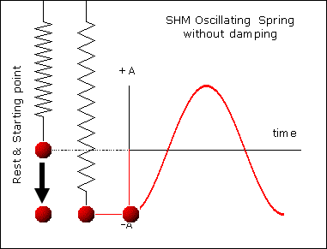
Simple Harmonic Motion
Example of a spring in simple harmonic motion

Slide 8
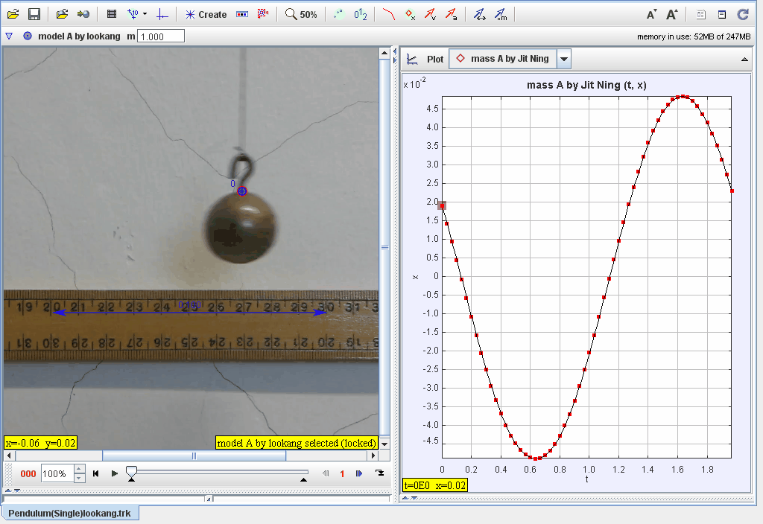
Simple Harmonic Motion
Example of a pendulum

Slide 9
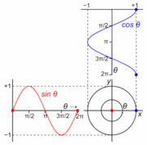
Simple Harmonic Motion
The unit circle from math. (All Circles in general)

Slide 10
Properties of waves
There four main properties that all waves share.
The Amplitude
The Frequency
Two of these properties depend on what dimension we are looking at for the waves.
Period
Wavelength

Slide 11
Properties of waves
The mathematical expression for a wave
$$Wave=Asin(2πft)$$
A = Amplitude
$f$ = frequency
$t$ = time

Slide 12
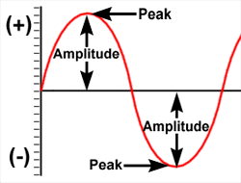
Amplitude
The height of the wave function.

Slide 13
Frequency
The amount of oscillations that occur within one second.
The amount of repeating motions that can occur in one second.
$f$ is always measured in Hz

Slide 14
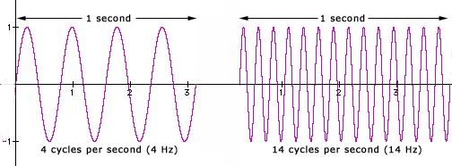
Frequency

Slide 15
Period
The amount of time it takes to complete one oscillation/cycle.
Period = 1/f
It is always measured in a unit of time.
It is usually represented by T

Slide 16
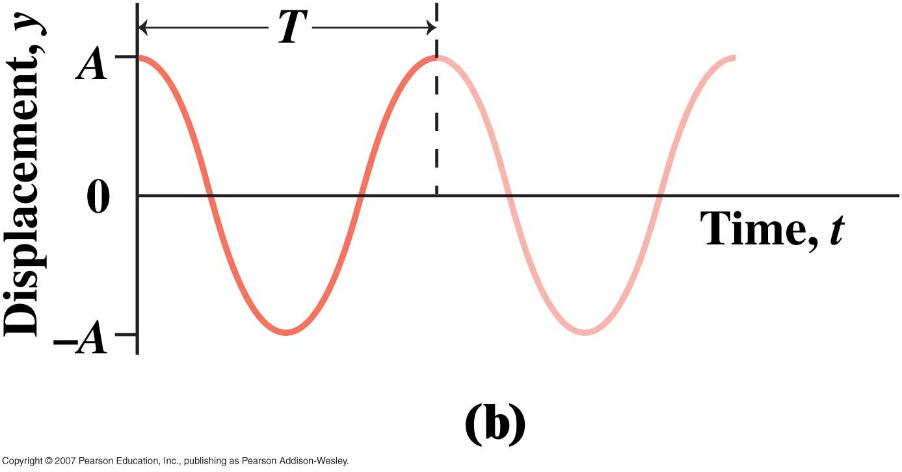
Period

Slide 17
Wavelength
Similar to period, but instead it is the distance between peaks on a wave.
It is always represented with a lower case lambda, (λ)

Slide 18
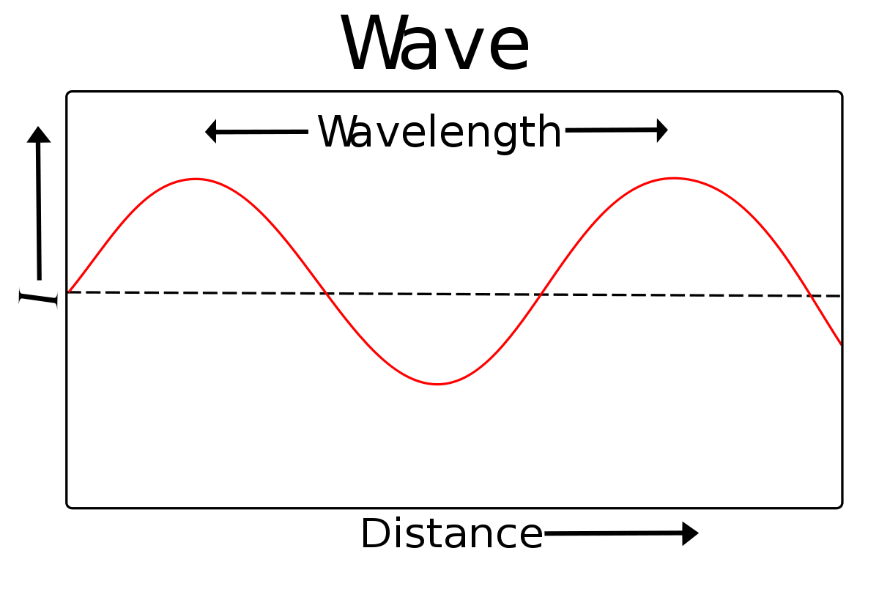
Wavelength

Slide 19
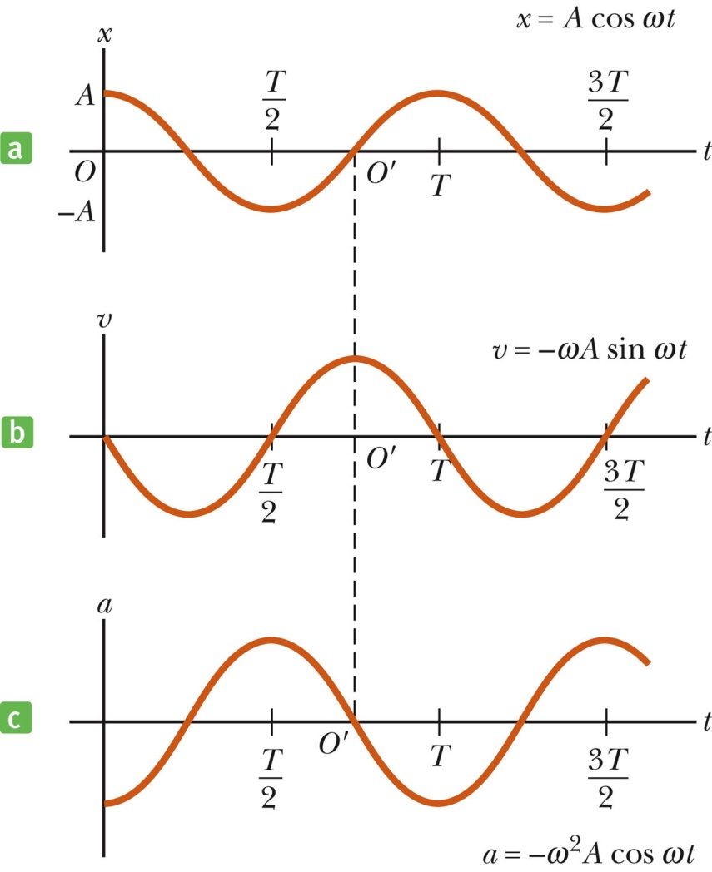
Graphical representation of motion
When x is a maximum or minimum, velocity is zero
When x is zero, the velocity is a maximum
When x is a maximum in the positive direction, a is a maximum in the negative direction

Slide 20
Returning to our springs

Slide 21
Returning to the pendulum

Slide 22
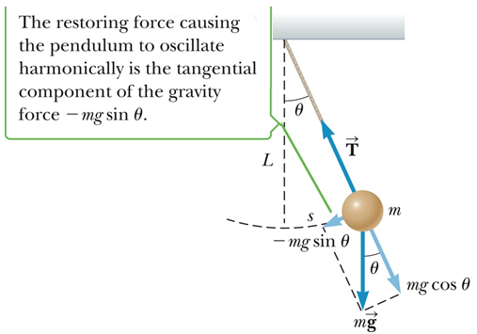
The simple pendulum
The force is the component of the weight tangent to the path of motion
F_{t} = - mg sin θ

Slide 23
The simple pendulum
So really a simple pendulum doesn’t exhibit simple harmonic motion because
$$simple harmonic motion must abide by f=kx$$
$$kx ≠mgsin\left(θ\right)$$
However, when the angle is small enough
$$sin\left(θ\right) ≈ θ$$
Thus
$$kx=mgθ, where k=mg and θ=x$$

Slide 24
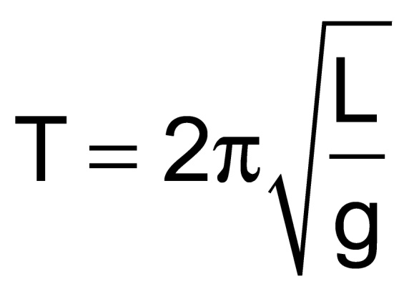
The simple pendulum
The period of a pendulum is represented by
The period of a pendulum only depends on the length of the string and the acceleration due to gravity

Slide 25
Dampened Oscillations
ideal systems oscillate indefinitely. They only exist in a “perfect world.”
In the real world friction exists, this friction will cause the energy in a system to decrease.
When the total energy of our system decreases this causes dampening.

Slide 26
Dampened Oscillations
ideal systems oscillate indefinitely. They only exist in a “perfect world.”
In the real world friction exists, this friction will cause the energy in a system to decrease.
When the total energy of our system decreases this causes dampening.

Slide 27
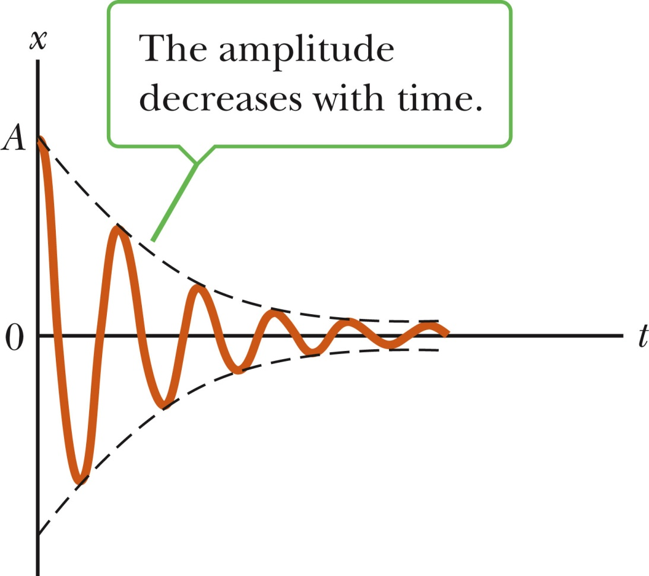
Dampened Oscillations
Dampening = The amplitude of our wave decreases with time.

Slide 28
Dampened Oscillations
There are three kinds of dampened oscillators.
Underdamped
Critically Damped
Overdamped

Slide 29
Underdamped Oscillations
When an oscillation occurs within a low viscosity fluid/medium the amplitude of the wave decreases steadily but the vibration is conserved.

Slide 30
Critically Damped + Overdamped Oscillations
Critically Damped -
In higher viscosity fluids/mediums the object will return to equilibrium rapidly without oscillating.
Overdamped –
In even higher viscosity fluids/mediums the object will return to equilibrium without oscillating but it will take a longer time.

Slide 31
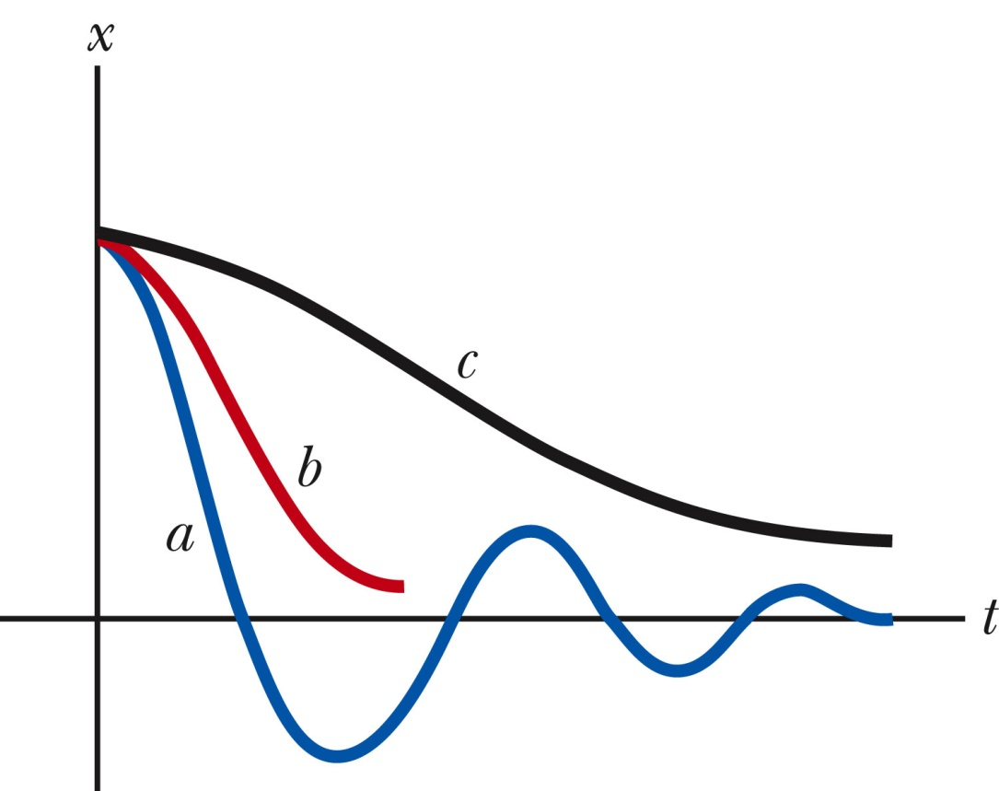
Dampened Oscillations
a = underdamped
b = critically damped
c = overdamped

Slide 32
Waves
There are two major forms of waves
Electromagnetic Waves
2. Mechanical Waves
Both of which carry energy and momentum.

Slide 33
Electromagnetic Waves
A wave that has the ability to propagate through a vacuum. It consists of an electric field and a magnetic field. Hence the name.
This includes radio waves, micro waves, infrared waves, visible light, ultraviolet light ,x-rays, and gamma rays

Slide 34
Mechanical Waves
A wave that must have a medium to propagate through.
This includes a rope, drum, water, sound, springs, etc.

Slide 35
Mechanical Waves

Slide 36
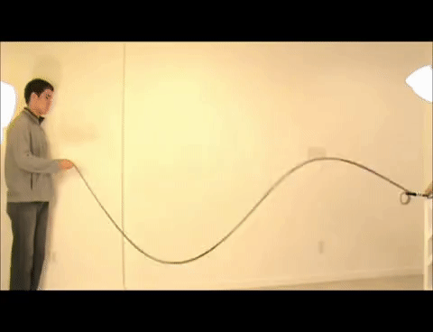
Mechanical Waves

Slide 37
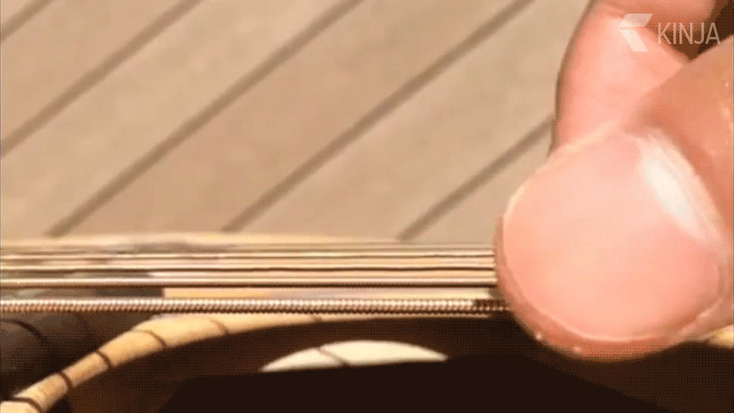
Mechanical Waves

Slide 38
Types of Waves
There also exists certain types of waves. These waves are defined by the orientation by which they propagate.
We will investigate
Transverse waves
Longitudinal waves

Slide 39
Transverse Waves
In a transverse wave the orientation of our wave is perpendicular to direction the wave is traveling.

Slide 40
Longitudinal Waves
In a longitudinal wave the oscillation is oriented parallel to direction that the wave is traveling.

Slide 41
Types of waves
Waves are not confined to only propagate in these two types.
Many waves are a mixture of transverse and longitudinal waves.
In science we call this a superposition of waves. Which basically means waves added together. (We will go into this more later on.)

Slide 42
Types of waves
No matter what the wave is, all waves can be represented by sine and cosine curves.

Slide 43
Speed of a wave
$Speed= \frac{d}{t}$
$Wavlength= λ=distance$
$Frequency=f=Hz= \frac{1}{s}$
$Speed of Wave=λf$

Slide 44
Wave Behavior
Boundary – Change or movement of a wave from one medium to another.
Incident Wave – Wave that strikes a boundary.
Reflected Wave – The return of an incident waves reflection. This can be oriented upward or downward.

Slide 45
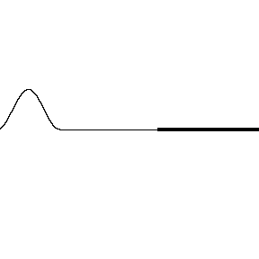
Wave Behavior

Slide 46
Interference of waves
Two traveling waves can pass through each other without being altered or destroyed.
Waves obey the superposition principle which basically states: When two or more traveling waves encounter each other while moving through a medium their wave functions are added together to form a new wave.

Slide 47
Interference of waves
Mathematically this essentially means if one wave $Asin(bx)$ encounters $Csin\left(dx\right)$ then the created wave is
$$New Wave=Asin\left(bx\right)+Csin\left(dx\right)$$
Another way to think about this is we just add the y points (displacements) together at the same x points (time).
This will become incredibly important when we talk about sound!

Slide 48
Interference of waves
There are two types of interference
Constructive interference
Destructive interference

Slide 49
Constructive Interference
When two waves are in phase they add together to enhance their amplitudes.
In phase means they have the same frequency and start at the same point.

Slide 50
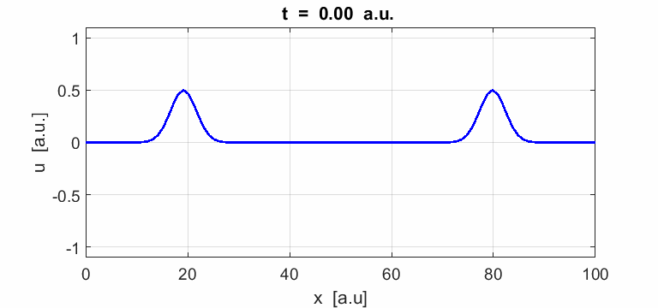
Constructive Interference
When two pulses travel in opposite directions a strange phenomena occurs.
When they meet each other their amplitudes add together.
Afterwards they continue along their path unchanged.

Slide 51
Destructive Interference
When two waves are out of phase they add together to decrease the overall amplitude.
Out of phase means they have the same frequency but start at a different point in the wave.
EX: sine(x) vs –sine(x)

Slide 52
Destructive Interference

Slide 53
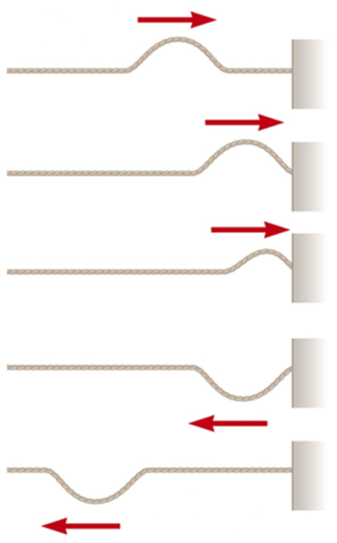
Reflections of Waves
Whenever a traveling wave reaches a boundary, some or all of the wave is reflected
When it is reflected from a fixed end, the wave is inverted
The shape remains the same

Slide 54
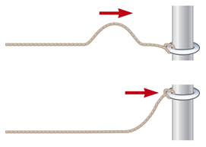
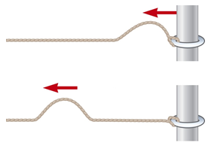
Reflections of Waves
When a traveling wave reaches a boundary, all or part of it is reflected
When reflected from a free end, the pulse is not inverted

Slide 55
Reflections of Waves

Slide 56
Chapter 13: Vibrations and Waves
HW: pg 453 – 454
Problems: 41 – 48 and 61
Homework is not graded but is highly
recommended

