Slide 1
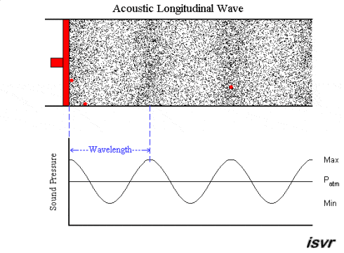
AP Physics
Chapter 14: Sound

Slide 2
What is Sound?
Sound waves are longitudinal pressure waves.
Their source comes from a vibrating object that pushes molecules.
The molecules run into each other and transfer their energy but they themselves do not move in position.
Sound waves must have a medium to propagate through.

Slide 3
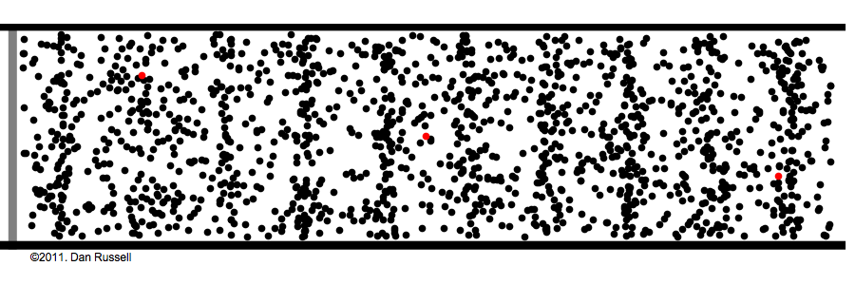
Visual Example of Sound

Slide 4
Another Example of Sound
A tuning fork is able to produce a sound by vibrating at a specific frequency.
Each time it vibrates it pushes the air molecules next to it and generates a pressure wave.

Slide 5
Categories of Sound Waves
Audible Waves
- Lay within the normal range of hearing
- Normally between 20 Hz to 20,000 Hz
Infrasonic Waves
- Frequencies below the audible range
- Earthquakes are a great example
Ultrasonic Waves
-Frequencies above the audible range
-Example: Dog Whistles

Slide 6
Applications of Sound Waves
Can be used to produce images of small objects
Widely used as a diagnostic and treatment tool in medicine
Ultrasonic flow meter to measure blood flow
May use piezoelectric devices that transform electrical energy into mechanical energy
Ultrasounds to observe babies in the womb
Cavitron Ultrasonic Surgical Aspirator (CUSA) used to surgically remove brain tumors; High-intensity Focused Ultrasound (HIFU) is also used for brain surgery
Ultrasonic ranging unit for cameras

Slide 7
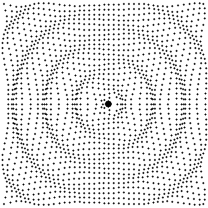
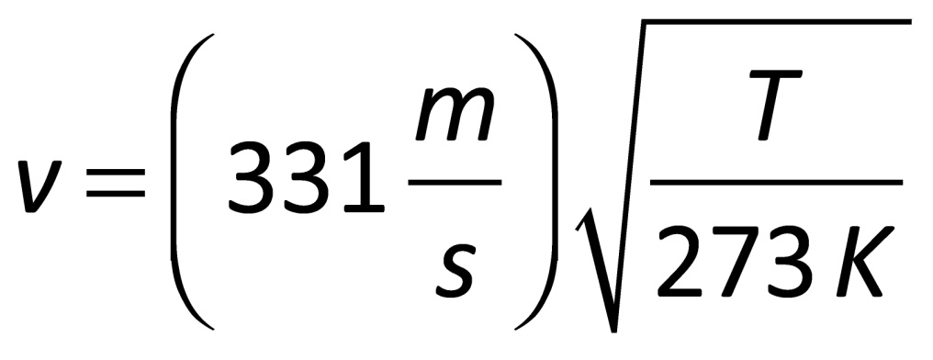
Speed of Sound in Air
331 m/s is the speed of sound at 0° C (273K)
Sound travels at different speeds in different temperatures

Slide 8
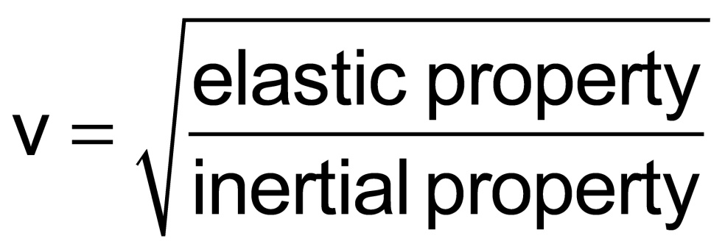
Speed of Sound in General
The speed of sound is higher in solids than in fluids
The molecules in a solid are closer together therefore the molecules take less time to transfer their energy from one particle to the other.
The speed is slower in liquids than in solids
Fluids are more compressible and the particles are farther apart, so it takes more time for the particles to transfer their energy.

Slide 9
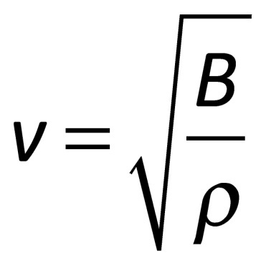
Speed of Sound in Fluids
In a fluid, the speed depends on the fluid’s compressibility and inertia
B is the Bulk Modulus of the liquid or the resistance to compressibility for that fluid
ρ is the density of the liquid
Compares with the equation for a transverse wave on a string

Slide 10
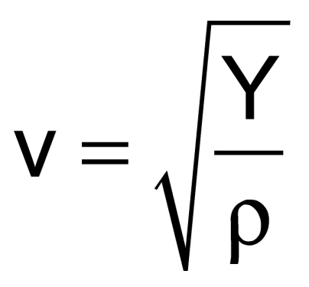
Speed of Sound in Solids
The speed depends on the solid’s compressibility and inertial properties
Y is the Young’s Modulus of the material or how well the solid resists compression
ρ is the density of the material

Slide 11
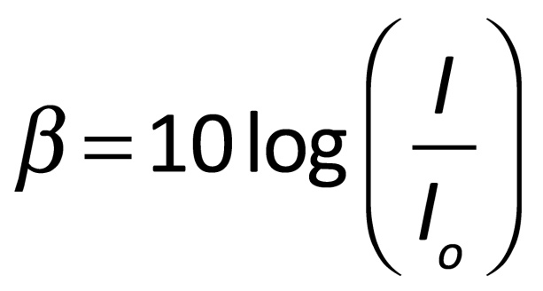
Sound Intensity
The sensation of loudness is logarithmic in the human ear
β is the intensity level or the decibel level of the sound
I_{o} is the threshold of hearing
I is usually measured in $\frac{W}{m^{2}}$

Slide 12
Sound Intensity
The sensation of loudness is logarithmic in the human ear
β is the intensity level or the decibel level of the sound
I_{o} is the threshold of hearing
I is usually measured in $\frac{W}{m^{2}}$ but can also be measured as a Pascal $\frac{N}{m^{2}}$

Slide 13
Intensity vs Intensity Level
Intensity is a physical quantity with units.
Intensity level is a unit-less convenient mathematical transformation of intensity to a logarithmic scale

Slide 14
Intensity Levels
Threshold of hearing is 0 dB
Threshold of pain is 120 dB
Jet airplanes are about 150 dB
Table 14.2 (page 476) lists intensity levels of various sounds
Multiplying a given intensity by 10 adds 10 dB to the intensity level

Slide 15
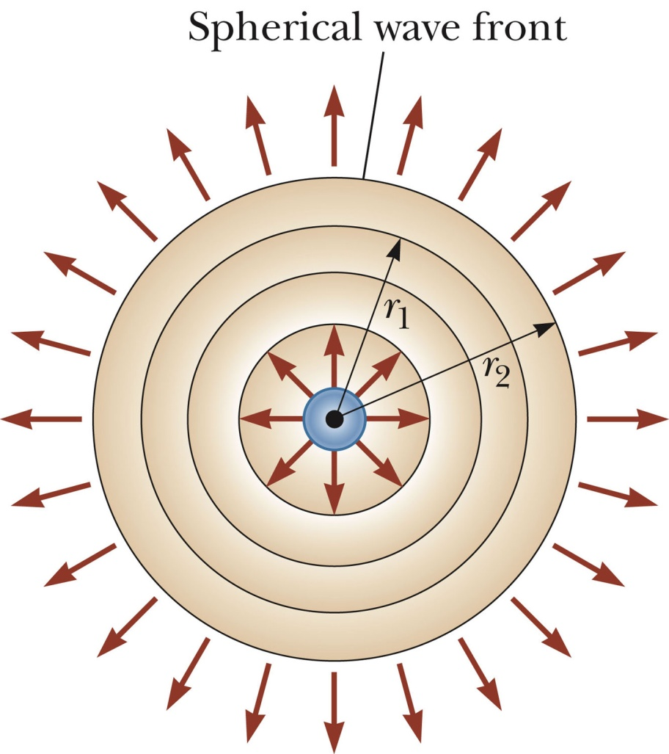
Spherical Waves
A spherical wave propagates radially outward from the oscillating sphere
The energy propagates equally in all directions

Slide 16
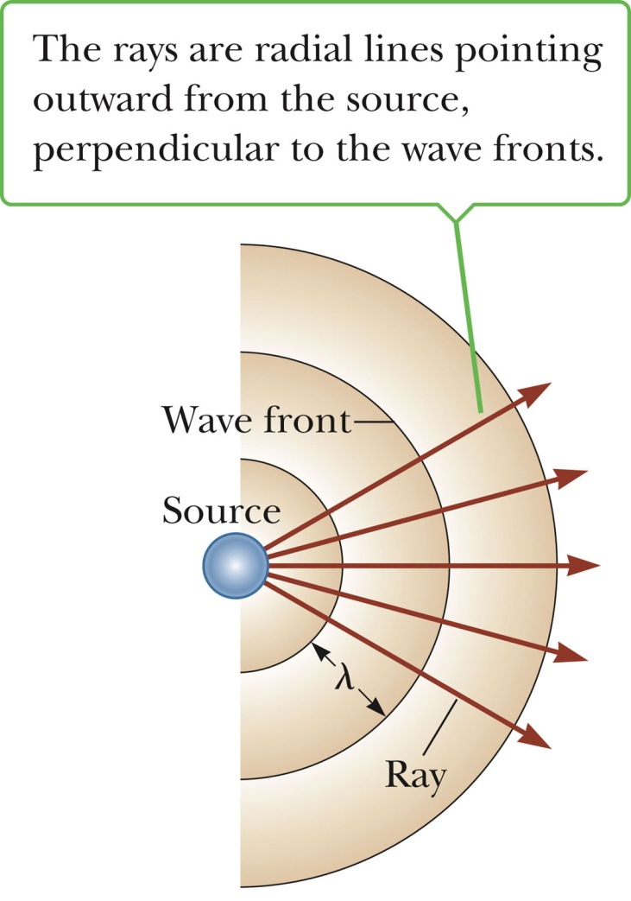
Spherical Waves
Wave fronts are the concentric arcs
The distance between successive wave fronts is the wavelength
Rays are the radial lines pointing out from the source and perpendicular to the wave fronts

Slide 17
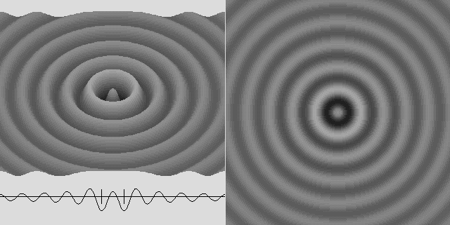
Spherical Waves

Slide 18
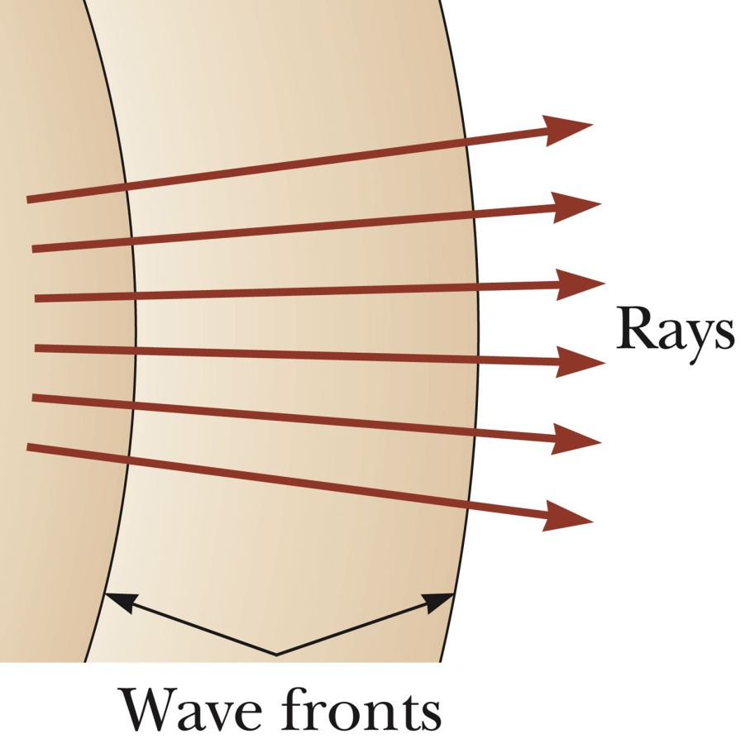
Planar Waves
Far away from the source, the wave fronts are nearly parallel planes
The rays are nearly parallel lines
A small segment of the wave front is approximately a plane wave

Slide 19
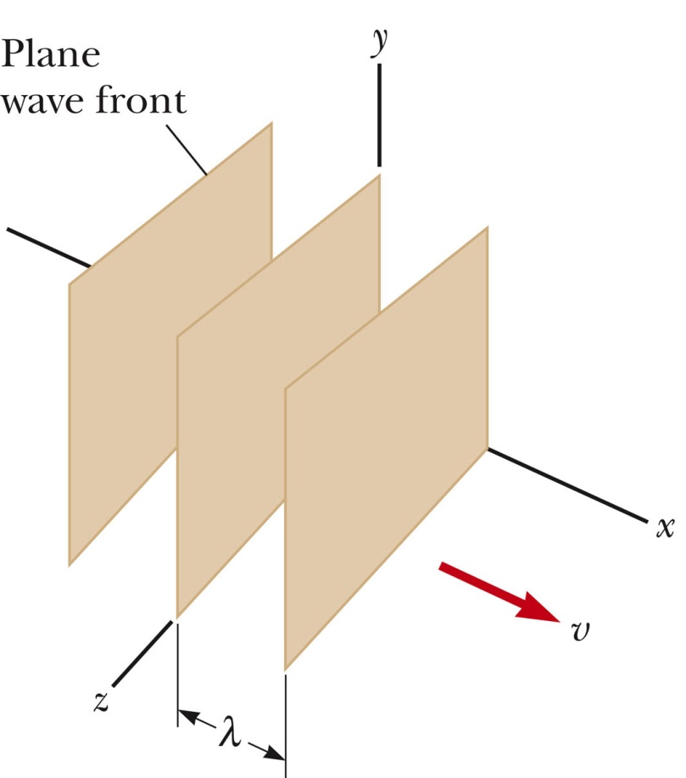
Planar Waves
Any small portion of a spherical wave that is far from the source can be considered a plane wave
This shows a plane wave moving in the positive x direction
The wave fronts are parallel to the plane containing the y- and z-axes

Slide 20
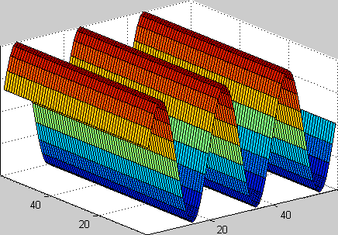
Planar Waves

Slide 21
The Doppler Effect
A phenomena that describes the observed effect of a wave when the observer and or source of the waves are moving.
This effect applies to all waves.
When the observer and or the source are moving towards each other the observed frequency of the wave is higher
When the observer and or the source are moving away from each other the observed frequency of the wave is lower.

Slide 22
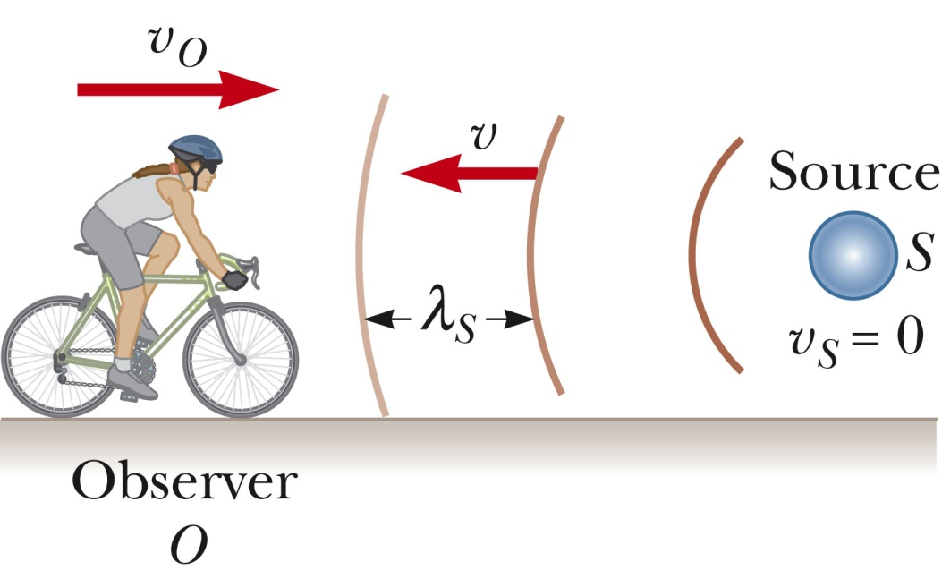
The Doppler Effect
An observer is moving toward a stationary source
Due to his movement, the observer detects an additional number of wave fronts
The frequency heard is increased; the loudness does not change.

Slide 23
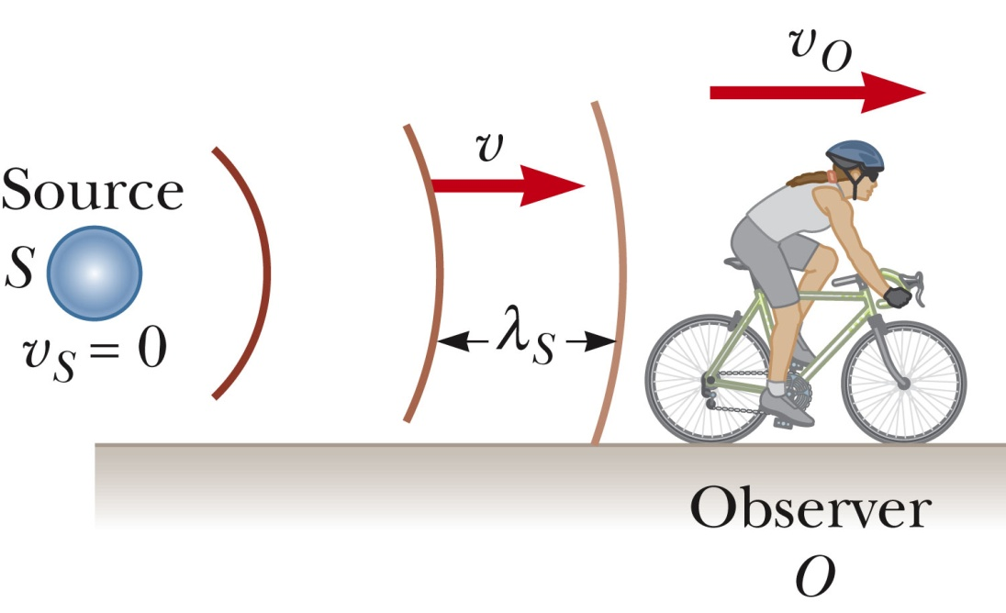
The Doppler Effect
An observer is moving away from a stationary source
The observer detects fewer wave fronts per second
The frequency appears lower; the loudness does not change.

Slide 24
The Doppler Effect
The Doppler Effect does not depend on distance.
As you get closer, the intensity will increase
The real frequency will not change
The apparent frequency will change

Slide 25
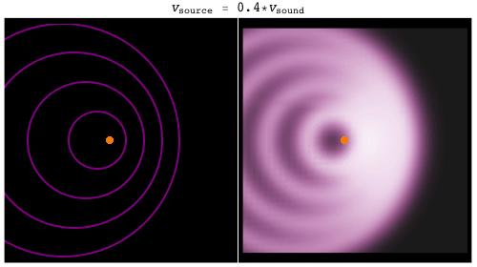
The Doppler Effect Examples

Slide 26
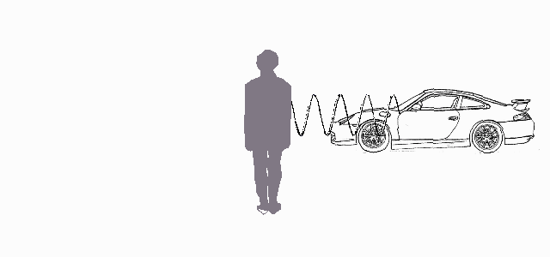
The Doppler Effect Examples

Slide 27
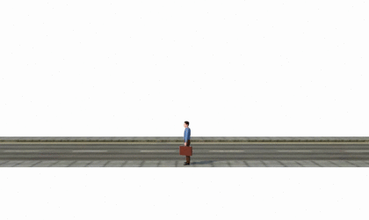
The Doppler Effect Examples

Slide 28
The Doppler Effect Examples

Slide 29
Shock Waves
What happens when the source of our waves is faster than the waves themselves?
Sonic Boom! Or a shock wave.

Slide 30
Shock Waves

Slide 31
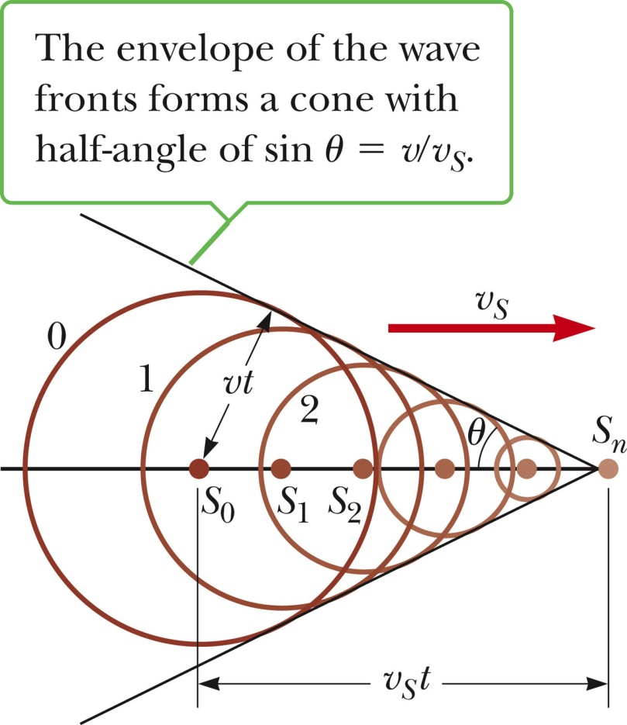
Shock Waves
A shock wave results when the source velocity exceeds the speed of the wave itself
The circles represent the wave fronts emitted by the source

Slide 32
Shock Waves
Tangent lines are drawn from S_{n} to the wave front centered on S_{o}
The angle between one of these tangent lines and the direction of travel is given by sin θ = v / v_{s}
The ratio v_{s} /v is called the Mach Number
The conical wave front is the shock wave

Slide 33
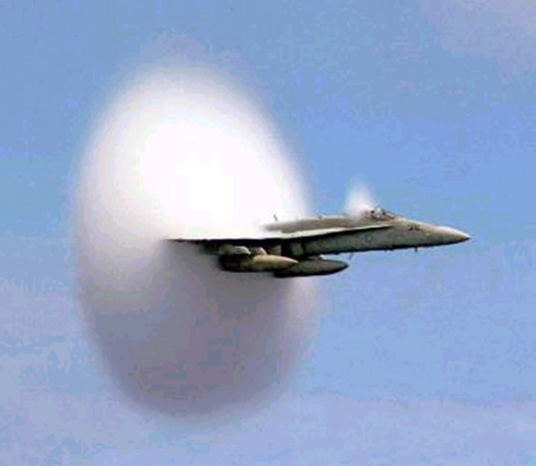
Shock Waves
Shock waves carry energy concentrated on the surface of the cone, with correspondingly great pressure variations
A jet produces a shock wave seen as a fog of water vapor

Slide 34
Shock Waves

Slide 35
Interference of Waves
Sound waves interfere
Constructive interference occurs when the path difference between two waves’ motion is zero or some integer multiple of wavelengths
Path difference = nλ (n = 0, 1, 2, … )
Destructive interference occurs when the path difference between two waves’ motion is an odd half wavelength
Path difference = (n + ½)λ (n = 0, 1, 2, … )

Slide 36
Interference of Waves
Sound waves interfere
Constructive interference occurs when the path difference between two waves’ motion is zero or some integer multiple of wavelengths
Path difference = nλ (n = 0, 1, 2, … )
Destructive interference occurs when the path difference between two waves’ motion is an odd half wavelength
Path difference = (n + ½)λ (n = 0, 1, 2, … )

Slide 37
Standing Waves: The only thing that matters
Whenever a wave is confined to a boundary a standing wave is formed.
This can be a physical boundary such as a guitar string bound by it’s length or a drum membrane bound by it’s circumference.
This can also be a boundary in space when a reflected wave travels back on itself or when two identical waves travel in the opposite direction from each other and combine by the superposition principle
When this happens the wave appears to be motionless, hence the name standing wave.

Slide 38
Standing Waves
A node occurs where the two traveling waves have the same magnitude of displacement, but the displacements are in opposite directions
Net displacement is zero at that point
The distance between two nodes is ½λ
An antinode occurs where the standing wave vibrates at maximum amplitude

Slide 39
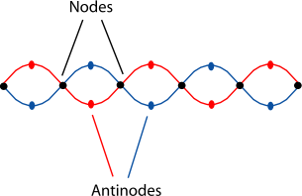
Standing Waves

Slide 40
Standing Waves
Standing waves have defined wavelengths based on the length of their boundary
$$λ= \frac{2}{n} L$$
Where
$λ$ = wavelength
L = length of boundary
n = an increasing integer starting at 1

Slide 41
Standing Waves
Let’s talk about a guitar string.
When you pluck a guitar string you hear a beautiful tone.
This tone is actually just a superposition of the standing waves that the guitar string can actually make.

Slide 42
Standing Waves
Let’s talk about a guitar string.
When you pluck a guitar string you hear a beautiful tone.
This tone is actually just a superposition of the standing waves that the guitar string can actually make.

Slide 43
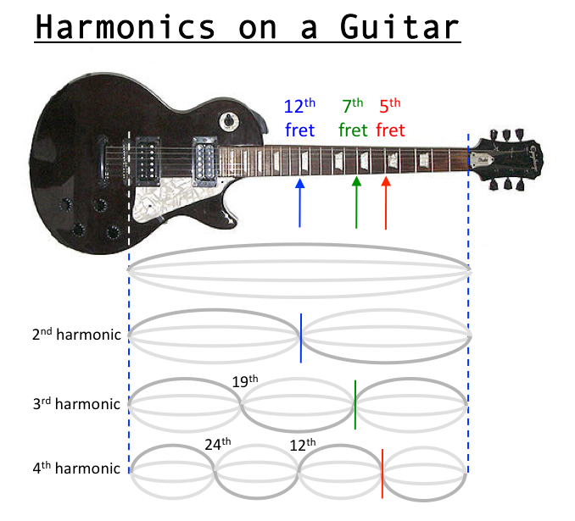
Standing Waves

Slide 44
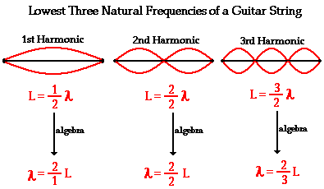
Standing Waves
ƒ₁, ƒ₂, ƒ₃ form a harmonic series
ƒ₁ is the fundamental and also the first harmonic
ƒ₂ is the second harmonic or the first overtone
Waves in the string that are not in the harmonic series are quickly damped out
In effect, when the string is disturbed, it “selects” the standing wave frequencies

Slide 45
Standing Waves
These harmonic frequencies are said to the be the natural frequencies of the object in question. However, these natural frequencies behave differently.
Some harmonics will have different intensities than other harmonics and the time in which these harmonics decay also varies.

Slide 46
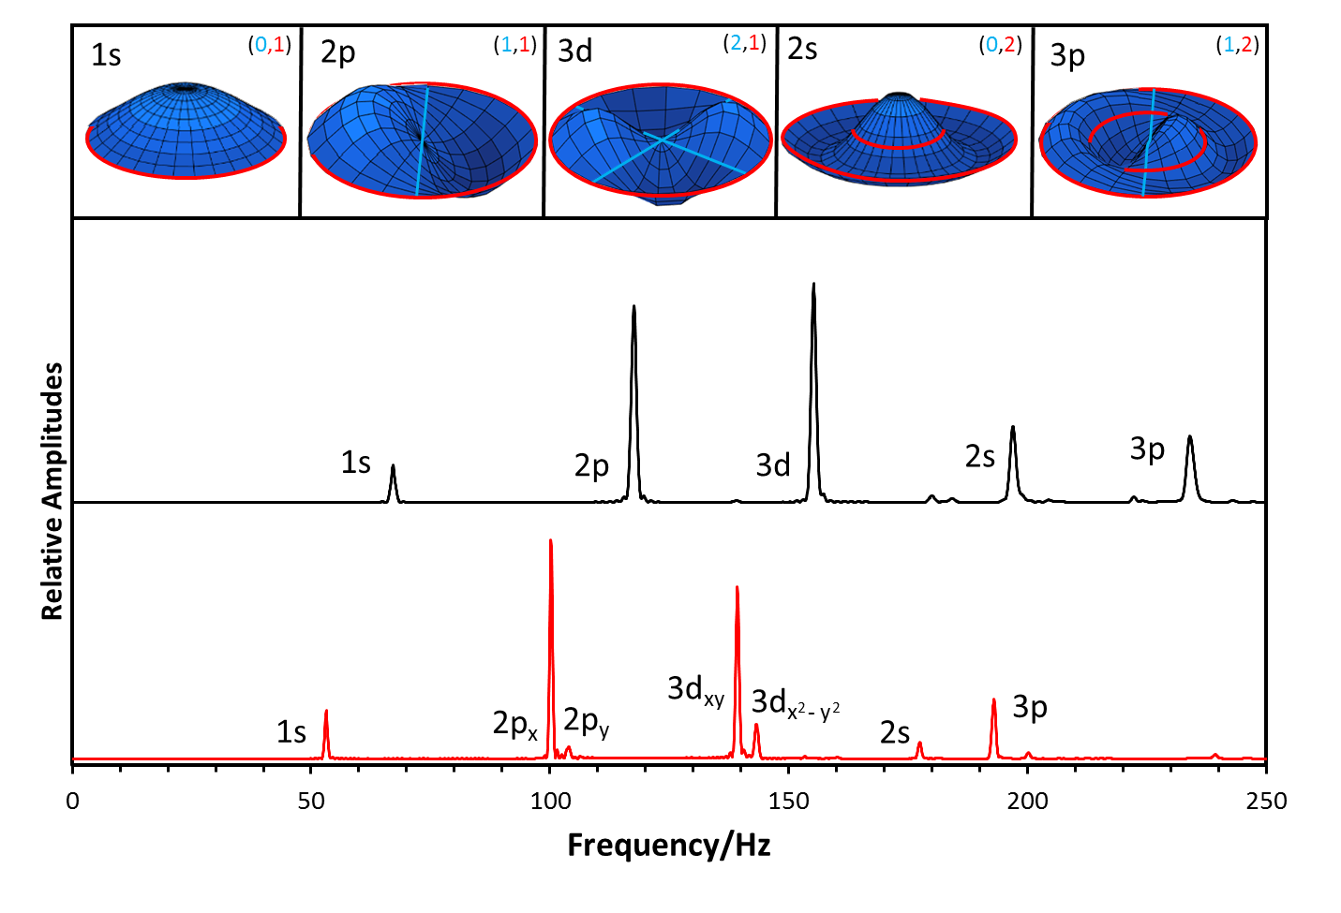
Standing Waves
The natural frequencies for a drum head.

Slide 47
Analyzing Real Waves
If we record the sound of let’s say a drum head when it is hit we can analyze the sound and break it up into it’s natural harmonics that make the wave using a Fourier Transform to transfer the recorded sound out of the time domain into the frequency domain.

Slide 48
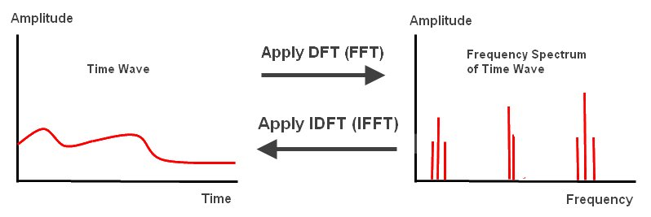
Analyzing Real Waves

Slide 49
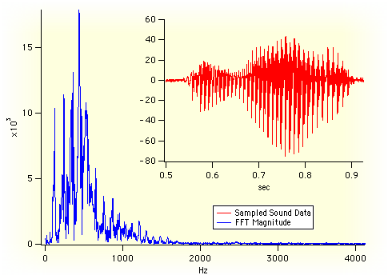
Analyzing Real Waves
What most sound Fourier Transforms look like.

Slide 50
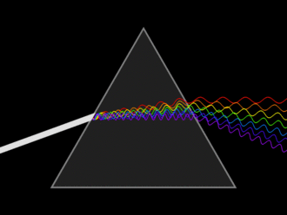
Analyzing Real Waves
Sound is not the only wave that abides by the superposition principle though
White light is an example of a superposition of all the wavelengths of visible light.

Slide 51
Analyzing Real Waves
This also lends us the ability to identify atoms based off of their emission spectrum because the frequency of the waves relates to the energy levels of their atomic orbitals

Slide 52
Analyzing Real Waves
Once we understand the natural frequencies of an object though we can play those same frequencies back at the object to excite it.
This leads us to the idea of resonance.

Slide 53
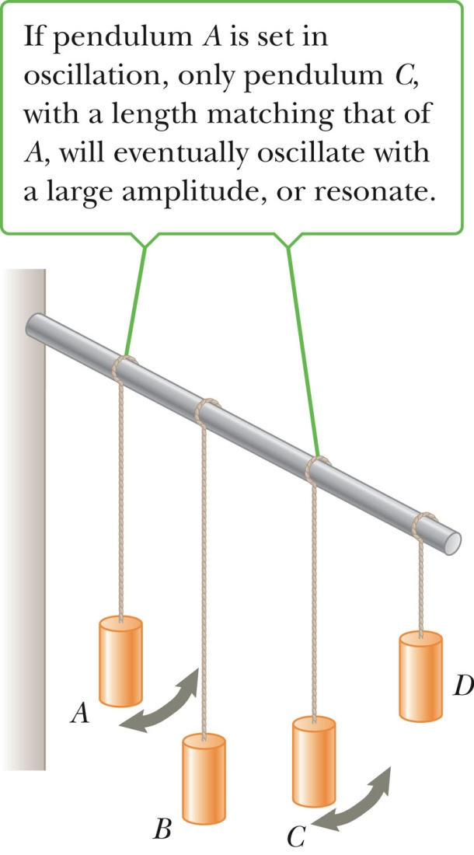
Resonance
Pendulum A is set in motion
The others begin to vibrate due to the vibrations in the flexible beam
Pendulum C oscillates at the greatest amplitude since its length, and therefore its natural frequency, matches that of A

Slide 54
Resonance
Child being pushed on a swing
Shattering a wine glass
Upper deck of the Nimitz Freeway collapse due to the Loma Prieta earthquake
Tacoma Narrows Bridge collapse due to oscillations caused by the wind
Exciting a drum head by playing it’s natural frequencies at it
So many more examples

Slide 55
Resonance

Slide 56
Resonance

Slide 57
Resonance
https://www.youtube.com/watch?v=cPALfz-6pnQ

Slide 58
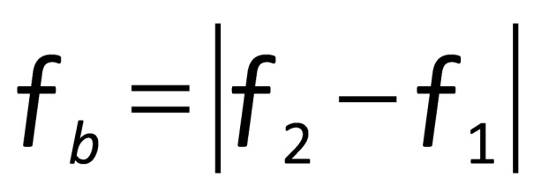
Beats
Beats are alternations in loudness, due to interference
Waves have slightly different frequencies and the time between constructive and destructive interference alternates
The beat frequency equals the difference in frequency between the two sources:

Slide 59
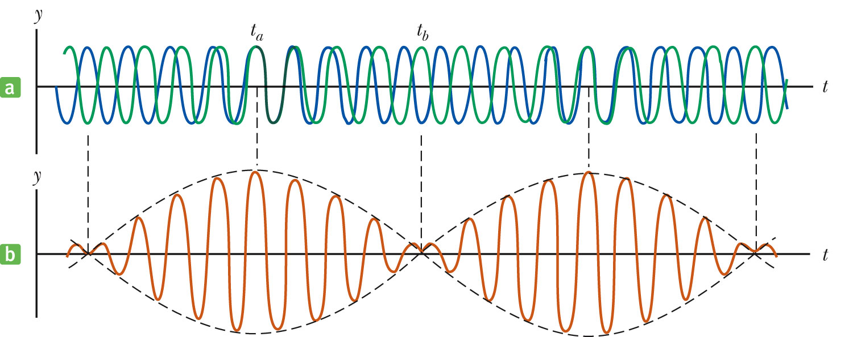
Beats

Slide 60
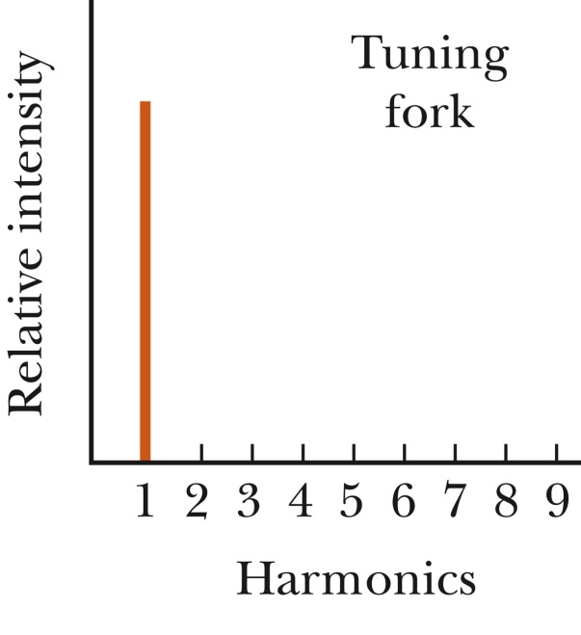
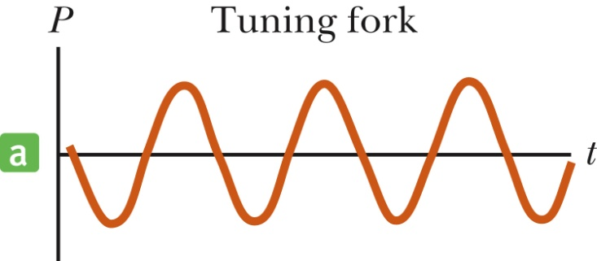
Quality of sound – Tuning Fork
Tuning fork produces only the fundamental frequency

Slide 61
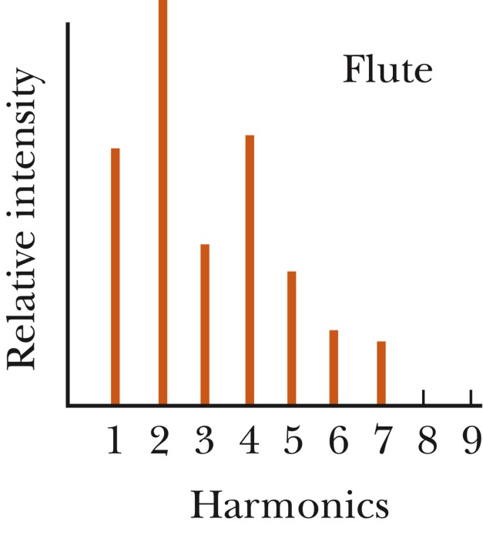
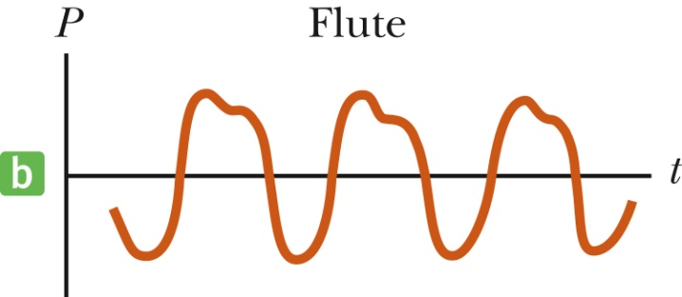
Quality of sound - Flute
The same note played on a flute sounds differently
The second harmonic is very strong
The fourth harmonic is close in strength to the first

Slide 62
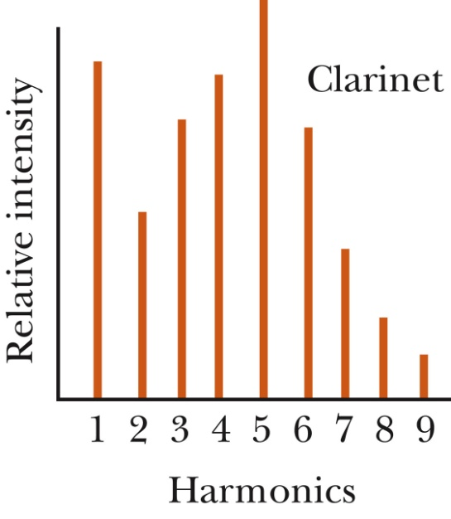
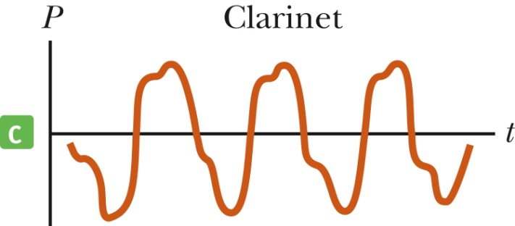
Quality of sound - Clarinet
The fifth harmonic is very strong
The first and fourth harmonics are very similar, with the third being close to them

Slide 63
Quality of sound - Timbre
In music, the characteristic sound of any instrument is referred to as the quality of sound, or the timbre, of the sound
The quality depends on the mixture of harmonics in the sound

Slide 64
Quality of sound - Pitch
Pitch is related mainly, although not completely, to the frequency of the sound
Pitch is not a physical property of the sound
Frequency is the stimulus and pitch is the response
It is a psychological reaction that allows humans to place the sound on a scale

Slide 65
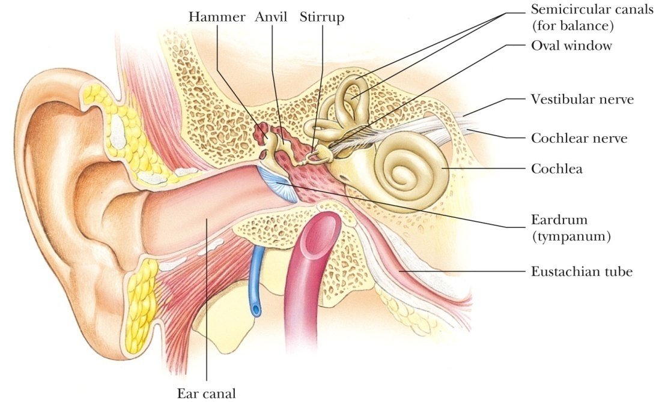
Quality of sound – Human Ear
The outer ear consists of the ear canal that terminates at the eardrum
Just behind the eardrum is the middle ear
The bones in the middle ear transmit sounds to the inner ear

Slide 66
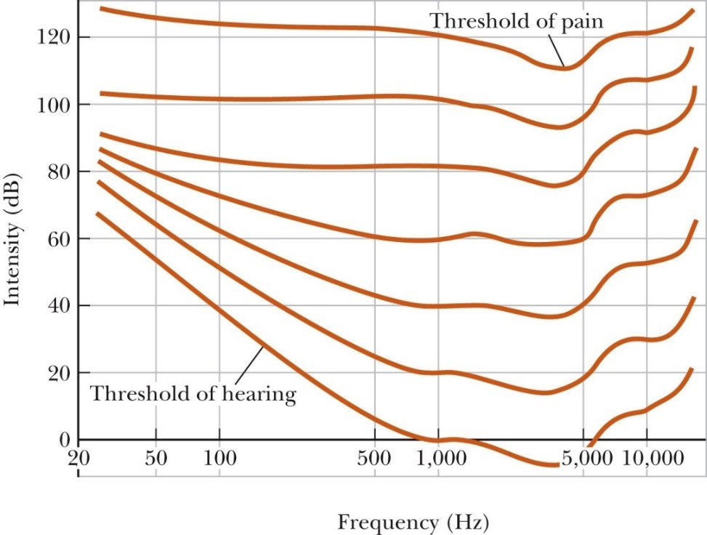
Quality of sound – Hearing
Bottom curve is the threshold of hearing
Threshold of hearing is strongly dependent on frequency
Easiest frequency to hear is about 3300 Hz
When the sound is loud (top curve, threshold of pain) all frequencies can be heard equally well

Slide 67
AP Physics
Chapter 14: Sound
HW: Pg 488 - 494
Conceptual Questions: 1 – 8, 10, 11
Problems: 1,5

