Slide 1
PSB Unit 2 Chemical Bonding Section 3

Slide 2
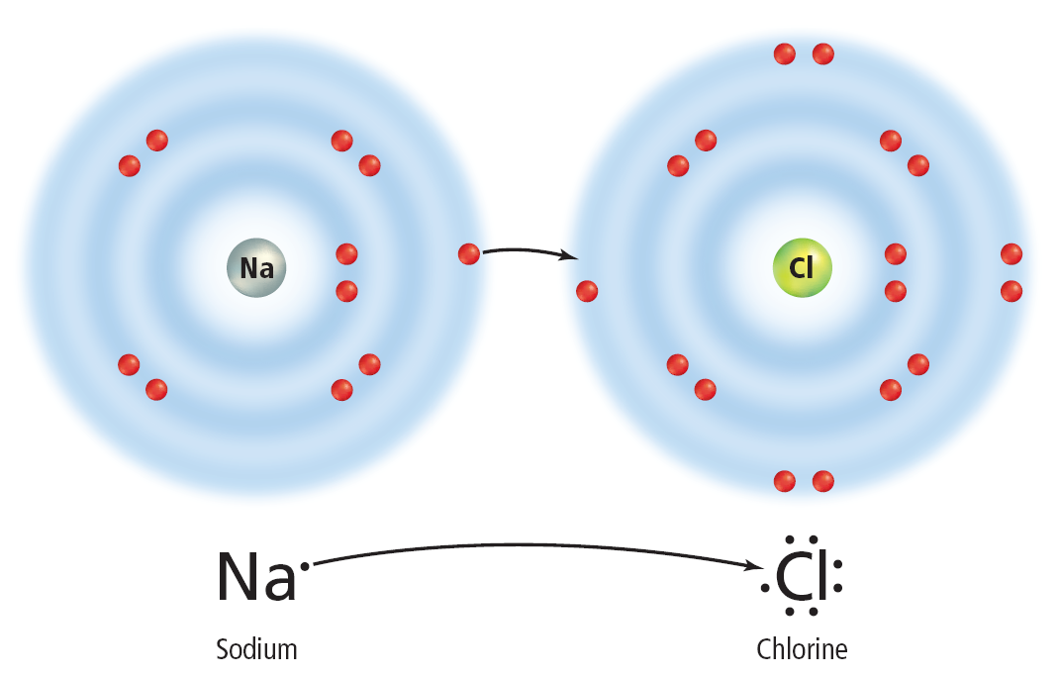
Making Atoms Stable
How does hydrogen, or any other element, become stable?
They do this by combining with other atoms so that by gaining, losing, or sharing electrons they have a complete outer energy level.
As a result, each atom achieves stability.
This illustration shows electron dot diagrams for sodium and chlorine.
When they combine, sodium loses one electron and chlorine gains one electron.

Slide 3
Making Atoms Stable
Sodium had only one electron in its outer energy level, which it lost to combine with chlorine in sodium chloride.
Look back to the next, outermost energy level of sodium.
This is now the new outer energy level, and it is stable with eight electrons (or with two electrons in the case of hydrogen).

Slide 4
Making Atoms Stable
When atoms gain, lose, or share electrons, an attraction forms between the atoms, pulling them together to form a compound.
This attraction is called a chemical bond. A chemical bond is the force that holds atoms together in a compound.

Slide 5
Ions
An atom that has lost or gained electrons is called an ion. An ion is a charged particle because it now has either more or fewer electrons than protons.
It is the electric forces between oppositely charged particles, such as ions, that hold compounds together.
Some atoms prefer to gain electrons and some atoms prefer to lose electrons.
A cation is when an atom loses an electron. It is a positively charged ion.
An anion is when an atom gains an electron. It is a negatively charged ion.
With elements from the Main Group elements, we can predict what ion it will form.

Slide 6
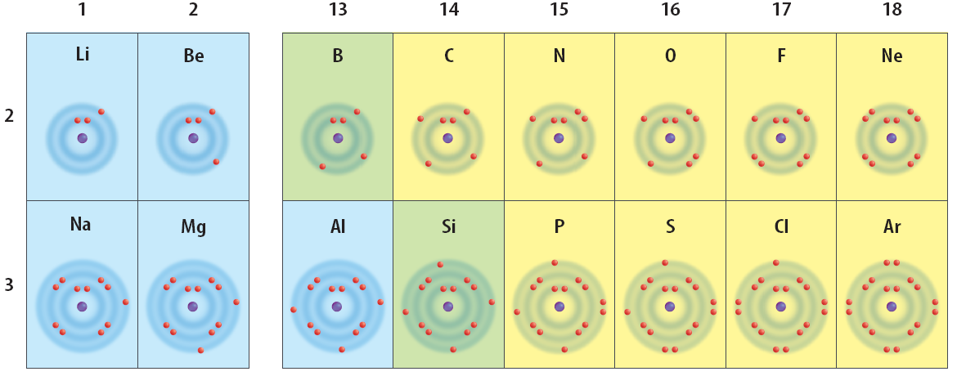
Ions
Atoms in the Main Group elements gain or lose electrons to become stable. (like the Noble Gases)
Lose
1 e⁻
Lose
2 e⁻
Lose
3 e⁻
Gain
3 e⁻
Gain
2 e⁻
Gain
1 e⁻
Wants to be like
1+
2+
3+
3-
2-
1-

Slide 7
Ions
When writing ions, the charge is written as a superscript
Charges are written with the number first, then the charge. This indicates how many there are, and then what the charge is.
Magnesium wants to lose two electrons, therefore the magnesium ion would be written Mg²⁺
Ions Practice
Li¹⁺
Ca²⁺
Li
Ca
F¹⁻
Al³⁺
F
Al
O²⁻
N³⁻
O
N

Slide 8
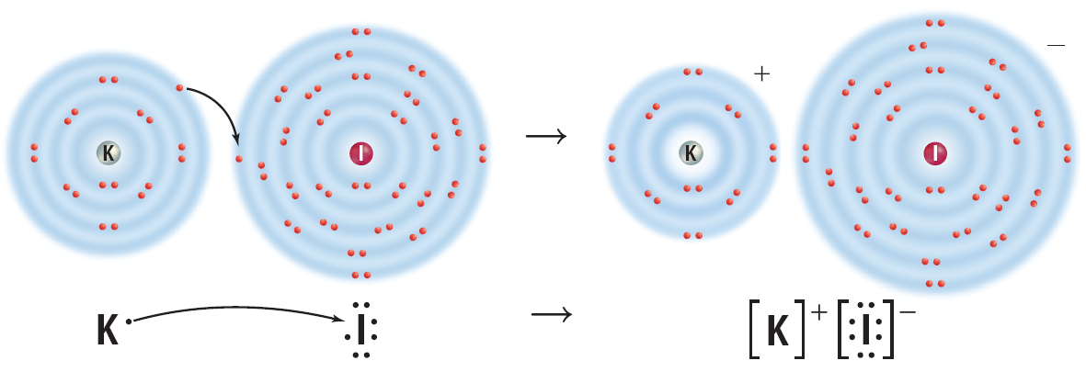
A Bond Forms
A neutral atom of potassium has one valence electron and a neutral atom of iodine has seven valence electrons. Both are not stable outer energy levels.
When potassium forms a compound with iodine, potassium loses one electron and iodine gains one electron.
The potassium atom has become a cation (K⁺) and the iodine atom has become an anion (I⁻).
The resulting compound has a neutral charge because the positive and negative charges of the ions cancel each other.

Slide 9
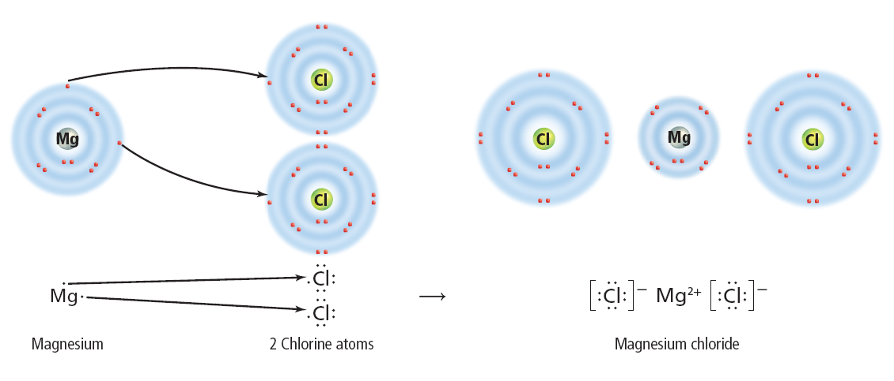
Ionic Bonds
An ionic bond is the force of attraction between the opposite charges of the ions in an ionic compound.
In an ionic bond, a transfer of electrons takes place.
The formation of magnesium chloride, MgCl₂, is another example of ionic bonding.
When magnesium reacts with chlorine, a magnesium atom loses two electrons and becomes a positively charged ion, Mg²⁺. At the same time, two chlorine atoms gain one electron each and become negatively charged chloride ions, Cl ⁻.

Slide 10
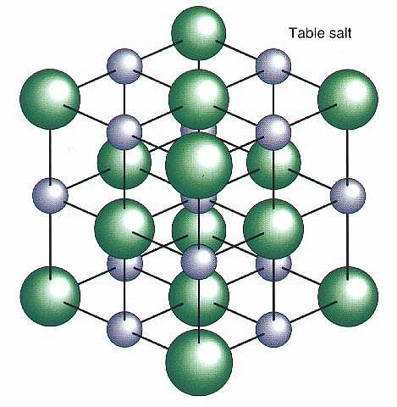
Ionic Bonds
The result of this bond is a neutral compound.
The compound as a whole is neutral because the sum of the charges on the ions is zero.
When atoms form an ionic compound, their electrons are shifted to the other atoms, but the overall number of protons and electrons of the combined atoms remains equal and unchanged. Therefore, the compound is neutral.
Ionic bonds usually are formed by bonding between metals and nonmetals.

Slide 11
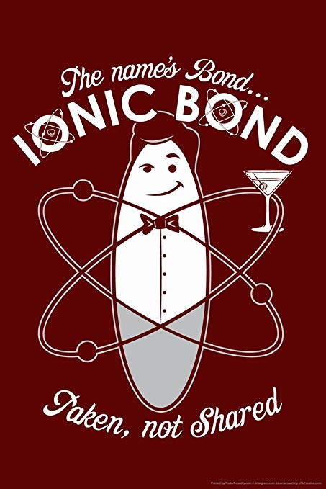

Slide 12
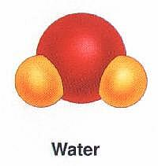
Covalent Bonds
Some atoms of nonmetals are unlikely to lose electrons.
Therefore, these atoms become more chemically stable by sharing electrons, rather than by losing or gaining electrons.
The attraction that forms between atoms when they share electrons is known as a covalent bond.
A neutral particle that forms as a result of electron sharing is called a molecule. Therefore, not all compounds are molecules!
The result of this type of bonding is a stable outer energy level for each atom in the molecule.

Slide 14
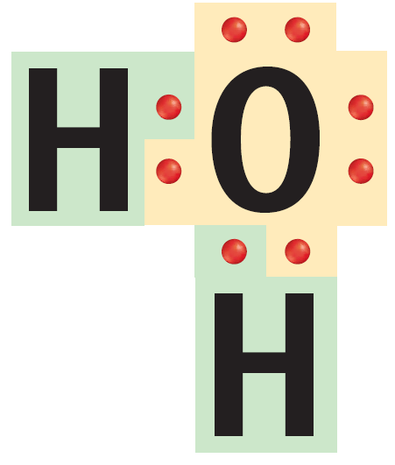
Covalent Bonds
A single covalent bond is made up of two shared electrons.
A covalent bond also can contain more than one pair of electrons. When there is more than one pair of electrons, it is called a multiple covalent bond.

Slide 15
Types of Covalent Bonds
Covalent Bonds are divided up into two different types: polar covalent and nonpolar covalent
A nonpolar covalent bond occurs when there is an equal sharing of electrons between the two atoms
Neither one is stronger than the other one
This happens if the same atom is bonded to itself like in O₂
Such a molecule does not have oppositely charged ends.
Electrons are not always shared equally between atoms in a covalent bond.

Slide 16
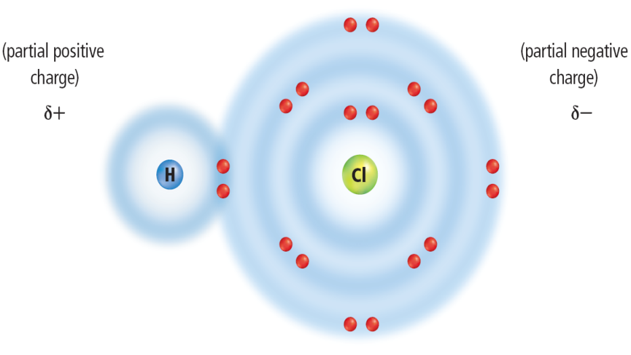
Types of Covalent Bonds
A polar covalent bond occurs when there is an unequal sharing of electrons between the two atoms
One atom is stronger than the other one
One example of this unequal sharing is found in a molecule of hydrogen chloride, HCl.
As a result, the electrons shared in hydrogen chloride will spend more time near the chlorine atom than near the hydrogen atom.

Slide 17
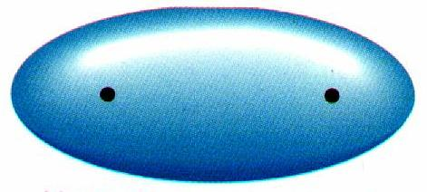
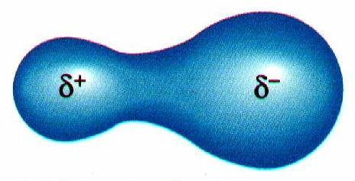
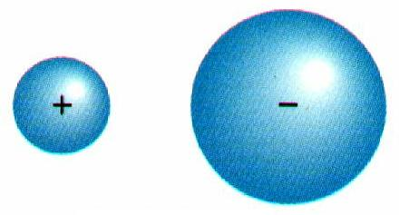
Chemical Bonds
Nonpolar Covalent Bond
Polar-Covalent Bond
Ionic Bond

