Slide 1
PS
Unit 2
Chemical Bonding
Section 1

Slide 2
Periodic Table of the Elements Current View
MCHS Periodic Table of the Elements
1 |  |  |  |  |  |  |  |  |  |  |  |  |  |  |  |  | 18
1 H hydrogen 1.0 | 2 |  |  |  |  |  |  |  |  |  |  | 13 | 14 | 15 | 16 | 17 | 2 He helium 4.0
3 Li lithium 7.0 | 4 Be beryllium 9.0 |  |  |  |  |  |  |  |  |  |  | 5 B boron 10.8 | 6 C carbon 12.0 | 7 N nitrogen 14.0 | 8 O oxygen 16.0 | 9 F fluorine 19.0 | 10 Ne neon 20.2
11 Na sodium 23.0 | 12 Mg magnesium 24.3 | 3 | 4 | 5 | 6 | 7 | 8 | 9 | 10 | 11 | 12 | 13 Al aluminium 27.0 | 14 Si silicon 28.1 | 15 P phosphorus 31.0 | 16 S sulphur 32.1 | 17 Cl chlorine 35.5 | 18 Ar argon 40.0
19 K potassium 39.1 | 20 Ca calcium 40.1 | 21 Sc scandium 45.0 | 22 Ti titanium 47.9 | 23 V vanadium 50.9 | 24 Cr chromium 52.0 | 25 Mn manganese 54.9 | 26 Fe iron 55.8 | 27 Co cobalt 58.9 | 28 Ni nickel 58.7 | 29 Cu copper 63.5 | 30 Zn zinc 65.4 | 31 Ga gallium 69.7 | 32 Ge germanium 72.6 | 33 As arsenic 74.9 | 34 Se selenium 79.0 | 35 Br bromine 79.9 | 36 Kr krypton 83.8
37 Rb rubidium 85.5 | 38 Sr strontium 87.6 | 39 Y yttrium 88.9 | 40 Zr zirconium 91.2 | 41 Nb niobium 92.9 | 42 Mo molybdenum 95.9 | 43 Tc technetium [98] | 44 Ru ruthenium 101.0 | 45 Rh rhodium 102.9 | 46 Pd palladium 106.4 | 47 Ag silver 107.9 | 48 Cd cadmium 112.4 | 49 In indium 114.8 | 50 Sn tin 118.7 | 51 Sb antimony 121.8 | 52 Te tellurium 127.6 | 53 I iodine 126.9 | 54 Xe xenon 131.3
55 Cs caesium 132.9 | 56 Ba barium 137.3 | 57 La lanthanum 138.9 | 72 Hf hafnium 178.5 | 73 Ta tantalum 180.9 | 74 W tungsten 183.8 | 75 Re rhenium 186.2 | 76 Os osmium 190.2 | 77 Ir iridium 192.2 | 78 Pt platinum 195.1 | 79 Au gold 197.0 | 80 Hg mercury 200.6 | 81 Tl thallium 204.4 | 82 Pb lead 207.2 | 83 Bi bismuth 209.0 | 84 Po polonium [209] | 85 At astatine [210] | 86 Rn radon [222]
87 Fr francium [223] | 88 Ra radium [226] | 89 Ac actinium [227] | 104 Rf rutherfordium [261] | 105 Db dubnium [262] | 106 Sg seaborgium [266] | 107 Bh bohrium [264] | 108 Hs hassium [269] | 109 Mt meitnerium [268] | 110 Ds darmstadtium [271] | 111 Rg roentgenium [272] | 112 Cn copernicium [285] | 113 Uut ununtrium [286] | 114 Fl flerovium [289] | 115 Uup unupentium [288] | 116 Lv livermorium [293] | 117 Uus unuseptium [294] | 118 Uuo ununoctium [294]
 |  |  |  | 58 Ce cerium 140.1 | 59 Pr praseodymium 140.9 | 60 Nd neodymium 144.2 | 61 Pm promethium [145] | 62 Sm samarium 150.4 | 63 Eu europium 152.0 | 64 Gd gadolinium 157.3 | 65 Tb terbium 158.9 | 66 Dy dysprosium 162.5 | 67 Ho holmium 164.9 | 68 Er erbium 167.3 | 69 Tm thulium 168.9 | 70 Yb ytterbium 173.0 | 71 Lu lutetium 175.0
 |  |  |  | 90 Th thorium 232.0 | 91 Pa protactinium 231.0 | 92 U uranium 238.0 | 93 Np neptunium [237] | 94 Pu plutonium [244] | 95 Am americium [243] | 96 Cm curium [247] | 97 Bk berkelium [247] | 98 Cf californium [251] | 99 Es einsteinium [252] | 100 Fm fermium [257] | 101 Md mendelevium [258] | 102 No nobelium [259] | 103 Lr lawrencium [262]

Slide 3
Periodic Table
The vertical columns in the periodic table are called groups, families, or columns, and are numbered 1 through 18.
The horizontal rows in the periodic table are called periods, and are numbered 1 through 7.

Slide 4
Periodic Table of the Elements Current View
MCHS Periodic Table of the Elements
1 |  |  |  |  |  |  |  |  |  |  |  |  |  |  |  |  | 18
1 H hydrogen 1.0 | 2 |  |  |  |  |  |  |  |  |  |  | 13 | 14 | 15 | 16 | 17 | 2 He helium 4.0
3 Li lithium 7.0 | 4 Be beryllium 9.0 |  |  |  |  |  |  |  |  |  |  | 5 B boron 10.8 | 6 C carbon 12.0 | 7 N nitrogen 14.0 | 8 O oxygen 16.0 | 9 F fluorine 19.0 | 10 Ne neon 20.2
11 Na sodium 23.0 | 12 Mg magnesium 24.3 | 3 | 4 | 5 | 6 | 7 | 8 | 9 | 10 | 11 | 12 | 13 Al aluminium 27.0 | 14 Si silicon 28.1 | 15 P phosphorus 31.0 | 16 S sulphur 32.1 | 17 Cl chlorine 35.5 | 18 Ar argon 40.0
19 K potassium 39.1 | 20 Ca calcium 40.1 | 21 Sc scandium 45.0 | 22 Ti titanium 47.9 | 23 V vanadium 50.9 | 24 Cr chromium 52.0 | 25 Mn manganese 54.9 | 26 Fe iron 55.8 | 27 Co cobalt 58.9 | 28 Ni nickel 58.7 | 29 Cu copper 63.5 | 30 Zn zinc 65.4 | 31 Ga gallium 69.7 | 32 Ge germanium 72.6 | 33 As arsenic 74.9 | 34 Se selenium 79.0 | 35 Br bromine 79.9 | 36 Kr krypton 83.8
37 Rb rubidium 85.5 | 38 Sr strontium 87.6 | 39 Y yttrium 88.9 | 40 Zr zirconium 91.2 | 41 Nb niobium 92.9 | 42 Mo molybdenum 95.9 | 43 Tc technetium [98] | 44 Ru ruthenium 101.0 | 45 Rh rhodium 102.9 | 46 Pd palladium 106.4 | 47 Ag silver 107.9 | 48 Cd cadmium 112.4 | 49 In indium 114.8 | 50 Sn tin 118.7 | 51 Sb antimony 121.8 | 52 Te tellurium 127.6 | 53 I iodine 126.9 | 54 Xe xenon 131.3
55 Cs caesium 132.9 | 56 Ba barium 137.3 | 57 La lanthanum 138.9 | 72 Hf hafnium 178.5 | 73 Ta tantalum 180.9 | 74 W tungsten 183.8 | 75 Re rhenium 186.2 | 76 Os osmium 190.2 | 77 Ir iridium 192.2 | 78 Pt platinum 195.1 | 79 Au gold 197.0 | 80 Hg mercury 200.6 | 81 Tl thallium 204.4 | 82 Pb lead 207.2 | 83 Bi bismuth 209.0 | 84 Po polonium [209] | 85 At astatine [210] | 86 Rn radon [222]
87 Fr francium [223] | 88 Ra radium [226] | 89 Ac actinium [227] | 104 Rf rutherfordium [261] | 105 Db dubnium [262] | 106 Sg seaborgium [266] | 107 Bh bohrium [264] | 108 Hs hassium [269] | 109 Mt meitnerium [268] | 110 Ds darmstadtium [271] | 111 Rg roentgenium [272] | 112 Cn copernicium [285] | 113 Uut ununtrium [286] | 114 Fl flerovium [289] | 115 Uup unupentium [288] | 116 Lv livermorium [293] | 117 Uus unuseptium [294] | 118 Uuo ununoctium [294]
 |  |  |  | 58 Ce cerium 140.1 | 59 Pr praseodymium 140.9 | 60 Nd neodymium 144.2 | 61 Pm promethium [145] | 62 Sm samarium 150.4 | 63 Eu europium 152.0 | 64 Gd gadolinium 157.3 | 65 Tb terbium 158.9 | 66 Dy dysprosium 162.5 | 67 Ho holmium 164.9 | 68 Er erbium 167.3 | 69 Tm thulium 168.9 | 70 Yb ytterbium 173.0 | 71 Lu lutetium 175.0
 |  |  |  | 90 Th thorium 232.0 | 91 Pa protactinium 231.0 | 92 U uranium 238.0 | 93 Np neptunium [237] | 94 Pu plutonium [244] | 95 Am americium [243] | 96 Cm curium [247] | 97 Bk berkelium [247] | 98 Cf californium [251] | 99 Es einsteinium [252] | 100 Fm fermium [257] | 101 Md mendelevium [258] | 102 No nobelium [259] | 103 Lr lawrencium [262]

Slide 5
Organization of the Periodic Table
The periodic table can be organized in different ways.
We will learn two different ways to organize the Periodic Table:
Metallic Character
Blocks

Slide 6
Organization of the Periodic Table
Metallic Character
The dividing
line is the
“stairstep”
Metals
Nonmetals
Metalloids
Note: Hydrogen is part of the Nonmetals

Slide 7
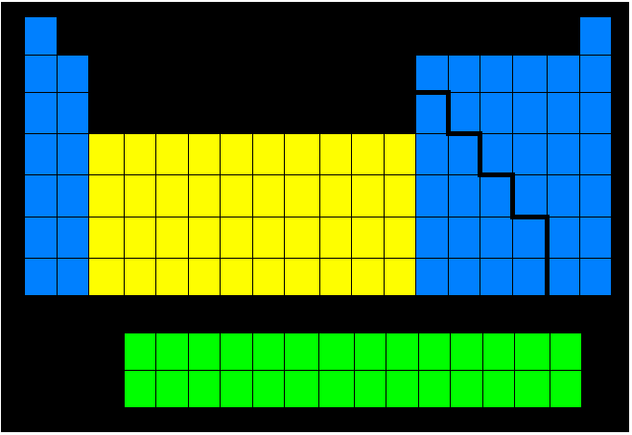
Organization of the Periodic Table
Blocks
Main Group
Elements
Transition Metals
Inner Transition Metals

Slide 8
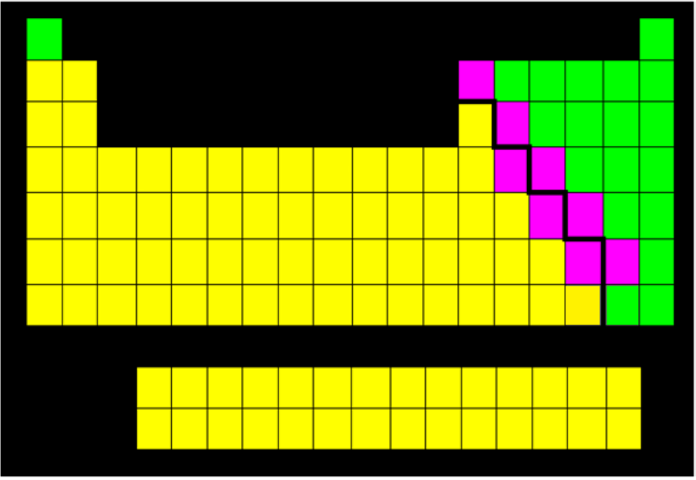
Properties of Metals
Metals usually have common properties -they are good conductors of heat and electricity, and all but one are solid at room temperature.

Slide 9
Properties of Metals
Metals also reflect light. This is a property called luster.
Metals are malleable (MAL ee uh bul), which means they can be hammered or rolled into sheets.
Metals are also ductile, which means they can be drawn into wires.

Slide 10
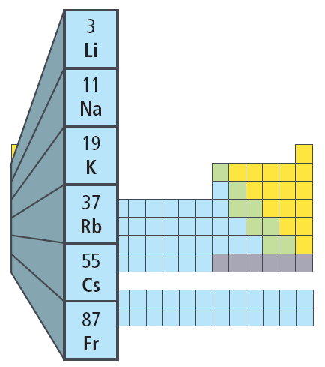
The Alkali Metals
The elements in Group 1 of the periodic table are the alkali metals.
Group 1 metals are shiny, malleable, and ductile.
They are also good conductors of heat and electricity. However, they are softer than most other metals.
The alkali metals are the most reactive
of all the metals. They react rapidly, sometimes violently, with oxygen and water.
Alkali metals don’t occur in nature in their elemental form and are stored in substances that are unreactive, such as an oil.

Slide 11
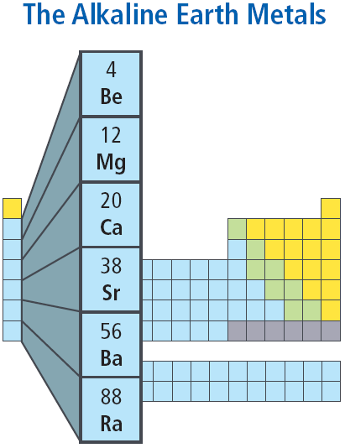
The Alkaline Earth Metals
The alkaline earth metals make up Group 2 of the periodic table.
Each atom of an alkaline earth metal has two electrons in its outer energy level.

Slide 12
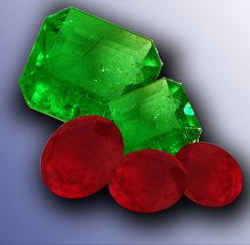
Transition Elements
Transition elements are those elements in Groups 3 through 12 in the periodic table.
They are called transition elements because they are considered to be elements in transition between the Main Group elements.
Transition elements are familiar because they often occur in nature as uncombined elements.
Transition elements often form colored compounds.
Gems show brightly colored compounds containing chromium.

Slide 13
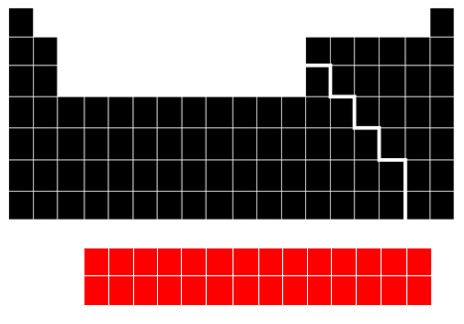
Inner Transition Metals
The two rows of elements that seem to be disconnected from the rest on the periodic table are called the inner transition elements.

Slide 14
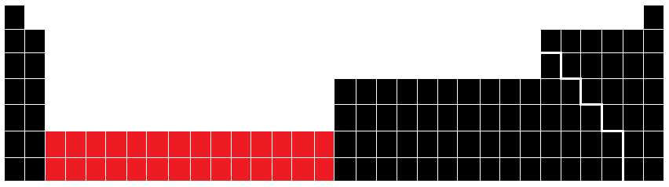
Inner Transition Metals
They are called this because like the transition elements, they fit in the periodic table between Groups 3 and 4 in periods 6 and 7, as shown.

Slide 15
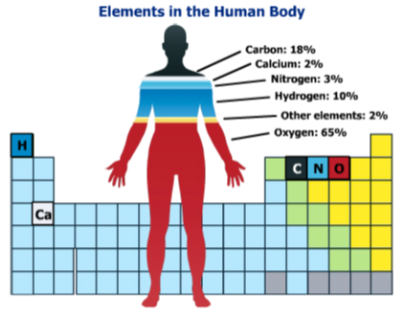
Properties of Nonmetals
Most of your body’s mass is made of oxygen, carbon, hydrogen, nitrogen and phosphorus.
Calcium, a metal, and other elements make up the remaining four percent of your body’s mass.

Slide 16
Properties of Nonmetals
Most nonmetals do not conduct heat or electricity well, and generally they are not shiny.
In the periodic table, all nonmetals except hydrogen are found at the right of the stair-step line.

Slide 17
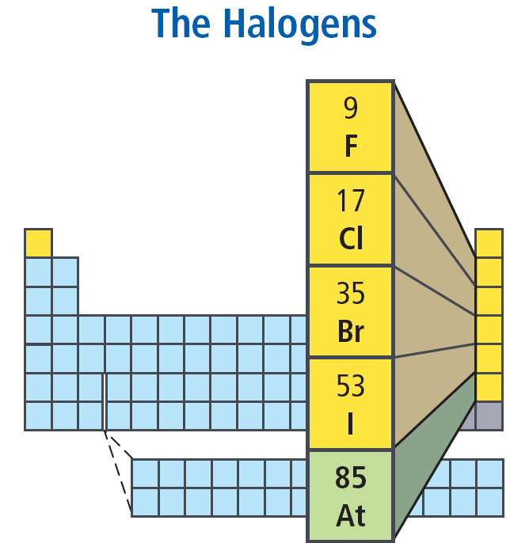
Halogens
Halogen lights contain small amounts of bromine or iodine vapor.
These elements, as well as fluorine, chlorine, and astatine, are called halogens and are in Group 17.

Slide 18
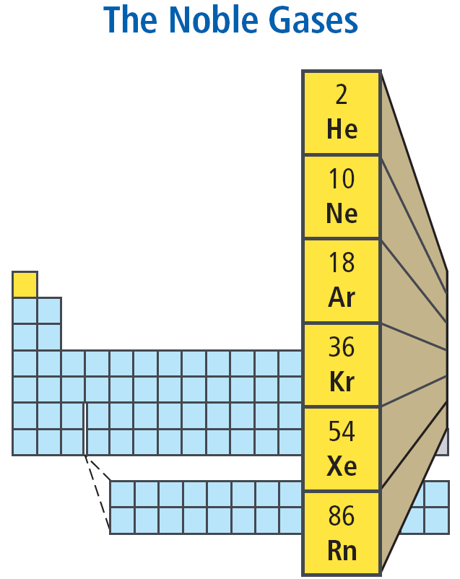
Noble Gases
The noble gases exist as isolated atoms.
They are stable because their outermost energy levels are full.
No naturally occurring noble gas compounds are known.

Slide 19
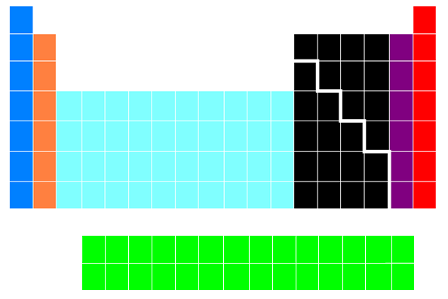
Families of the Periodic Table
Alkali Metals
Alkaline Earth
Metals
Transition
Metals
Halogens
Noble Gases
Inner Transition Metals

Slide 20
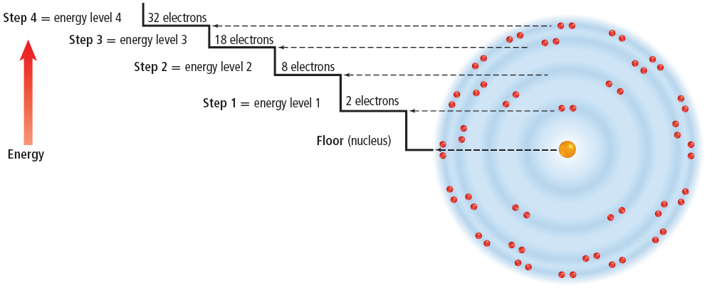
Energy Levels
Scientists have found that electrons within the electron cloud have different amounts of energy.
Energy levels closer to the nucleus have lower energy than those levels that are farther away.

