Slide 1
PS Unit 1
Matter
Section 3

Slide 2
Chemistry
The study of the composition, structure, and properties of matter and the changes it undergoes.
Branches of Chemistry
Organic Chemistry
Inorganic Chemistry
Physical Chemistry
Analytical Chemistry
Biochemistry
Theoretical Chemistry

Slide 3
Scientific Shorthand
Chemical symbols are made with one or two letters:
If one, it is capital.
If two, the first is capital and the second lowercase.
Capitalization is important! There is a difference between CO and Co
Some elements use the letter(s) of its name; some use the letter(s) of its name in another language (Latin)

Slide 4
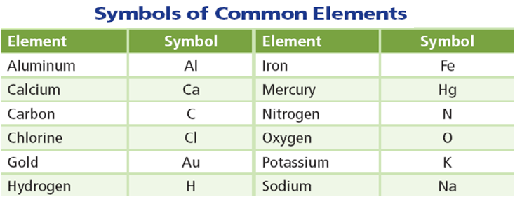
Scientific Shorthand
You are required to know 32 selected names and symbols.

Slide 5
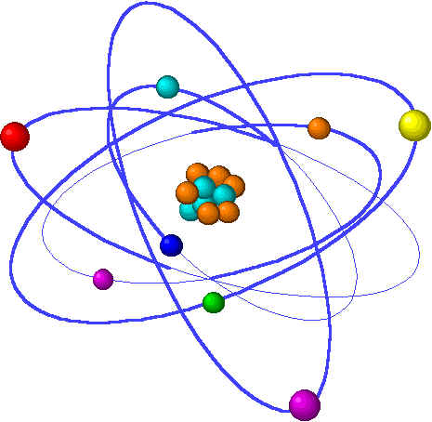
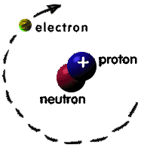
Element
pure substance made of only one kind of atom
Atom
smallest unit of an element that maintains the properties of that element
composed of particles called protons, neutrons, and electrons.

Slide 6
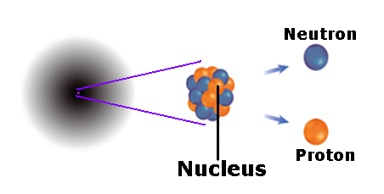
Atomic Components
Two parts to an atom:
Nucleus
Electron Cloud
Nucleus
Electron Cloud
Three components of an atom:
Protons
Neutrons
Electron

Slide 7
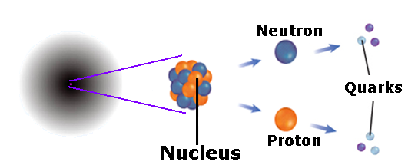
Quarks—Even Smaller Particles
Protons and neutrons are made up of smaller particles called quarks.
So far, scientists have confirmed the existence of six uniquely different quarks.

Slide 8
Component Charge Location
Protons
Neutrons
Electrons
1+
0
1-
Nucleus
Nucleus
Electron Cloud

Slide 9
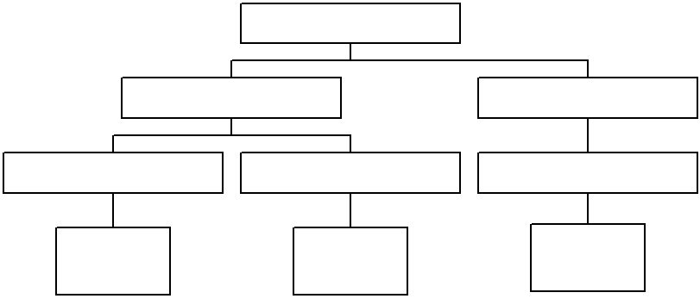
ATOM
[parts]
NUCLEUS
ELECTRON CLOUD
[made of]
[made of]
PROTONS
NEUTRONS
ELECTRONS
[charge]
[charge]
[charge]
POSITIVE CHARGE
NEUTRAL CHARGE
NEGATIVE CHARGE

Slide 10
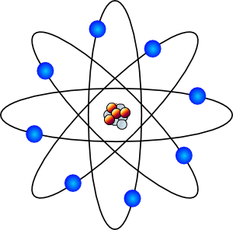
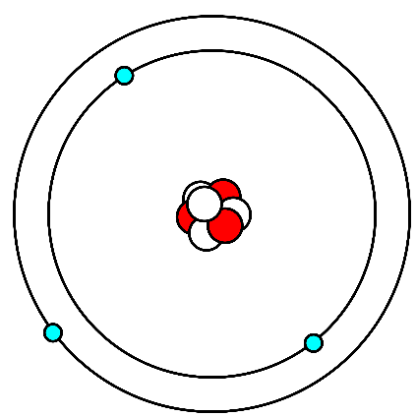
The Atomic Model
In the 1800s, John Dalton, a teacher from England, was able to offer evidence that atoms exist
Dalton's model of the atom, a solid sphere, was an early model of the atom
The model has changed over time
Dalton
1803
Thompson
1897
Rutherford
1909
Bohr
1913

Slide 11
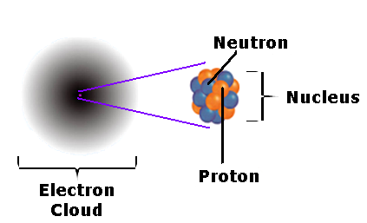
The Electron Cloud Model
By 1926, scientists had developed the electron cloud model of the atom that is in use today
An electron cloud is the area around the nucleus of an atom where its electrons are most likely found

Slide 12
The Electron Cloud Model
The electron cloud is 100,000 times larger than the diameter of the nucleus
In contrast, each electron in the cloud is much smaller than a single proton
Because an electron's mass is small and the electron is moving so quickly around the nucleus, it is impossible to describe its exact location in an atom

Slide 13
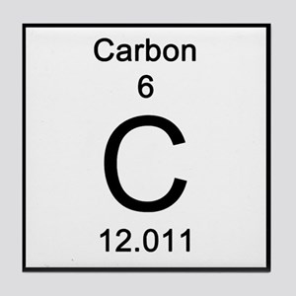
Atomic Number
number of protons in the nucleus of each atom
number of protons determines which element it is
Each element has its own number of protons
What number on the Periodic
Table is the atomic number?

Slide 14
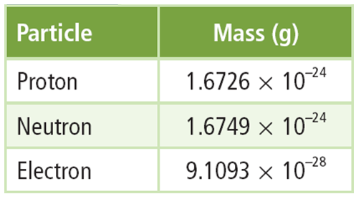
Atomic Mass
the mass of an atom
nucleus contains most of the mass (about 99%) because protons and neutrons are far more massive than electrons
mass of a proton is about the same as a neutron.
If we measure in grams, it is just too small of a number. We need to use a different measuring unit.

Slide 15
Atomic Mass
unit of measurement for atomic particles on the Periodic Table is the atomic mass unit (amu)
mass of a proton or a neutron is equal to 1 amu
atomic mass is determined from the Carbon-12 atom
Mass Number
number of protons and neutrons
this will always be a whole number (can’t have part of a proton or neutron)
For problems using mass number:
From Periodic Table - Round
Given – Use as-is

Slide 16
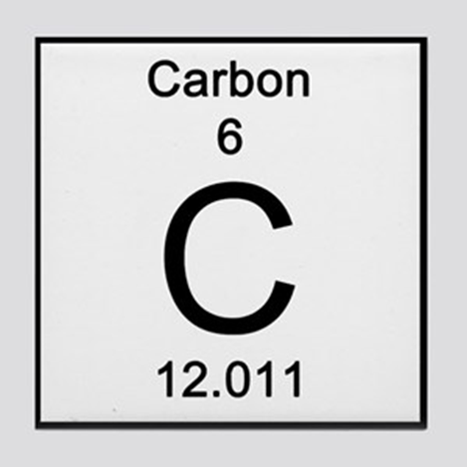
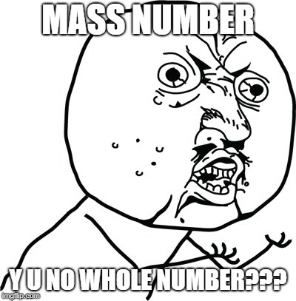
Isotopes
not all the atoms of an element have the same number of neutrons
(But they have the same number of protons)

Slide 17
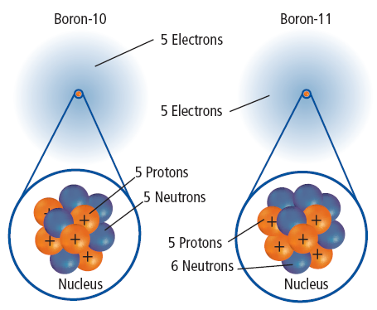
Isotopes
atoms of the same element that have different numbers of neutrons
different elements have different isotopes: some a lot, some very few
The average atomic mass of an element is the weighted-average mass of the mixture of its isotopes
For example, 80% of boron found in nature is boron-11, and 20% is boron-10
(You won’t have to calculate this)

Slide 18
Electrons
In a neutral atom, the number of electrons is equal to the number of protons
Element | Symbol | Mass Number | Atomic Number | Protons | Neutrons | Electrons
Boron
B
11
5
5
6
5
Carbon
C
12
6
6
6
6
Oxygen
O
16
8
8
8
8
Sodium
Na
23
11
11
12
11
Copper
Cu
64
29
29
35
29
Oxygen
O
18
8
8
10
8

Slide 19
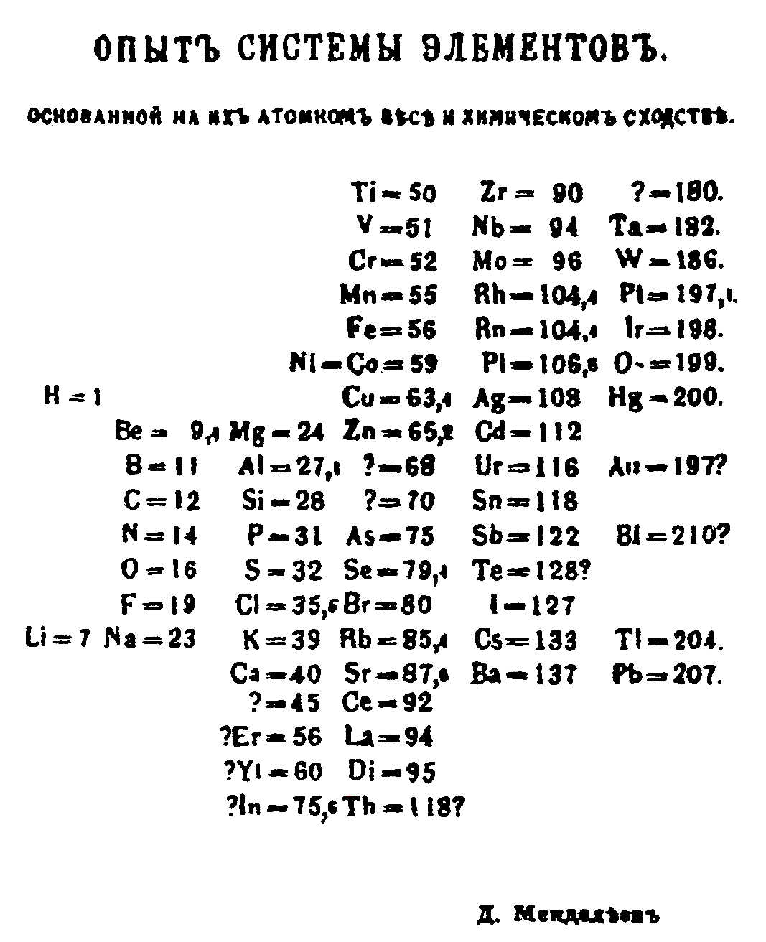
Organizing the Elements
Periodic means "repeated in a pattern"
Dmitri Mendeleev, Russian (1860’s), arranged the elements in order of increasing atomic masses
Elements with similar properties are grouped together, leaving spaces for missing elements

Slide 20
Organizing the Elements
Using Mendeleev’s table, properties of undiscovered elements could be predicted.
Mendeleev’s table had some discrepancies (problems), but was still considered as the “Father of the Periodic Table
Henry G.J. Moseley arranged elements based on their increasing atomic numbers not atomic masses, fixing the discrepancies in Mendeleev’s arrangement.
The current periodic table uses Moseley's arrangement of the elements

Slide 21
Periodic Table
arrangement of the elements in order of their atomic number so that elements with similar properties fall in the same column or group
Periodic Law
when elements are arranged in order of increasing atomic number, elements with similar properties appear at regular intervals

Slide 22
Periodic Table of the Elements Current View
MCHS Periodic Table of the Elements
1 |  |  |  |  |  |  |  |  |  |  |  |  |  |  |  |  | 18
1 H hydrogen 1.0 | 2 |  |  |  |  |  |  |  |  |  |  | 13 | 14 | 15 | 16 | 17 | 2 He helium 4.0
3 Li lithium 7.0 | 4 Be beryllium 9.0 |  |  |  |  |  |  |  |  |  |  | 5 B boron 10.8 | 6 C carbon 12.0 | 7 N nitrogen 14.0 | 8 O oxygen 16.0 | 9 F fluorine 19.0 | 10 Ne neon 20.2
11 Na sodium 23.0 | 12 Mg magnesium 24.3 | 3 | 4 | 5 | 6 | 7 | 8 | 9 | 10 | 11 | 12 | 13 Al aluminium 27.0 | 14 Si silicon 28.1 | 15 P phosphorus 31.0 | 16 S sulphur 32.1 | 17 Cl chlorine 35.5 | 18 Ar argon 40.0
19 K potassium 39.1 | 20 Ca calcium 40.1 | 21 Sc scandium 45.0 | 22 Ti titanium 47.9 | 23 V vanadium 50.9 | 24 Cr chromium 52.0 | 25 Mn manganese 54.9 | 26 Fe iron 55.8 | 27 Co cobalt 58.9 | 28 Ni nickel 58.7 | 29 Cu copper 63.5 | 30 Zn zinc 65.4 | 31 Ga gallium 69.7 | 32 Ge germanium 72.6 | 33 As arsenic 74.9 | 34 Se selenium 79.0 | 35 Br bromine 79.9 | 36 Kr krypton 83.8
37 Rb rubidium 85.5 | 38 Sr strontium 87.6 | 39 Y yttrium 88.9 | 40 Zr zirconium 91.2 | 41 Nb niobium 92.9 | 42 Mo molybdenum 95.9 | 43 Tc technetium [98] | 44 Ru ruthenium 101.0 | 45 Rh rhodium 102.9 | 46 Pd palladium 106.4 | 47 Ag silver 107.9 | 48 Cd cadmium 112.4 | 49 In indium 114.8 | 50 Sn tin 118.7 | 51 Sb antimony 121.8 | 52 Te tellurium 127.6 | 53 I iodine 126.9 | 54 Xe xenon 131.3
55 Cs caesium 132.9 | 56 Ba barium 137.3 | 57 La lanthanum 138.9 | 72 Hf hafnium 178.5 | 73 Ta tantalum 180.9 | 74 W tungsten 183.8 | 75 Re rhenium 186.2 | 76 Os osmium 190.2 | 77 Ir iridium 192.2 | 78 Pt platinum 195.1 | 79 Au gold 197.0 | 80 Hg mercury 200.6 | 81 Tl thallium 204.4 | 82 Pb lead 207.2 | 83 Bi bismuth 209.0 | 84 Po polonium [209] | 85 At astatine [210] | 86 Rn radon [222]
87 Fr francium [223] | 88 Ra radium [226] | 89 Ac actinium [227] | 104 Rf rutherfordium [261] | 105 Db dubnium [262] | 106 Sg seaborgium [266] | 107 Bh bohrium [264] | 108 Hs hassium [269] | 109 Mt meitnerium [268] | 110 Ds darmstadtium [271] | 111 Rg roentgenium [272] | 112 Cn copernicium [285] | 113 Uut ununtrium [286] | 114 Fl flerovium [289] | 115 Uup unupentium [288] | 116 Lv livermorium [293] | 117 Uus unuseptium [294] | 118 Uuo ununoctium [294]
 |  |  |  | 58 Ce cerium 140.1 | 59 Pr praseodymium 140.9 | 60 Nd neodymium 144.2 | 61 Pm promethium [145] | 62 Sm samarium 150.4 | 63 Eu europium 152.0 | 64 Gd gadolinium 157.3 | 65 Tb terbium 158.9 | 66 Dy dysprosium 162.5 | 67 Ho holmium 164.9 | 68 Er erbium 167.3 | 69 Tm thulium 168.9 | 70 Yb ytterbium 173.0 | 71 Lu lutetium 175.0
 |  |  |  | 90 Th thorium 232.0 | 91 Pa protactinium 231.0 | 92 U uranium 238.0 | 93 Np neptunium [237] | 94 Pu plutonium [244] | 95 Am americium [243] | 96 Cm curium [247] | 97 Bk berkelium [247] | 98 Cf californium [251] | 99 Es einsteinium [252] | 100 Fm fermium [257] | 101 Md mendelevium [258] | 102 No nobelium [259] | 103 Lr lawrencium [262]

