Slide 1
PS Unit 1 - Matter Section 2

Slide 2
Composition of Matter
Matter is anything that takes up space and has mass
All matter is made of elements
Notes:
Change elements to atoms?

Slide 3
Elements
A substance made up of atoms that are all alike
There are about 90 elements found naturally on Earth. To date, there have been 28 other elements that have been made in laboratories
Atoms
The smallest particle of an element that retains the elements properties

Slide 4
Compounds
A substance in which the atoms of two or more elements are chemically combined in a fixed proportion
Examples:
Water – it has two atoms of H and one O; H₂O
Chalk – has one Ca atom, one C atom, and three atoms of O; CaCO₃
Oxygen Gas – has two O atoms; O₂

Slide 5
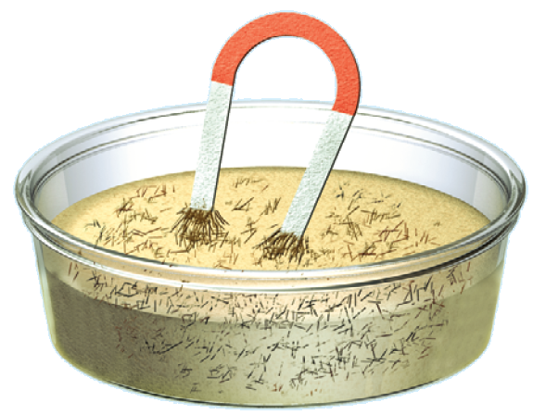
Mixture
Matter composed of two or more substances that can be separated by physical means
Two major types of mixtures are heterogeneous and homogeneous

Slide 6
Heterogeneous Mixture
Mixture where the different substances remain distinct
Examples – salad dressings; oil and water
There are 2 types of heterogeneous mixtures: Suspensions and Colloids

Slide 7
Suspensions
Heterogeneous mixture made of liquid and solid particles that settle
Example - River carrying sediment; when it reaches the delta, the solids settle

Slide 8
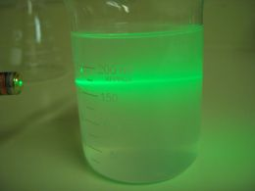
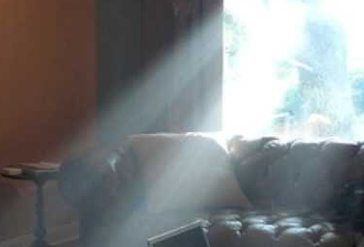
Colloids
Heterogeneous mixture where the different substances do not settle out
Use the Tyndall Effect to help identify colloids (scattering of light beam as it passes through a colloid)
Examples – Milk (made of water, fats, and proteins)
Fog

Slide 9
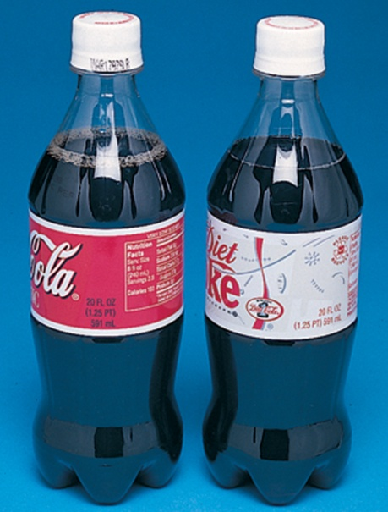
Homogeneous Mixture
Mixture that remains constantly and uniformly mixed
Interactions between particles keep the different substances from settling
Another word to describe a homogeneous mixture is a solution
Examples – Soft drinks

Slide 10
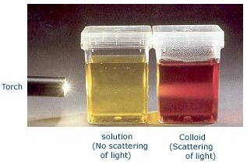
Comparing Colloids & Solutions

Slide 11
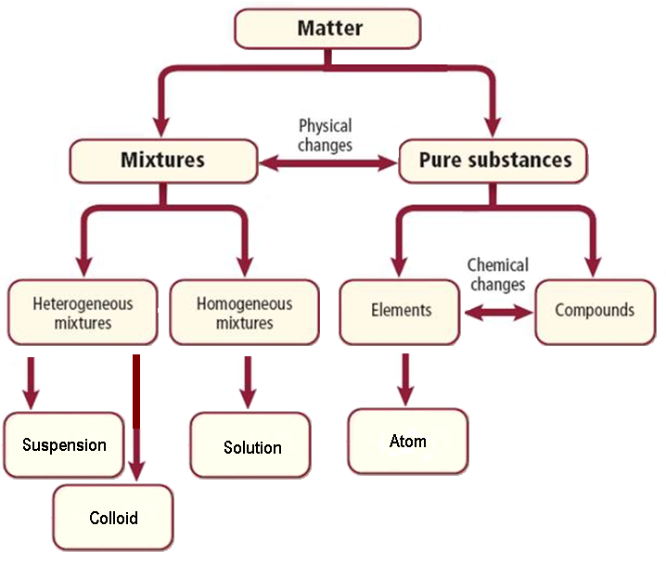
Matter Map

