Slide 1
PS Unit 1 - Matter Section 1

Slide 2
What is matter?
Anything that has mass and takes up space (has volume)
What is matter made of?
All matter is made of small particles (atoms)
How these particles are arranged and how they are moving determine the state of matter

Slide 3
States of Matter
There are 3 primary states of matter:
Solid
Liquid
Gas
The state of matter is determined by its kinetic energy (the energy of motion)

Slide 4
Kinetic Theory
How particles in matter behave
1. All matter is composed of tiny particles (atoms)
2. The particles move in constant, random motion
3. The particles collide with each other and with the walls of any container they are contained
4. The amount of energy that the particles lose from these collisions is negligible, or so small it does not affect the behavior of the matter

Slide 5
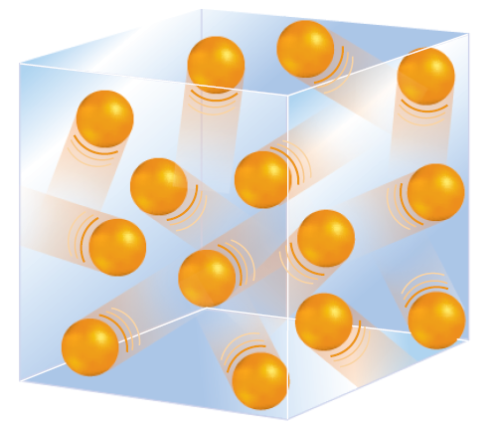
Gases
Gas particles are in constant motion, colliding with each other and with the container
Gases do not have a fixed volume, they fill their container
Gases do not have a fixed shape, they take the shape of their container

Slide 6
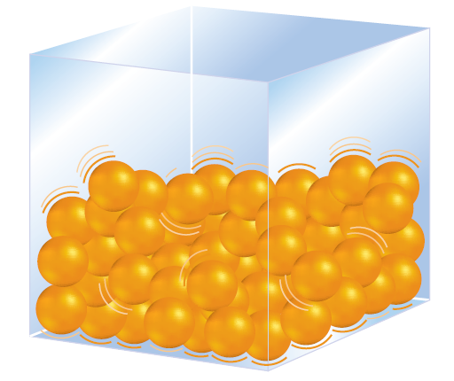
Liquids
Liquid particles are also in constant motion, but not moving as fast as particles in the gas state
Liquids have less kinetic energy than gases
Liquid particles are not able to overcome the attraction to each other, so liquids have a definite volume
Liquids do not have a fixed shape, they take the shape of their container

Slide 7
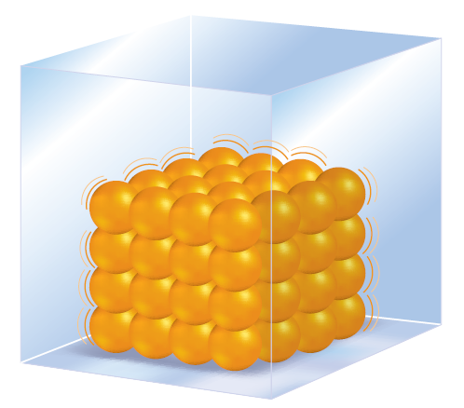
Solids
Solid particles are in constant motion, but have so little kinetic energy that they are not able to overcome their attraction to each other
Particles of a solid are closely packed together
Solids have a definite volume
Solids have a definite shape

Slide 8
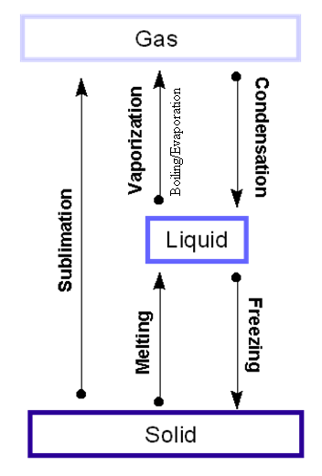
Changes in States of Matter
Matter can change from one state of matter to another state of matter
happens when the particles either gain or lose thermal energy

Slide 9
Freezing
Changing from liquid to solid
Freezing Point - the temperature at which a liquid turns into a solid
Heat of Fusion is the energy required to change a substance from a solid to a liquid.

Slide 10
Melting
Changing from solid to liquid
Melting Point - the temperature at which a solid becomes a liquid; same temperature as the freezing point (just a different name)
Heat of Fusion is the energy required to change a substance from solid to liquid (it is the same, just in reverse)

Slide 11
Vaporization
Changing from liquid to gas
Boiling Point – the temperature at which a liquid changes into a gas
Heat of Vaporization is the energy required to change a substance from a liquid to a gas
Vaporization can occur in two ways: Boiling Evaporation

Slide 12
Evaporation
Boiling
Occurs within a liquid at a specific temperature depending on the pressure on the surface of the liquid
Occurs at the surface of a liquid
Happens at temperatures below the liquid’s boiling point

Slide 13
Condensation
Changing from gas to liquid
It happens at the same temperature as the boiling point
Heat of Vaporization is the same moving from a gas to a liquid; just in reverse

Slide 14
Sublimation
Changing from solid directly to gas (no liquid)
Under some circumstances, solids can turn directly into a gas without going through the liquid phase
Ex. - Dry Ice

Slide 15
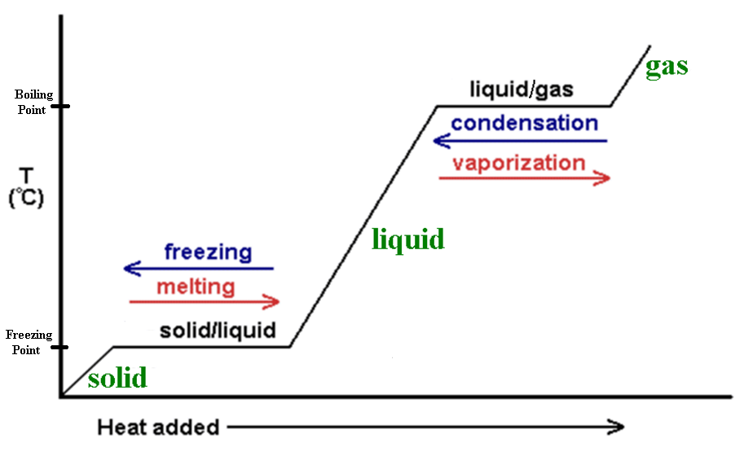
Heating Curves
This type of graph shows the temperature change of water as thermal energy, or heat, is constantly added

Slide 16
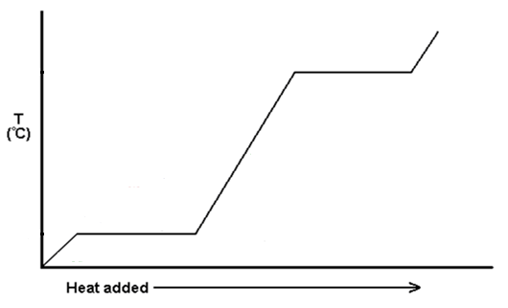
Heating Curves
Whenever there is a change in state of matter, the temperature stays the same until ALL of the matter has changed state. This is the area of no temperature change
The temperature remains constant during melting and vaporizing
Areas of increase are a change in temperature, not a change in state

Slide 17
Thermal Expansion
Particles move faster and separate as the temperature rises, resulting in an expansion of the entire object
thermometers(the warmer the liquid is, the further up the thermometer the liquid goes)
hot air balloon rise (as the air is heated, it expands, becoming less dense and rises relative to the air in the atmosphere)

Slide 18
Properties of Matter
There are two types of properties of matter – chemical properties and physical properties
There are two types of changes in matter – chemical changes and physical changes
‘Physical’ – does not change the substance
‘Chemical’ – changes the substance into something new

Slide 19
Physical Properties
Any characteristic of a material that you can observe without changing the identity of the substance
Examples: color, shape, size, density, melting point, boiling point, and magnetism

Slide 20
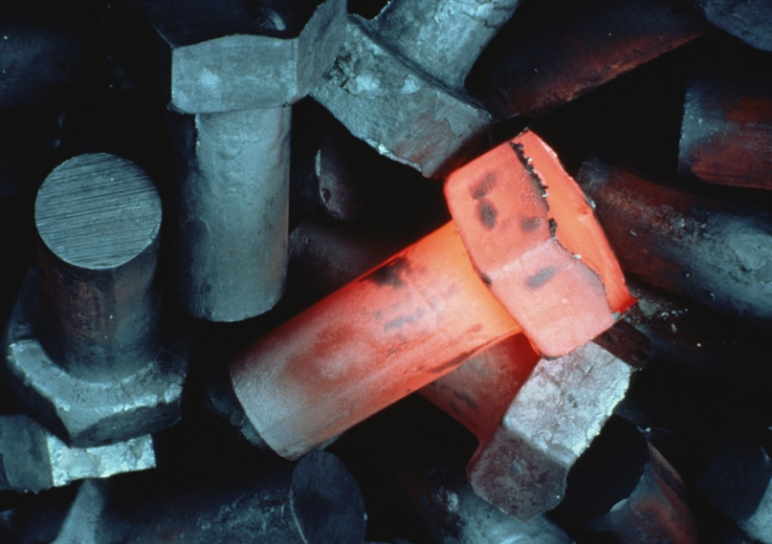
Physical Change
Change in the size, shape, or state of matter in which the identity of the substance remains the same
The chemical composition stays the same
Example – heating iron. The iron turns red when it is hot and white when it is even hotter. The color changes, but it is still iron.

Slide 21
Physical Property or Change?
Object height
Ripping a paper
Temperature
Object mass
State change

Slide 22
Chemical Properties
Any characteristic of a substance, such as flammability, that can be observed that produces a new substance
Examples – rust forming on metal, flammability

Slide 23
Chemical Change
A change from one substance to another
Change in the chemical composition of the substance
Can involve release of heat, light, or sound

Slide 24
Chemical Properties or Changes?
Flammability
Radioactivity
Gas is released
Rust forming
Light is emitted

Slide 25
Law of Conservation of Mass
Mass is neither gained nor lost due to either a chemical or physical change
“Mass can neither be created nor destroyed”
The total mass of the system stays the same
Total mass of the products = Total mass of the reactants
Total in = Total out

