Slide 1
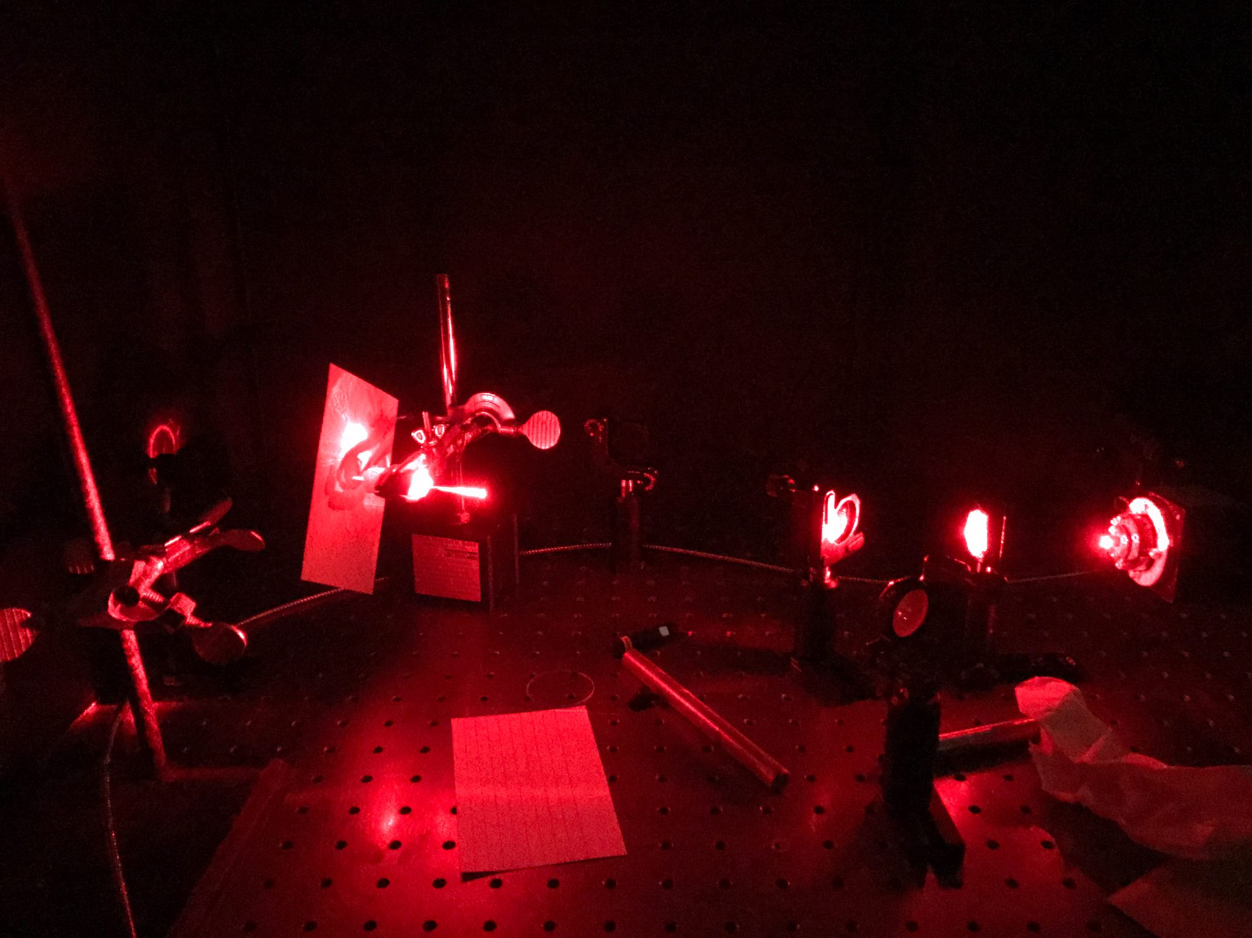
AP Physics
Chapter 22 - 25: Optics and Light

Slide 2
What is light?
Light is an electromagnetic wave.
This basically means that it is a wave that is composed of an electric field and a magnetic field.
It’s fields are oriented in a 90⁰ rotation from each other.

Slide 3
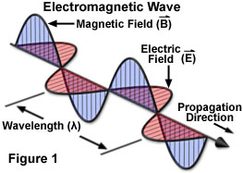
What is light?

Slide 4
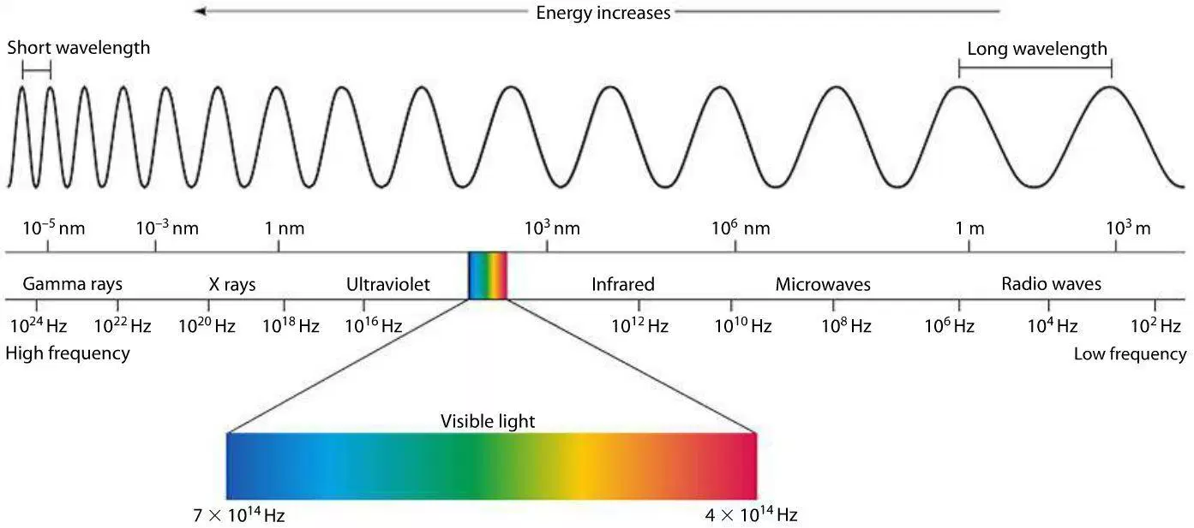
What is light?
It has a spectrum associated with it. This is called the electromagnetic spectrum.
The classification of light in this spectrum depends on frequency and wavelength.

Slide 5
What is light?
It has all the same properties of waves that we have talked about in the previous section along with some additional properties.
Since it is an electromagnetic wave, it does not need a medium to travel through.

Slide 6
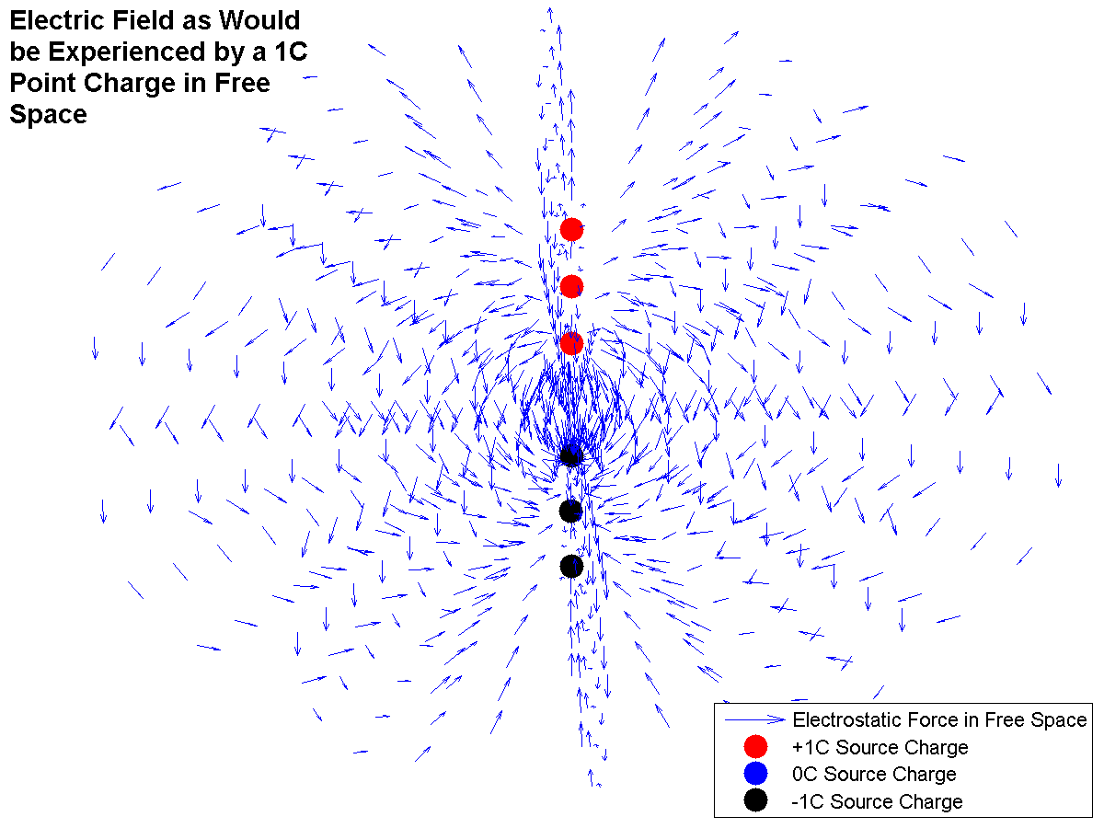
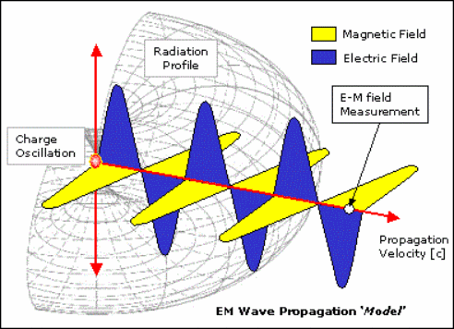
How do we create light?
We can create light by taking a charge and making it oscillate at a specific frequency.

Slide 7
What is light used for?
Pretty much all modern day technology.
The internet
Bluetooth
Radios
It is how the global warming phenomena can be explained
Cameras
MRIs and CAT Scans in the medical field
All microscopes
All spectrometry
Computer screens
Television
Satellites
Microwaves
Induction Heating Stoves
EVERYTHING!!!! Not really but pretty much.

Slide 8
Properties of Light
Before we get into the fun stuff there are some properties we need to talk about.
Refraction
Diffraction
Reflection
Internal Reflection
Polarization
Dispersion
Interference
Effects of materials on light
Scattering

Slide 9
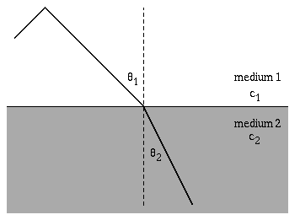
Refraction
When light changes mediums it experiences refraction!
This essentially means it changes the angle and speed at which it propagates.

Slide 10
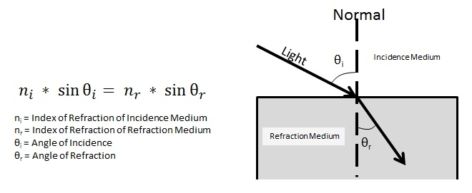
Refraction
This is determined by Snell’s law.
Light at shorter wavelengths or at higher frequencies experience more refraction than light with longer wavelengths and smaller frequencies

Slide 11
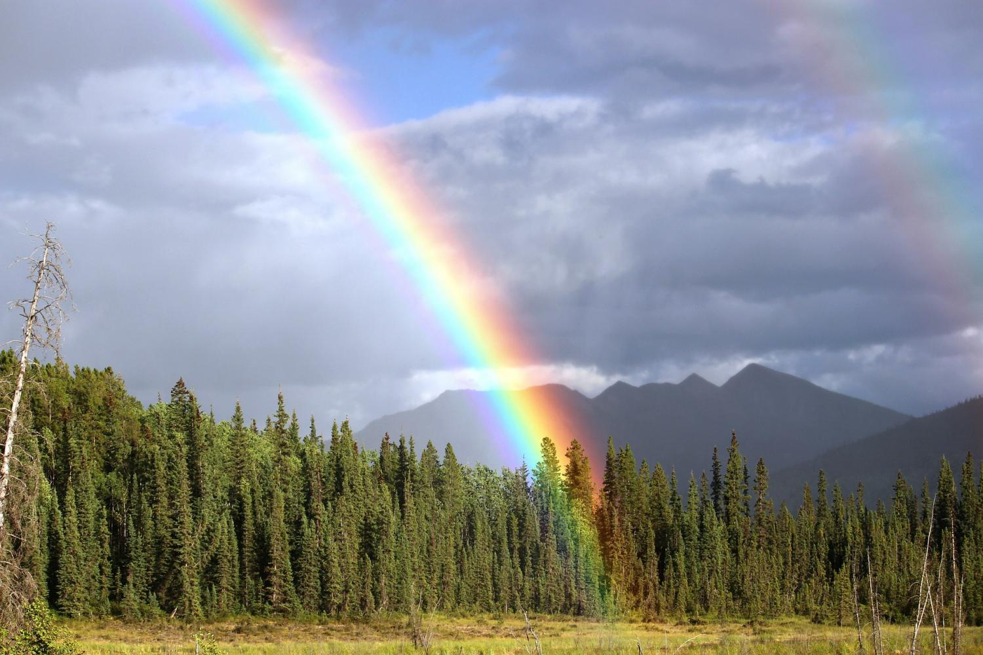
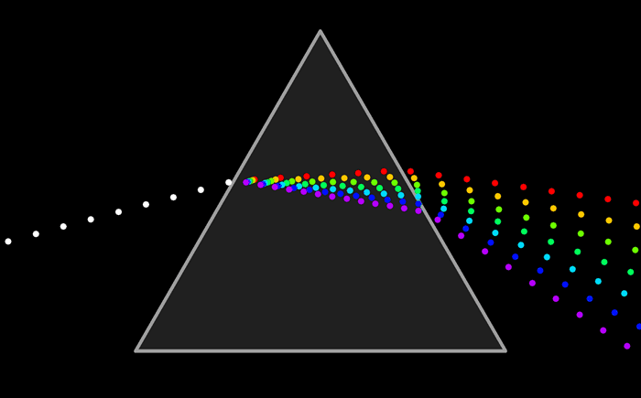
Refraction
This is what creates rainbows and it also explains how prisms are able to separate white light into its component wavelengths.

Slide 12
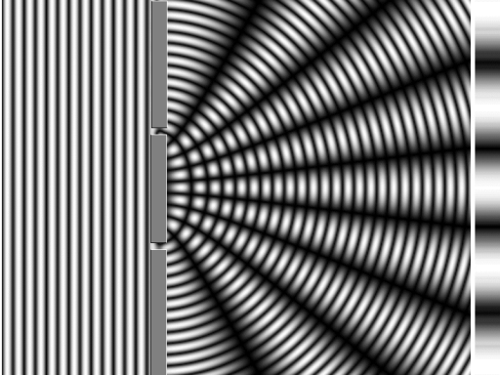
Diffraction
This is a phenomena that occurs when light passes through a narrow slit/aperture or across an edge. This causes interference between the wave forms produced.

Slide 13
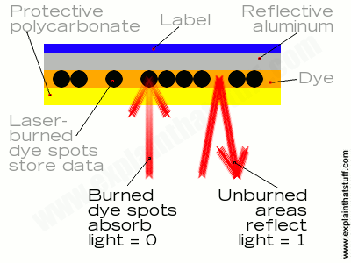
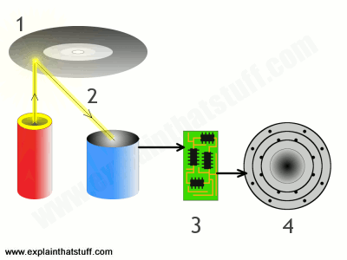
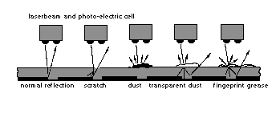
Diffraction
CD’s and DVD’s are essentially diffraction gratings. They use these gratings as a mean to store and transfer information that can be read through lasers.

Slide 14
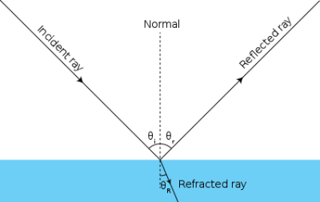
Reflection
Just light any other waves, when light hits another medium some of the wave is reflected or absorbed. Light is special though, and certain mediums can be totally transparent where no light will be reflected.

Slide 15
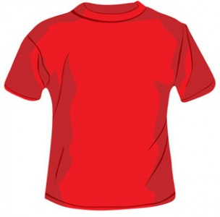
Reflection
All colors we see work by reflection.
A red shirt absorbs all colors of light except for red which is reflected and that is what we see.

Slide 16
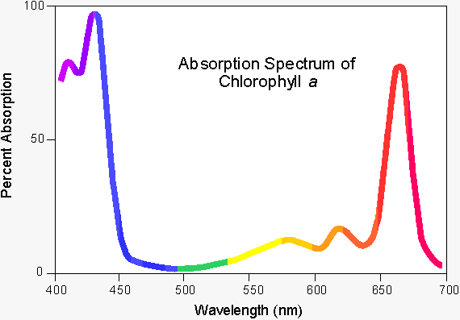
Reflection
Leaves changing colors has to do with the change in chlorophyll within the leaf. It starts to absorb different wavelengths of light and reflect others.

Slide 17
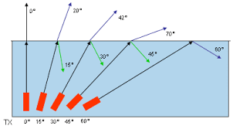
Internal Reflection
As light passes through a medium it likes to stay in that medium. When it hits a boundary some of it not most of the light can be reflected off and stays within the medium. When this happens we call it internall reflection.

Slide 18
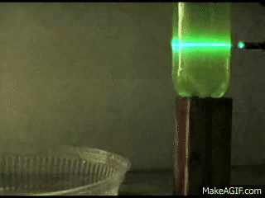
Internal Reflection
We can bend light to our will using this property. This is how fiber optic cables work.

Slide 19
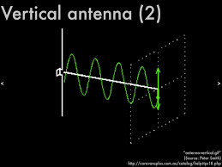
Polarization
This is a property of light that is used to express the orientation of the electric and magnetic field that light has.

Slide 20
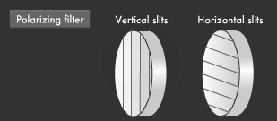
Polarization
Polarizers such as polarized sunglasses will block certain orientations of the lights electric and magnetic field and let some light through.

Slide 21
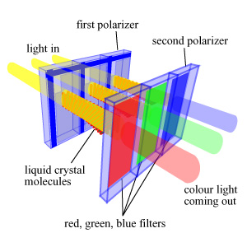
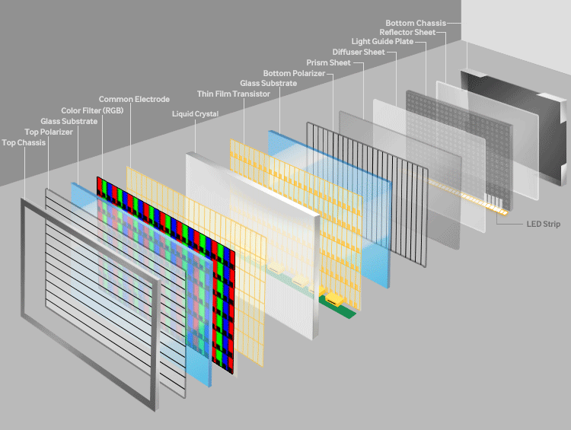
Polarization
This is also how your computer screen and iPhone screens work.

Slide 22
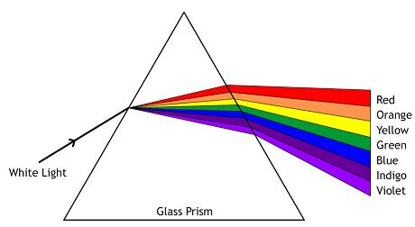
Dispersion
This is a property of light that is used to explain how light is broken up into its wave components.

Slide 23
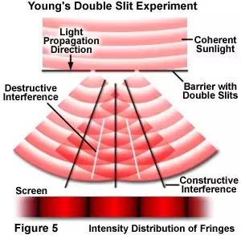
Interference
Light also behaves like all other waves in the fact that it has constructive and destructive interference patterns.

Slide 24
Effects of materials on light
Terms that are commonly referred to that involved reflection.
Opaque – All the light is absorbed and none is reflected nor does the light travel through it.
Transparent – All of the light passes through the material
Translucent – some of the light can pass through the material.

Slide 25
Effects of materials on light

Slide 26
Scattering
When light hits particles it also has the ability to scatter.
Types of Scattering:
Rayleigh Scattering
Mie Scattering
Non-Selective Scatter

Slide 27
Scattering
Rayleigh Scattering- The scattering of light without a change in wavelength. Lower wavelength light scatters more effectively.
This is why our sky is blue.

Slide 28
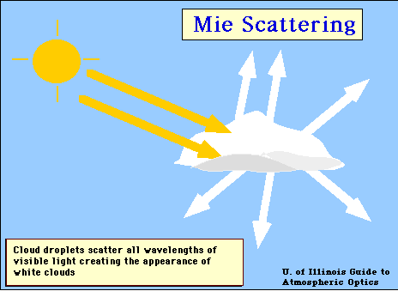
Scattering
Mie Scattering/Non-Selective Scattering- The scattering of light without a change in wavelength. The light scattered has to have a wavelength similar to or larger than the diameter of the particle is scattered off of.
This is why clouds and most
smoke is white.

Slide 29
Applications of light
We are going to go through some applications of light and talk about them. We are also going to set up some fun optics labs this week.
Think about some technologies you want to learn about and we will talk about it in class.

Slide 30
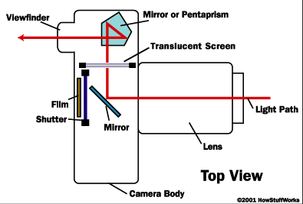
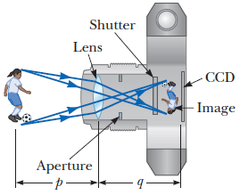
How cameras work

Slide 31
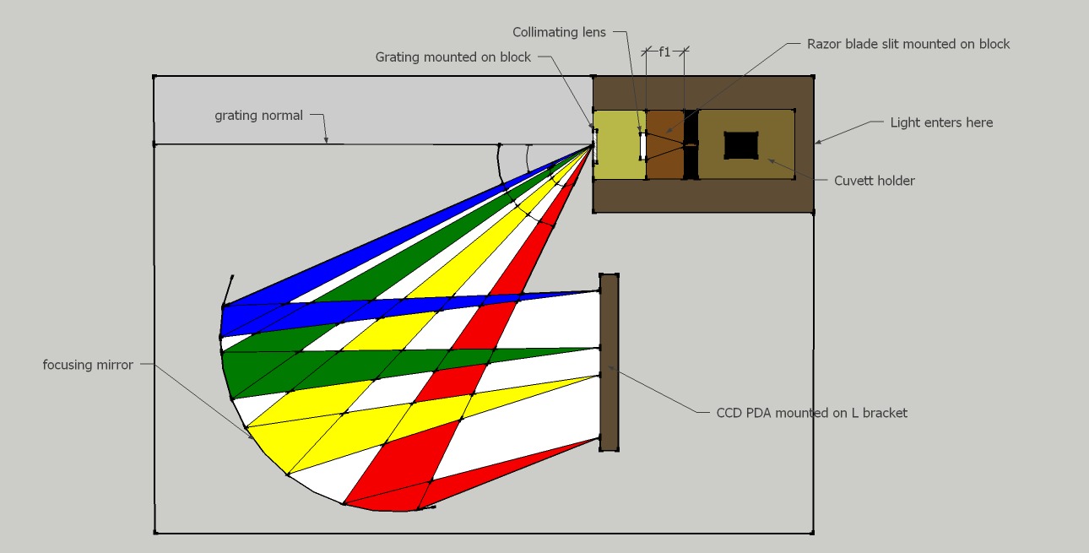
The CCD Array

Slide 32
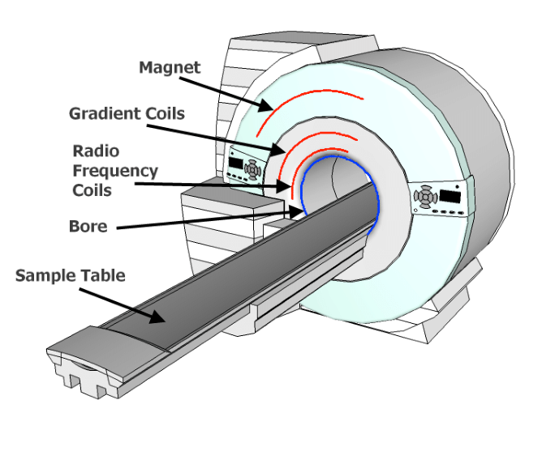
MRIs
Basically magnetic waves in the radio wave frequency is pulsed at your body. This excites the spin states of the nuclei of the hydrogen and carbon atoms in your soft tissue. The relaxation time of these excited spin states can be measured through a detector and an image can be generated based on the information.
The detectors for MRI’s are essentially just coils of wire. Literally.

Slide 33
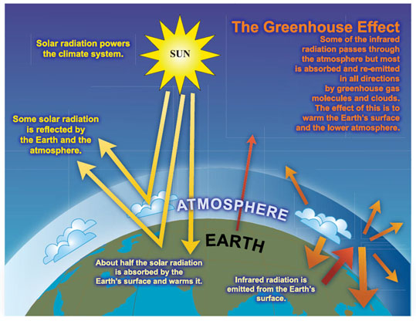
Global Warming/Heating of the Earth

Slide 34
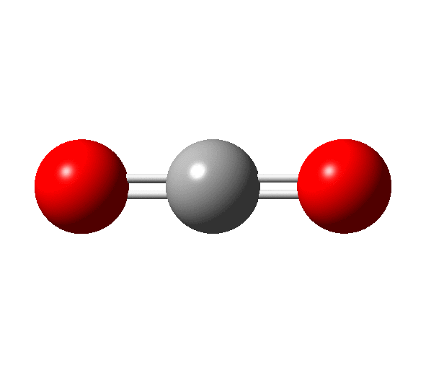
Global Warming Gases
CO2, what is considered the most common green house gas, is able to absorb IR light by its vibrations resonating with certain frequencies of IR/Heat waves.

Slide 35
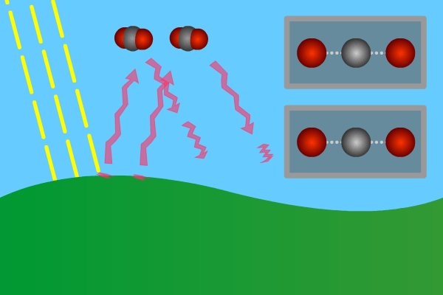
Global Warming Gases
CO₂, what is considered the most common green house gas, is able to absorb IR light by its vibrations resonating with certain frequencies of IR/Heat waves.

