Slide 1
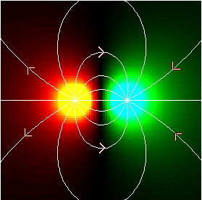
AP Physics
Chapter 15: Electric Forces and Fields

Slide 2

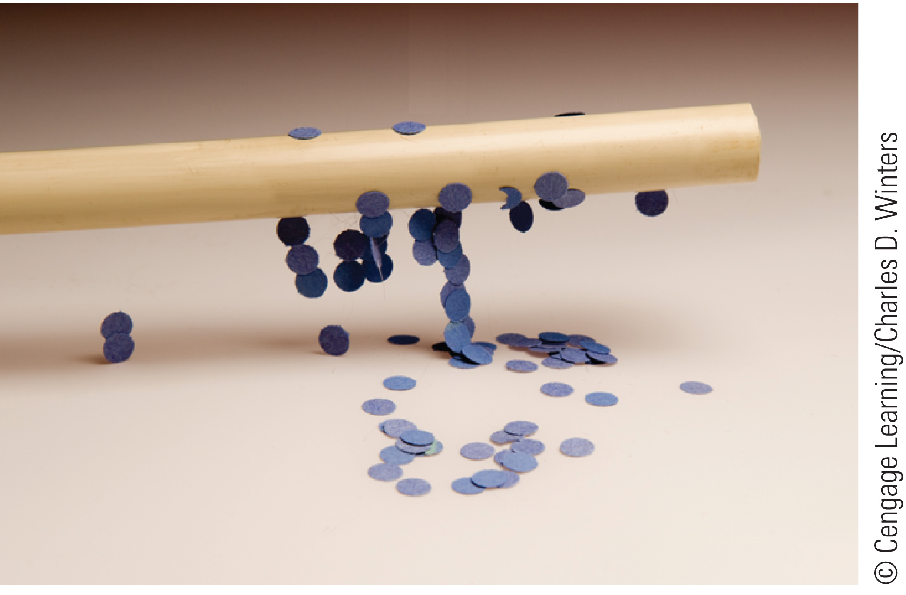
Properties of Electric Charges

Slide 3
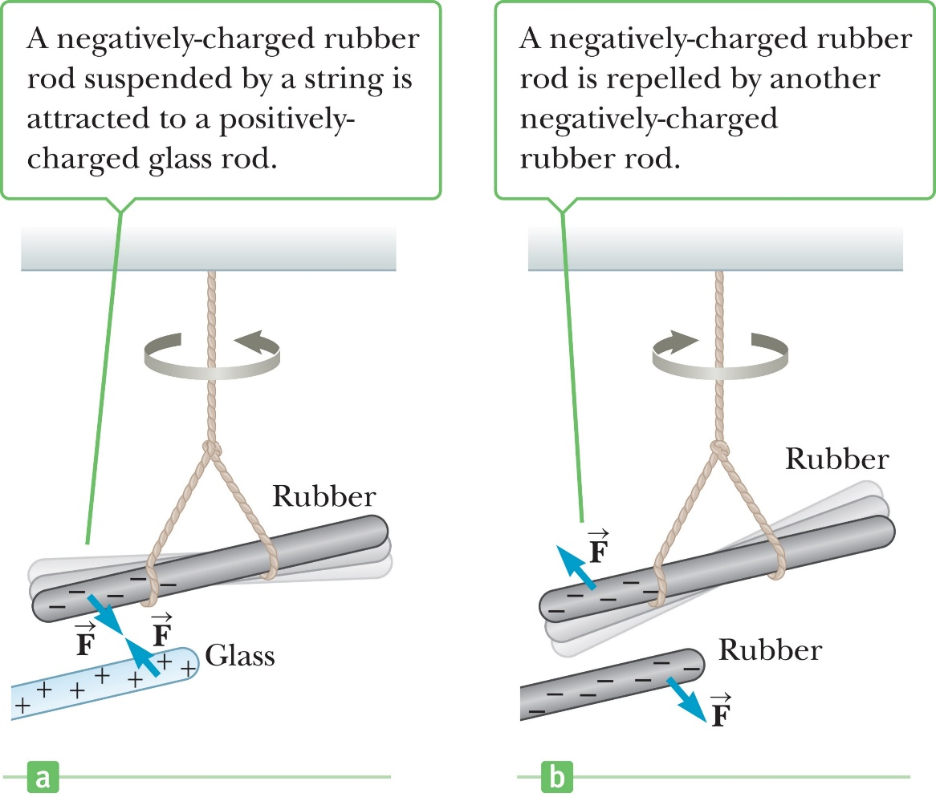
Properties of Electric Charges
Like charges repel each other.

Slide 4
Properties of Electric Charges
Like charges repel each other.

Slide 5
Properties of Electric Charges
Charge is simply the build up of extra electrons on a surface.
A surface with extra electrons is considered negatively charged.
A surface with a lack of electrons is considered positively charged.

Slide 6
Properties of Electric Charges
Nature has two carriers of charges
Electrons that are negatively charged
Protons that are positively charged
All matter in it’s “natural” state is neutrally charged, meaning it has the same number of protons and electrons.

Slide 7
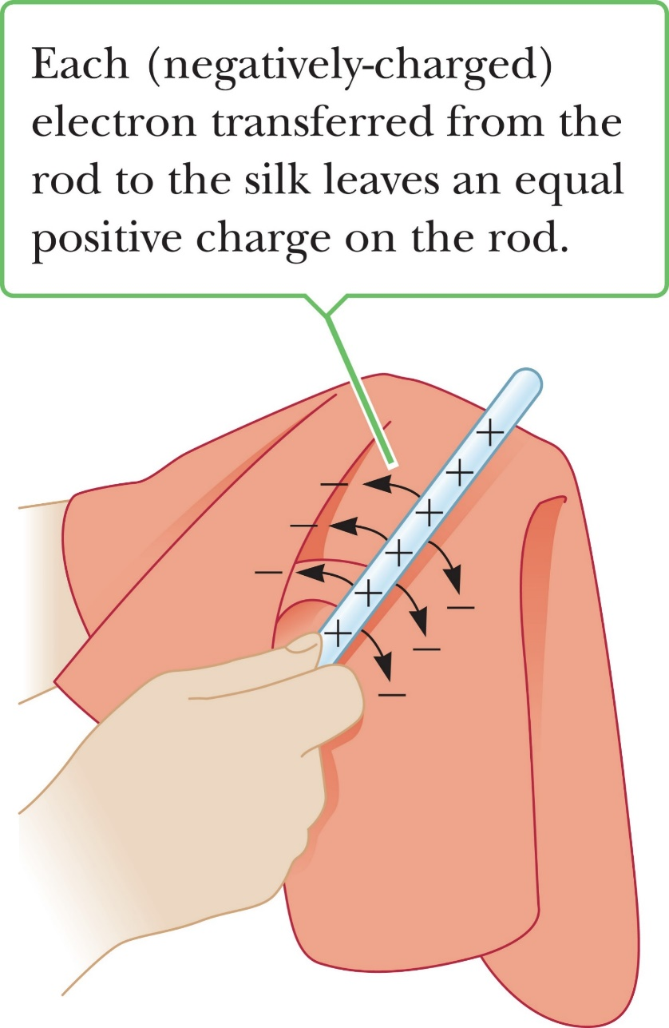
Properties of Electric Charges
When a glass rod is rubbed against silk the glass rod transfers electrons to the silk making the rod positively charged.
The silk on the other hand is negatively charged.
The rod and the silk gain charges in discrete increments. Meaning if the rod gets a +3 charge then the silk will receive a -3 charge.

Slide 8
Properties of Electric Charges
After a glass rod is rubbed against a silk cloth, the glass rod has a charge of +5 and the silk cloth has a charge of –7. What could the original charges of the glass rod and silk cloth have been?
+2, –5
0, –2
+5, 0
0, –5

Slide 9
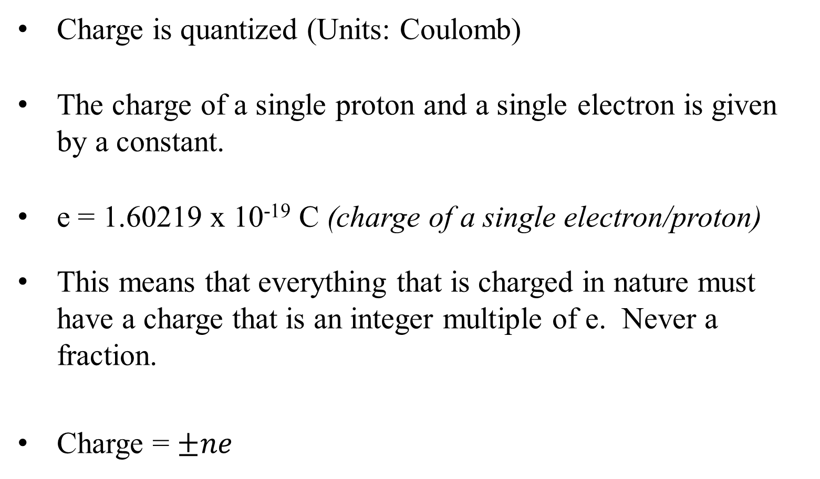
Properties of Electric Charges
Charge is quantized (Units: Coulomb)
The charge of a single proton and a single electron is given by a constant.
e = 1.60219 x 10⁻¹⁹ C (charge of a single electron/proton)
This means that everything that is charged in nature must have a charge that is an integer multiple of e. Never a fraction.
Charge = $±ne$

Slide 10
Conductors and Insulators
Electric charges can move freely through a conductor in the presence of an electric field.
In an insulator electric charges cannot move freely throughout the material. They can only build up on a surface.

Slide 11
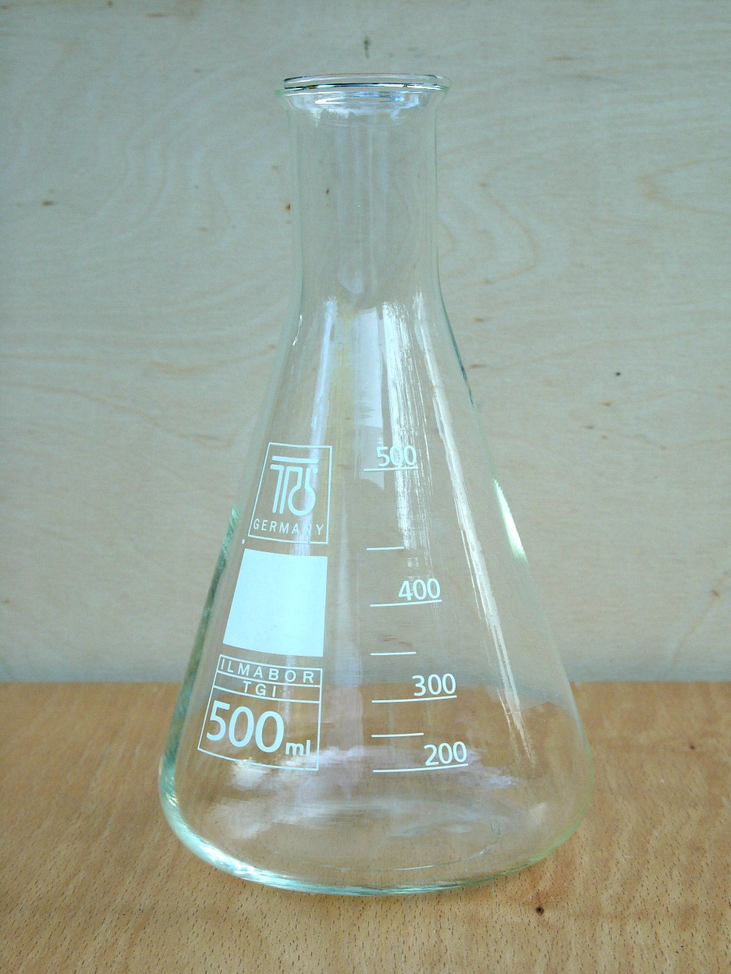
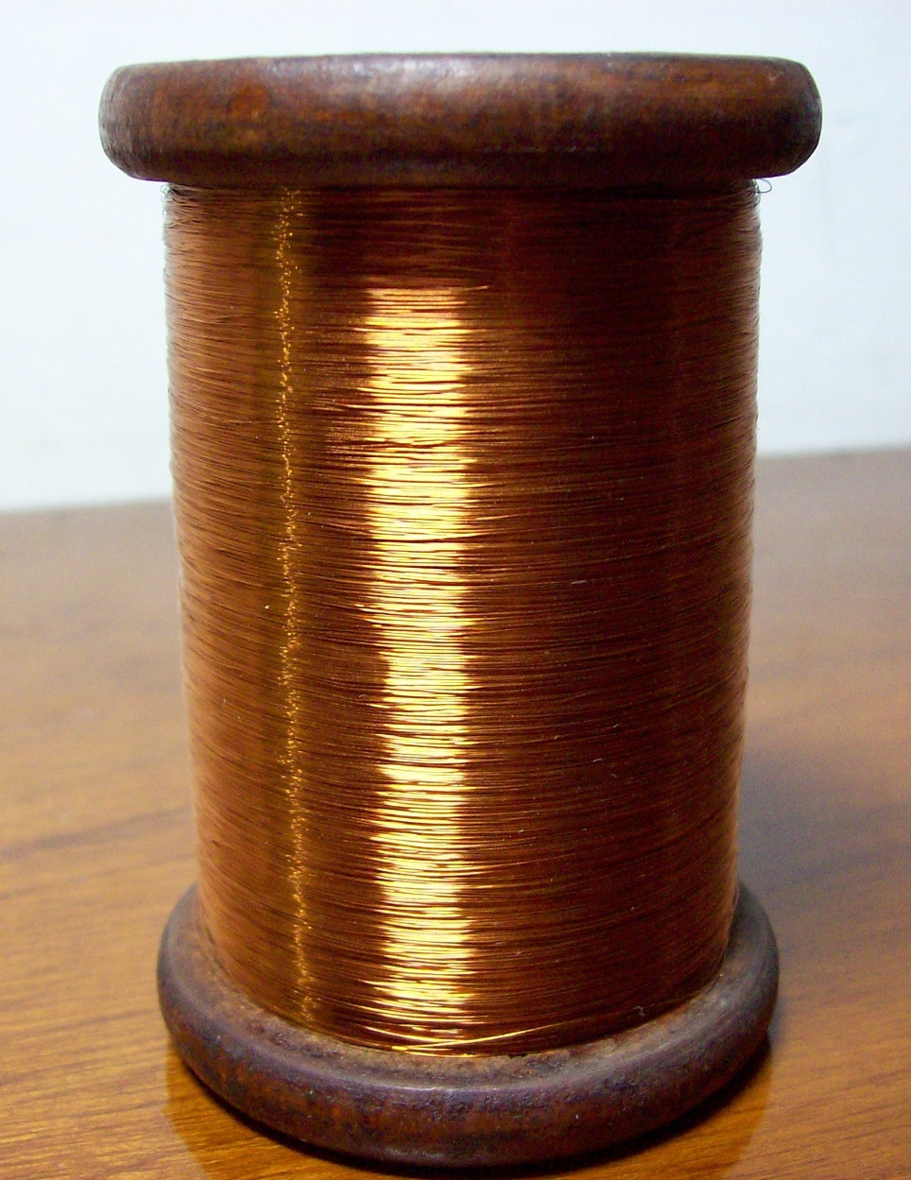
Conductors and Insulators
Insulator
Conductor

Slide 12
Conductors and Insulators
Let’s say I wanted to build up charge in a copper wire. When I take the copper wire in my hand and rub it against wool or silk, the charge flows freely throughout the copper wire into my hand and down into the ground through my body. Thus no charge can be built up. What can I do to make sure the copper wire builds up charge by blocking the discharge through my body?

Slide 13
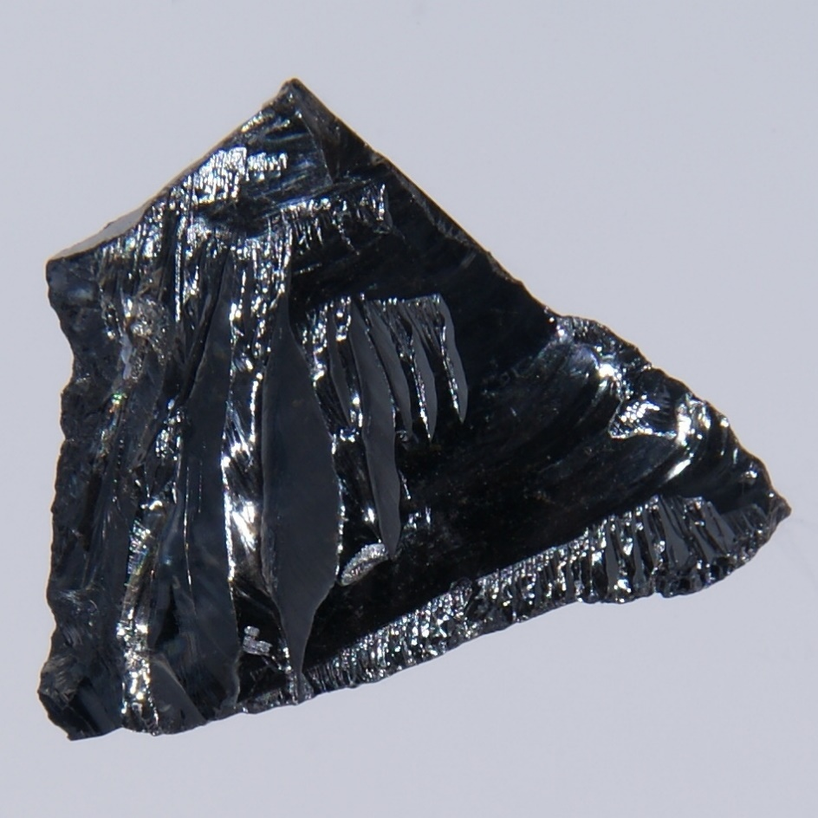
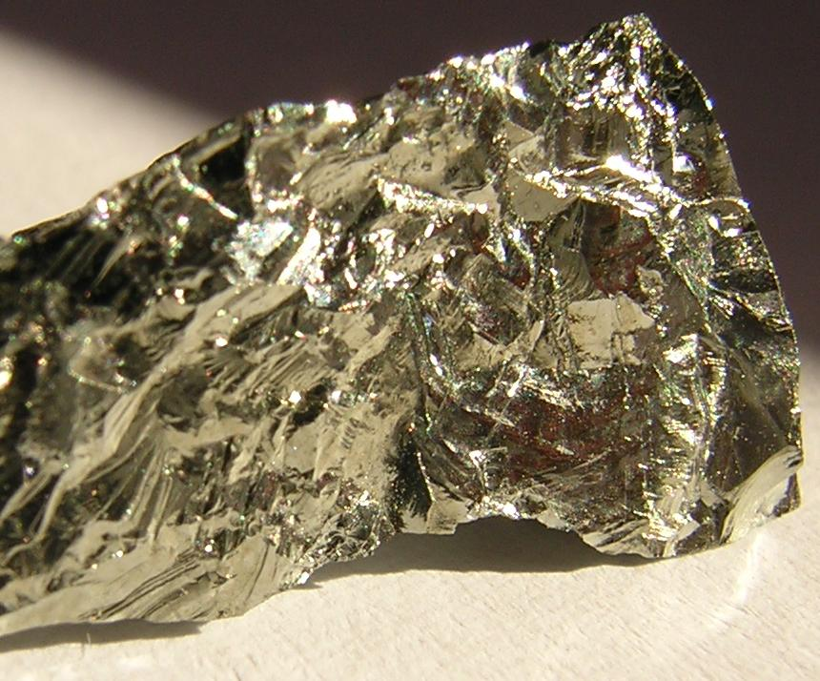
Conductors and Insulators
The third class of material is known as semi conductors.
They have properties of both conductors and insulators but we will not be discussing why this is for the purpose of this class.

Slide 14
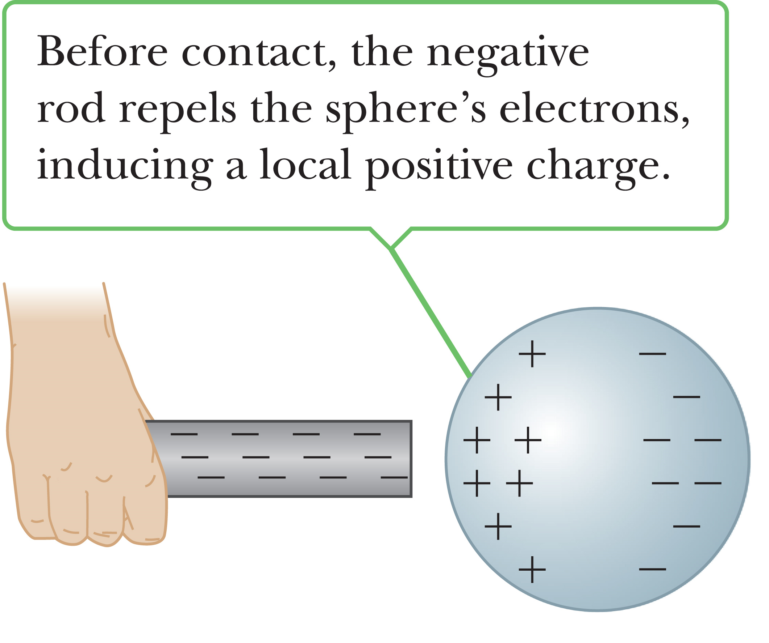
Charging by Conduction
When a negatively charged rod is brought into contact with a neutral sphere the electrons in the sphere are repelled creating a positive charge on one side of the sphere.

Slide 15
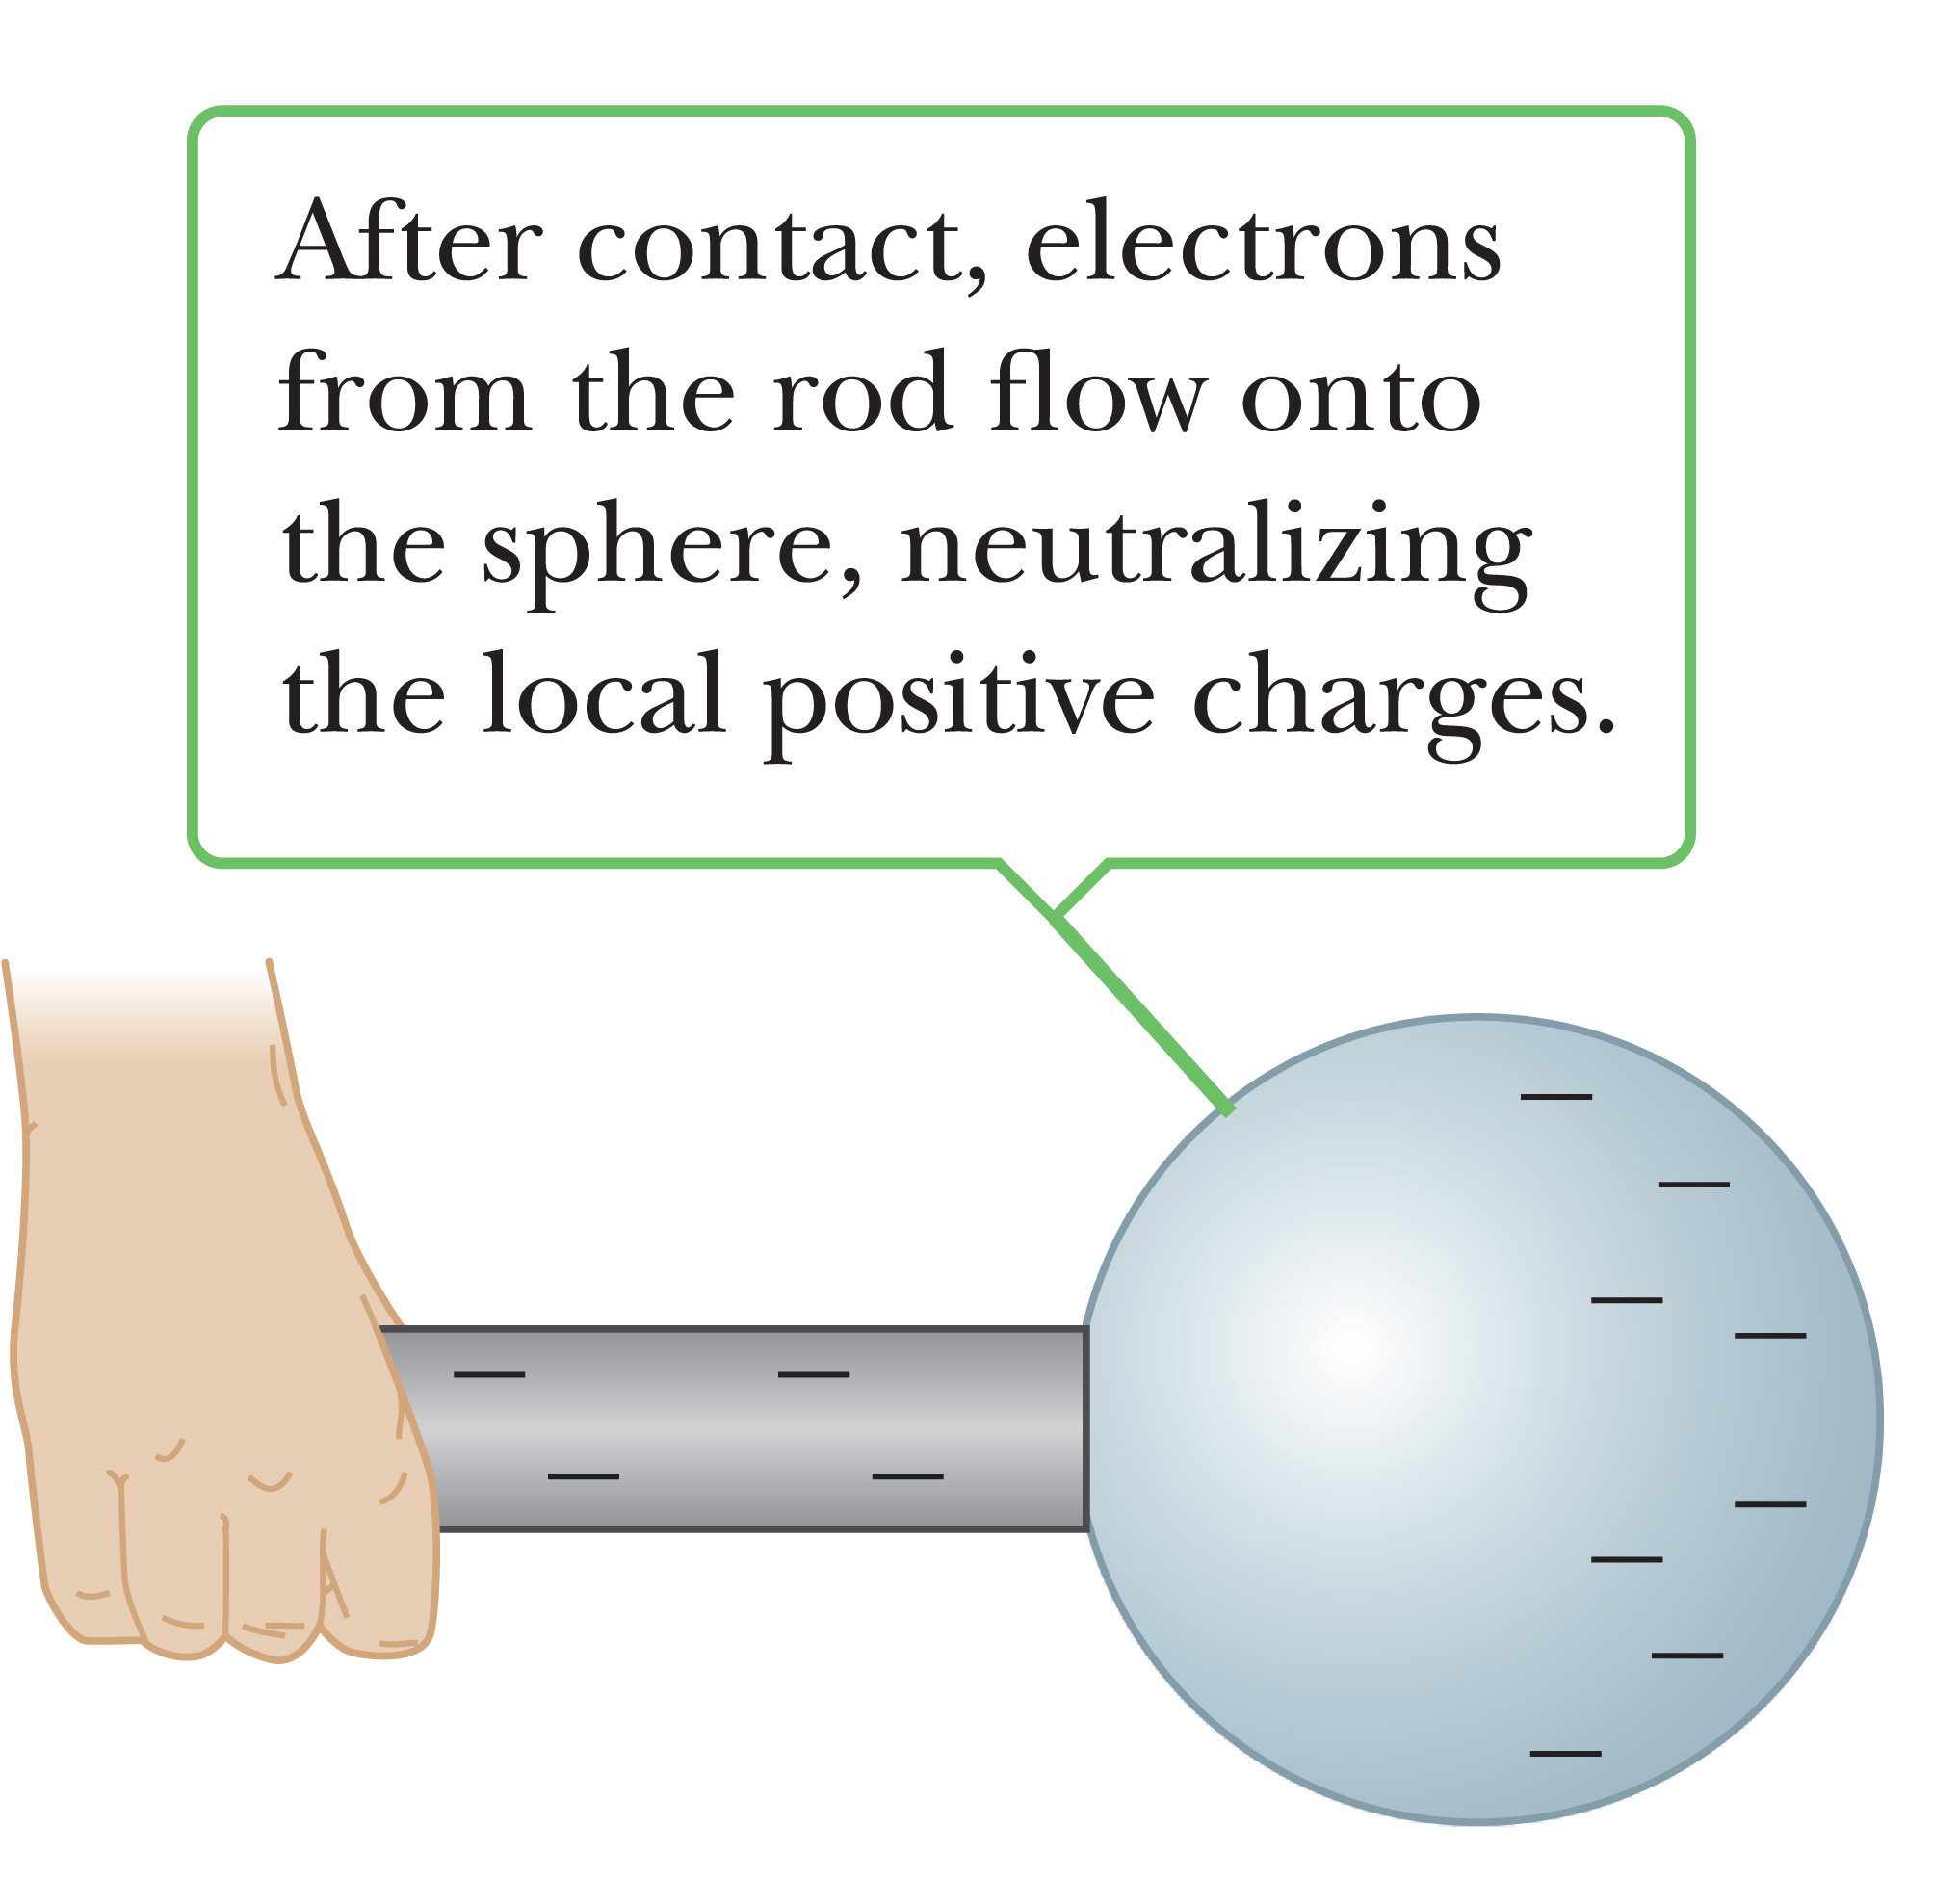
Charging by Conduction
Upon contact the excess electrons from the rod travel into the sphere neutralizing the positive charges.

Slide 16
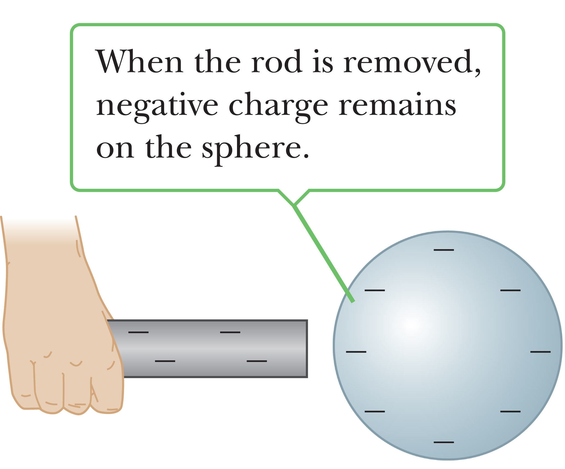
Charging by Conduction
When the rod is removed our sphere becomes overall negatively charged.

Slide 17
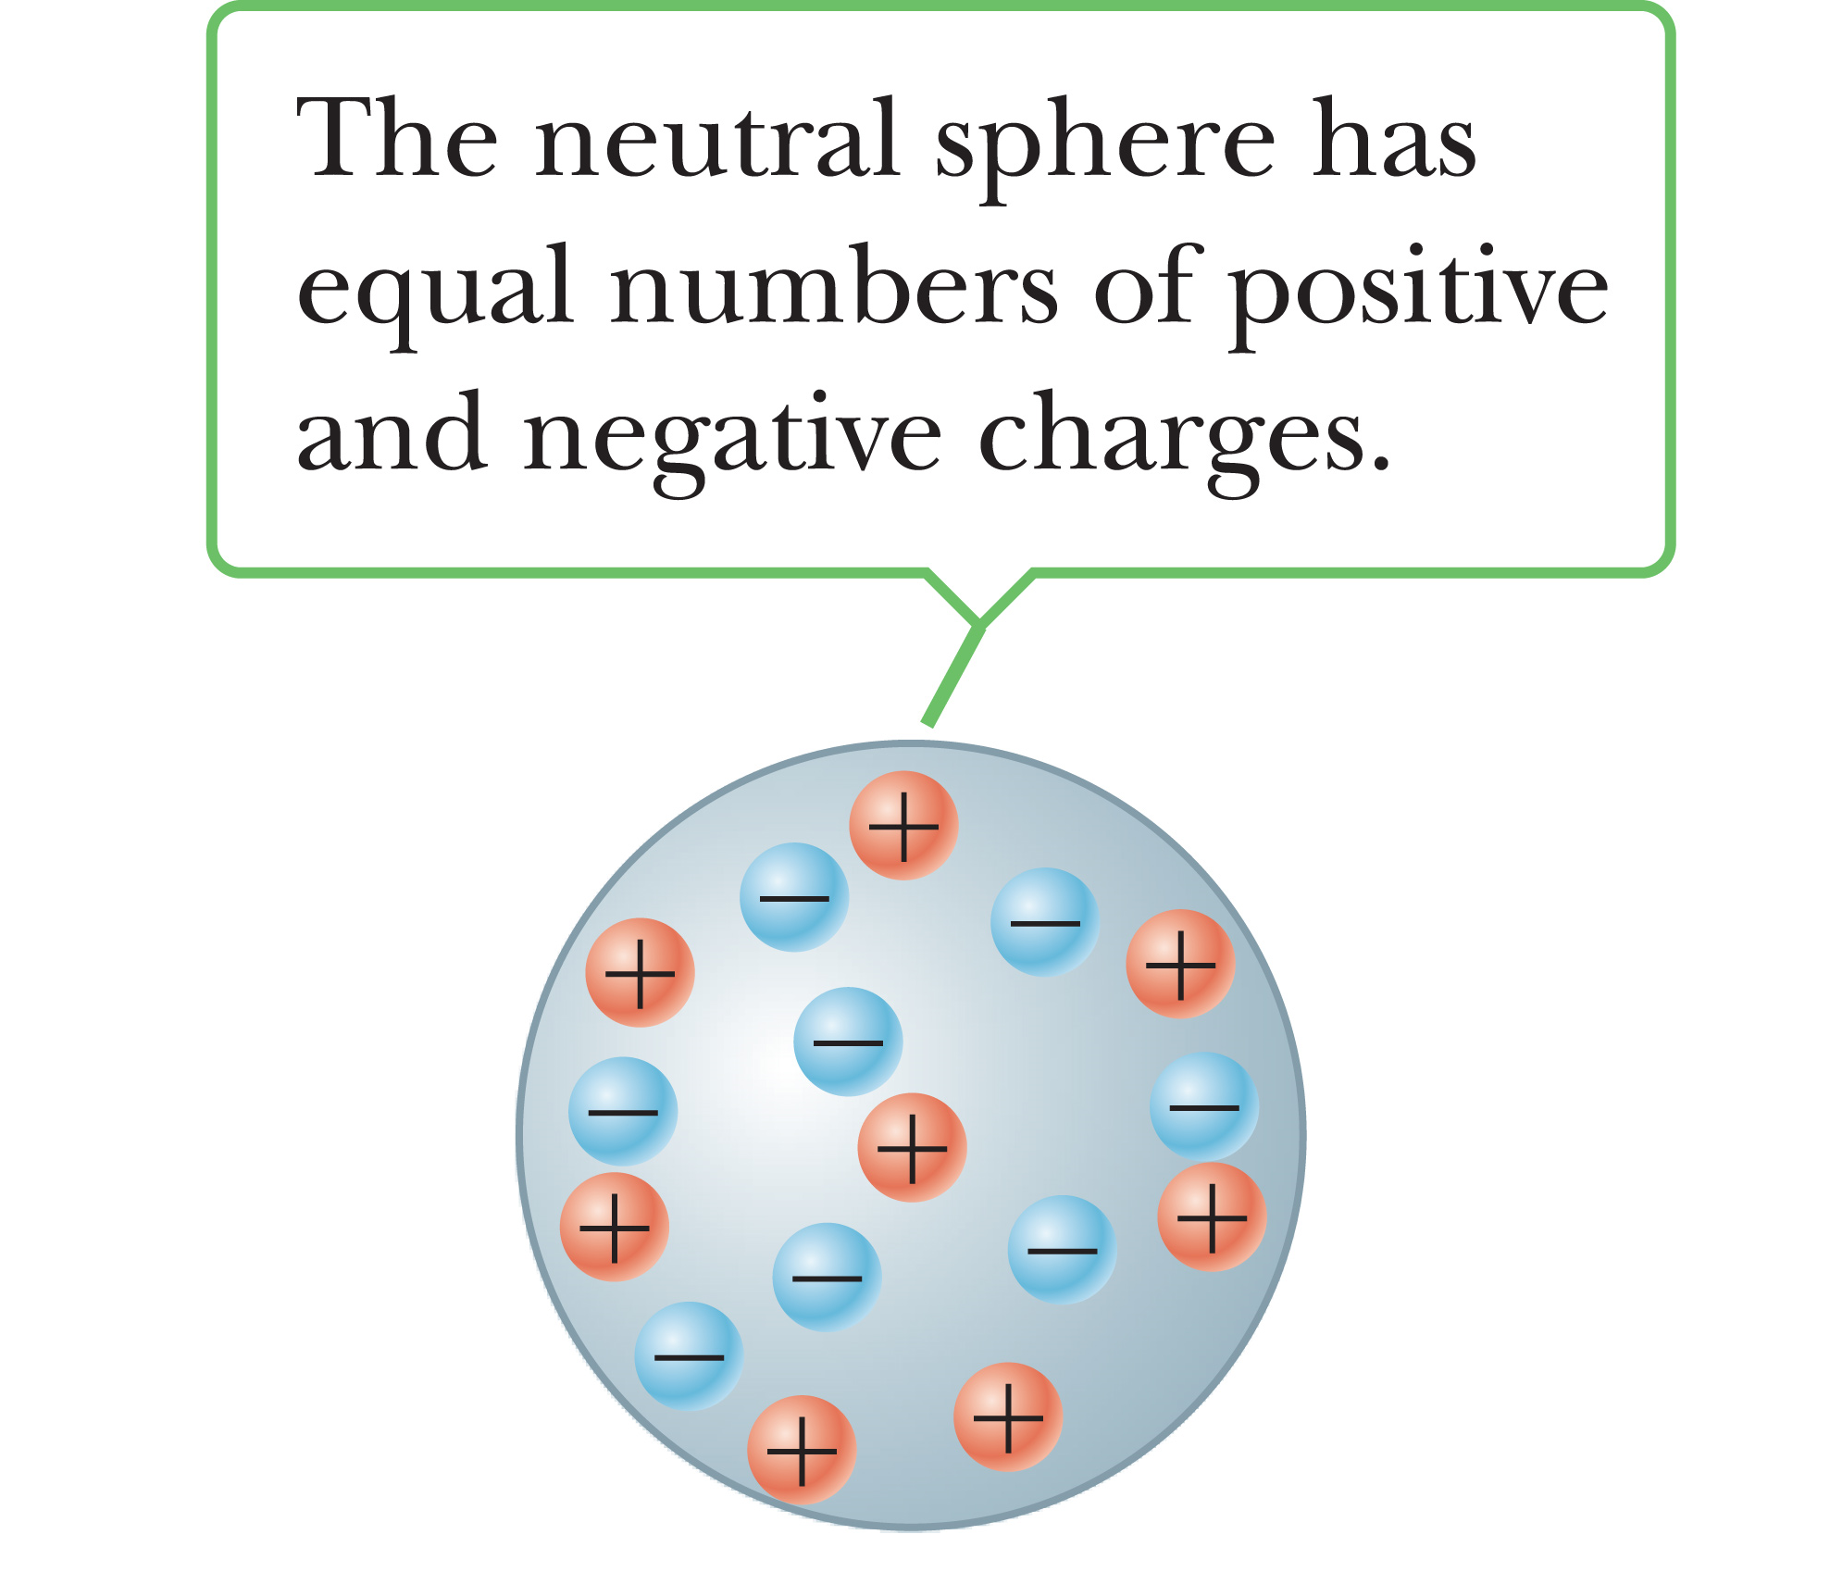
Charging by Induction
This is a method to charge materials without touching them.
In this scenario we have a neutral sphere.

Slide 18
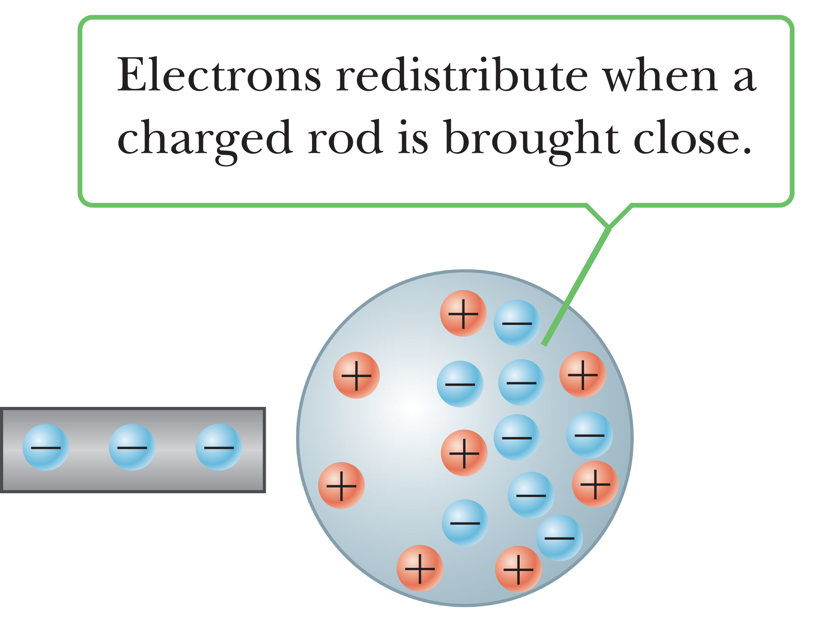
Charging by Induction
When a charged rod is brought close to the sphere the charges redistribute in the sphere similar to last scenario.

Slide 19
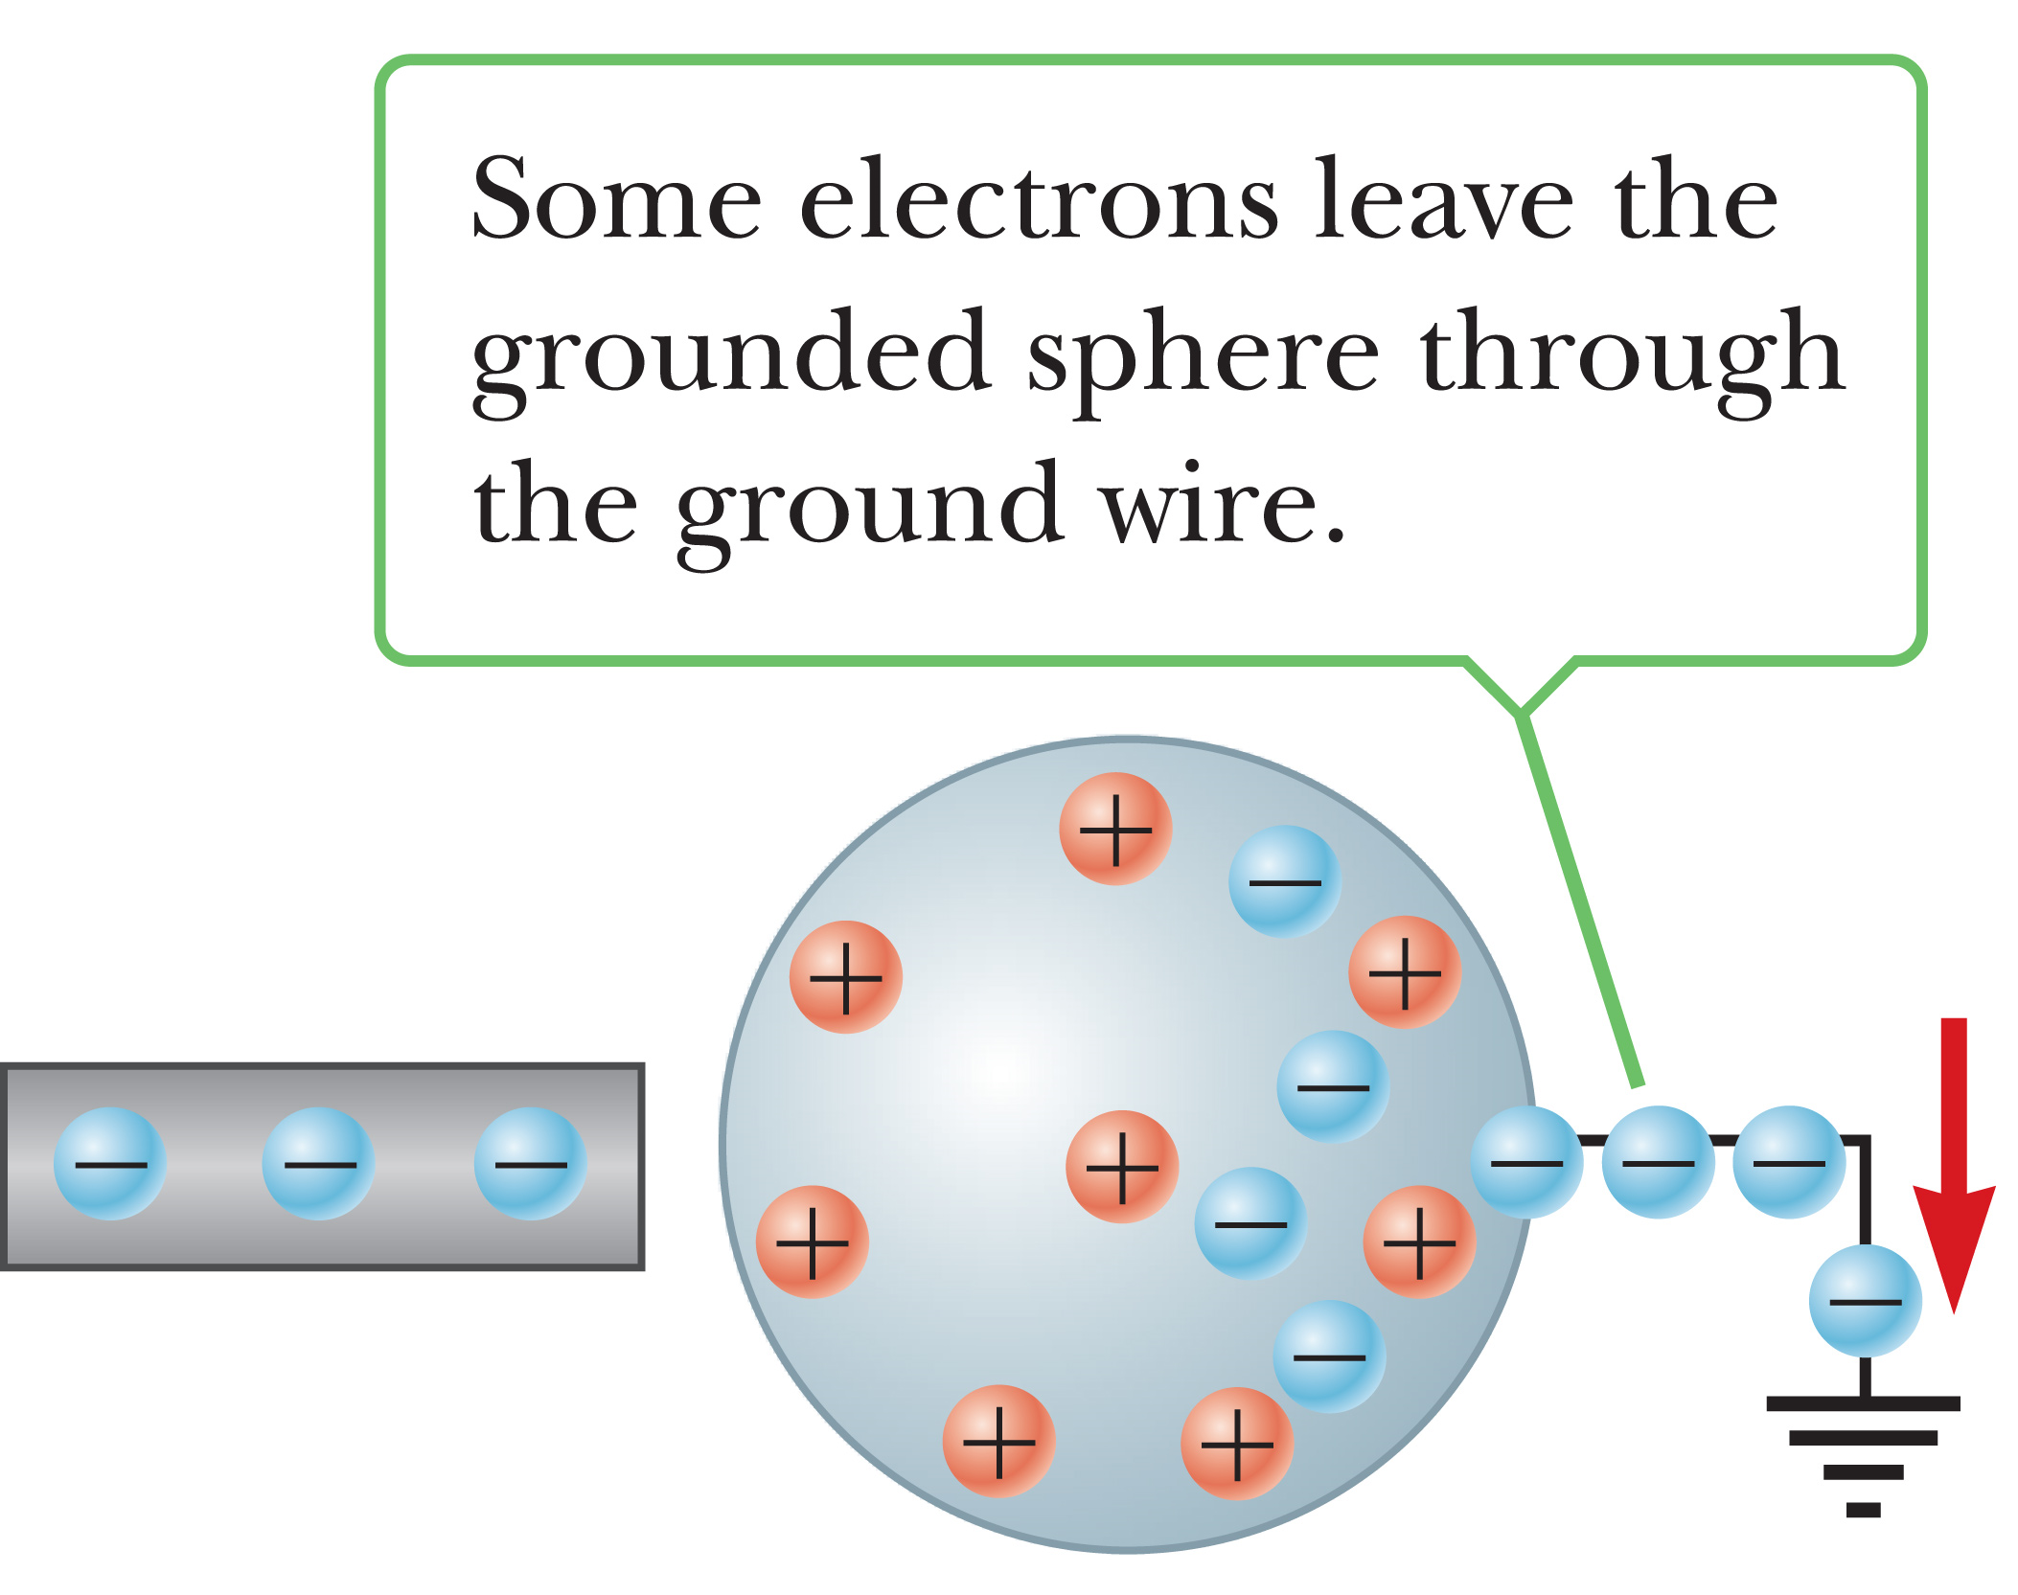
Charging by Induction
Attaching a wire/ground onto the sphere allows the build up of electrons to leave the sphere.

Slide 20
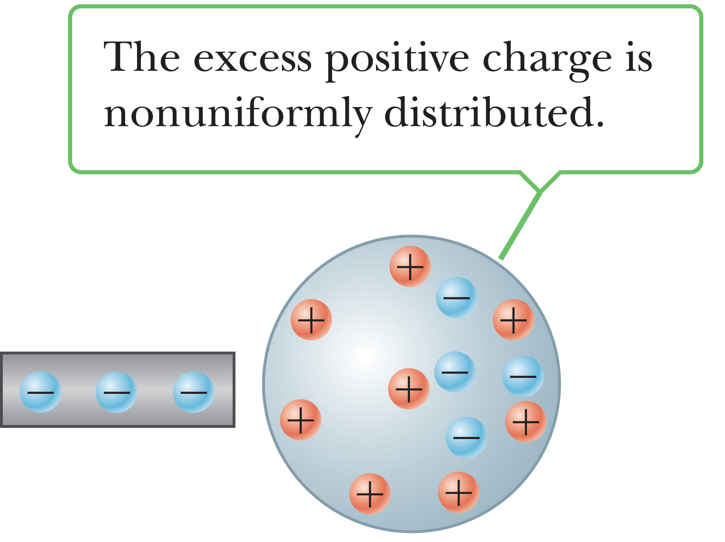
Charging by Induction
We can then remove the ground and the sphere is now positively charged.

Slide 21
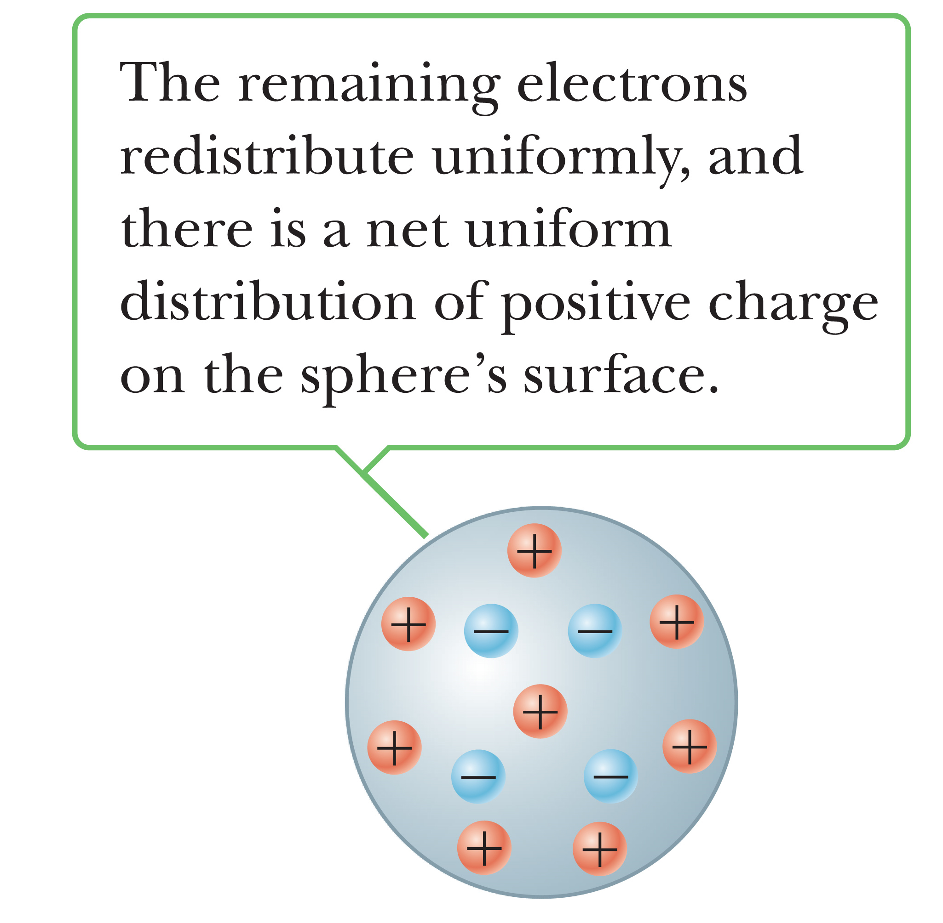
Charging by Induction

Slide 22
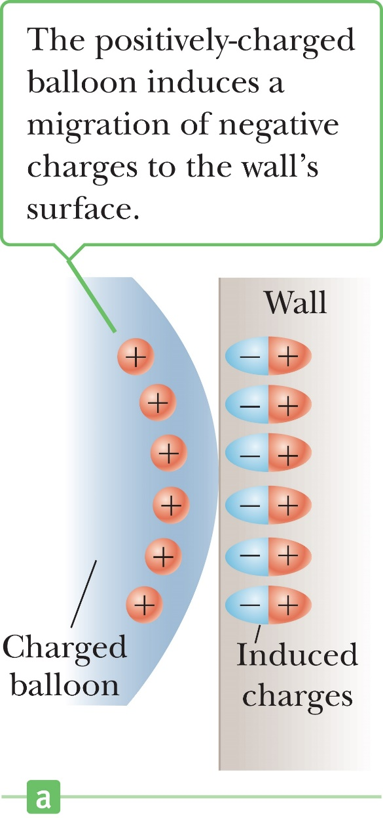
Charging by Induction
When we think of atoms the positive charged is in the center of the atom and the negative charge is on the outside.
However when in the presence of a field the charge distribution becomes split into a positive pole and a negative pole.
This is called polarization.

Slide 23
Charging by Induction
A suspended object A is attracted to a neutral wall. It's also attracted to a positively-charged object B. Which of the following is true about object A?
It is uncharged.
It has a negative charge.
It has a positive charge.
It may be either charged or uncharged.

Slide 24
Coulomb’s Law
Properties of Electric Force:
Directed along a line joining the two particles and inversely proportional to the square of the separation distance
Proportional to the product of the magnitudes of the charges of the two particles
Attractive if the charges are of opposite sign and repulsive if the charges have the same sign

Slide 25
Coulomb’s Law
It takes 6.3 x 10¹⁸ protons to equal 1 C.

Slide 26
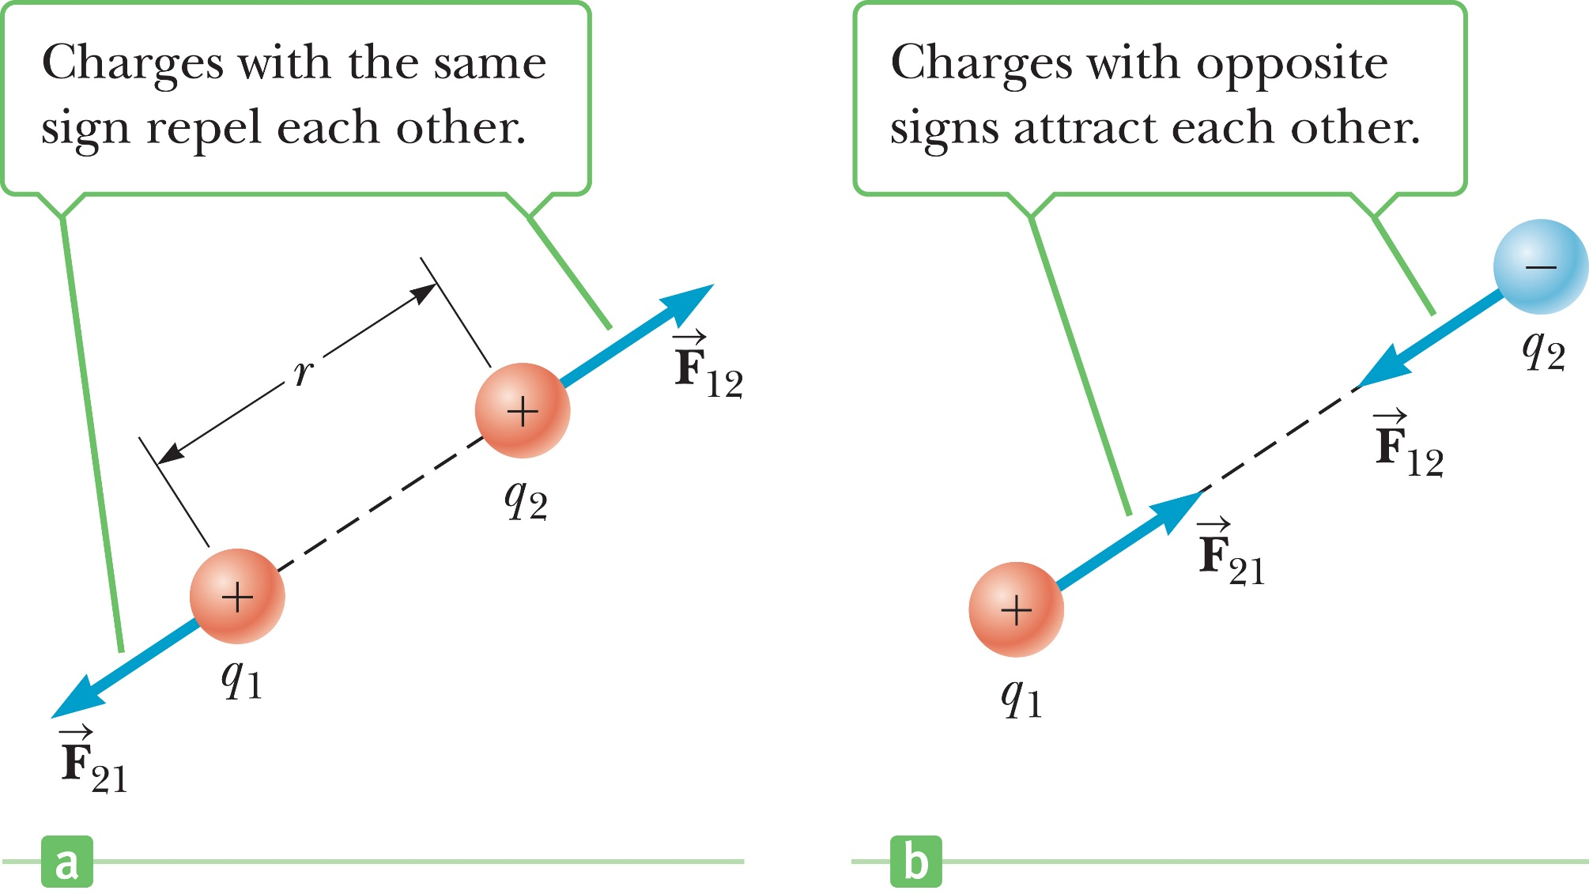
Coulomb’s Law

Slide 27
Coulomb’s Law
Object A has a charge of +2 µC, and object B has a charge of +6 µC. Which statement is true?

Slide 28
Coulomb’s Law
Electric forces: attractive or repulsive; gravitational forces: always attractive
Electric force much stronger than gravitational force

Slide 29
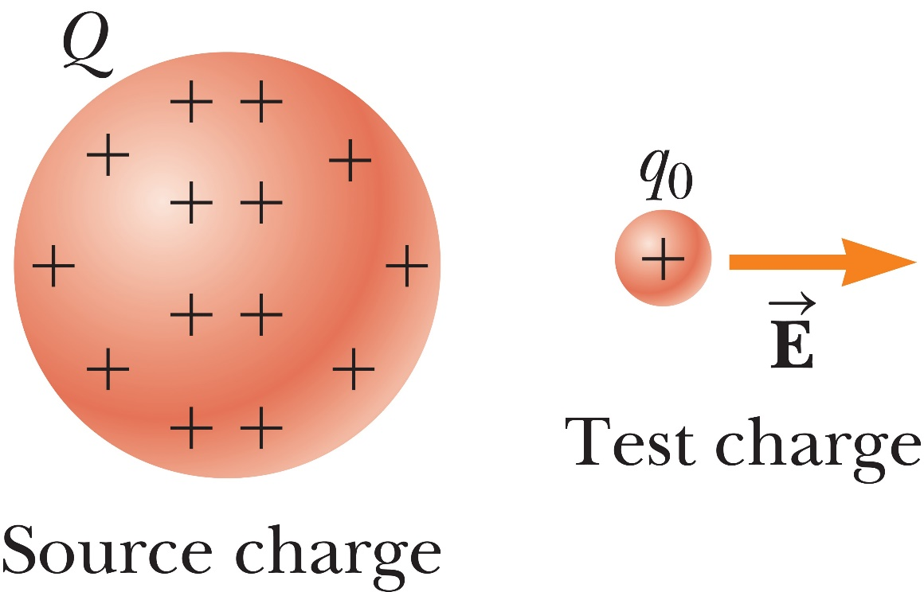
Electric Fields
When a small charge is placed near a big charge it is subjected to an electric field
This electric field is equal to the force vector divided by the charge of the smaller particle.

Slide 30
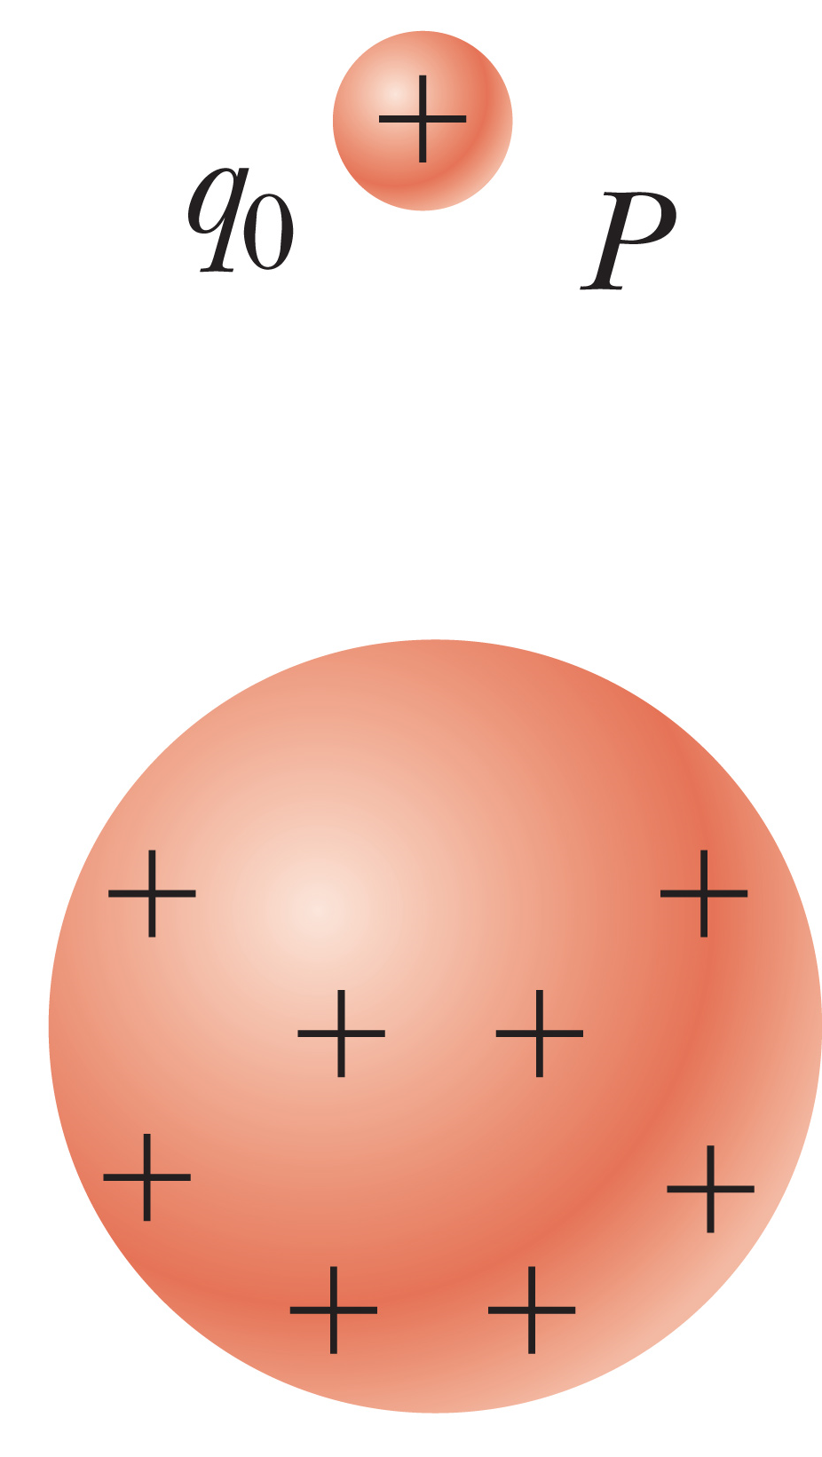
Electric Fields
If the smaller charge is relatively the same as our big charge, then a redistribution of charge occurs in our big charge.

Slide 31
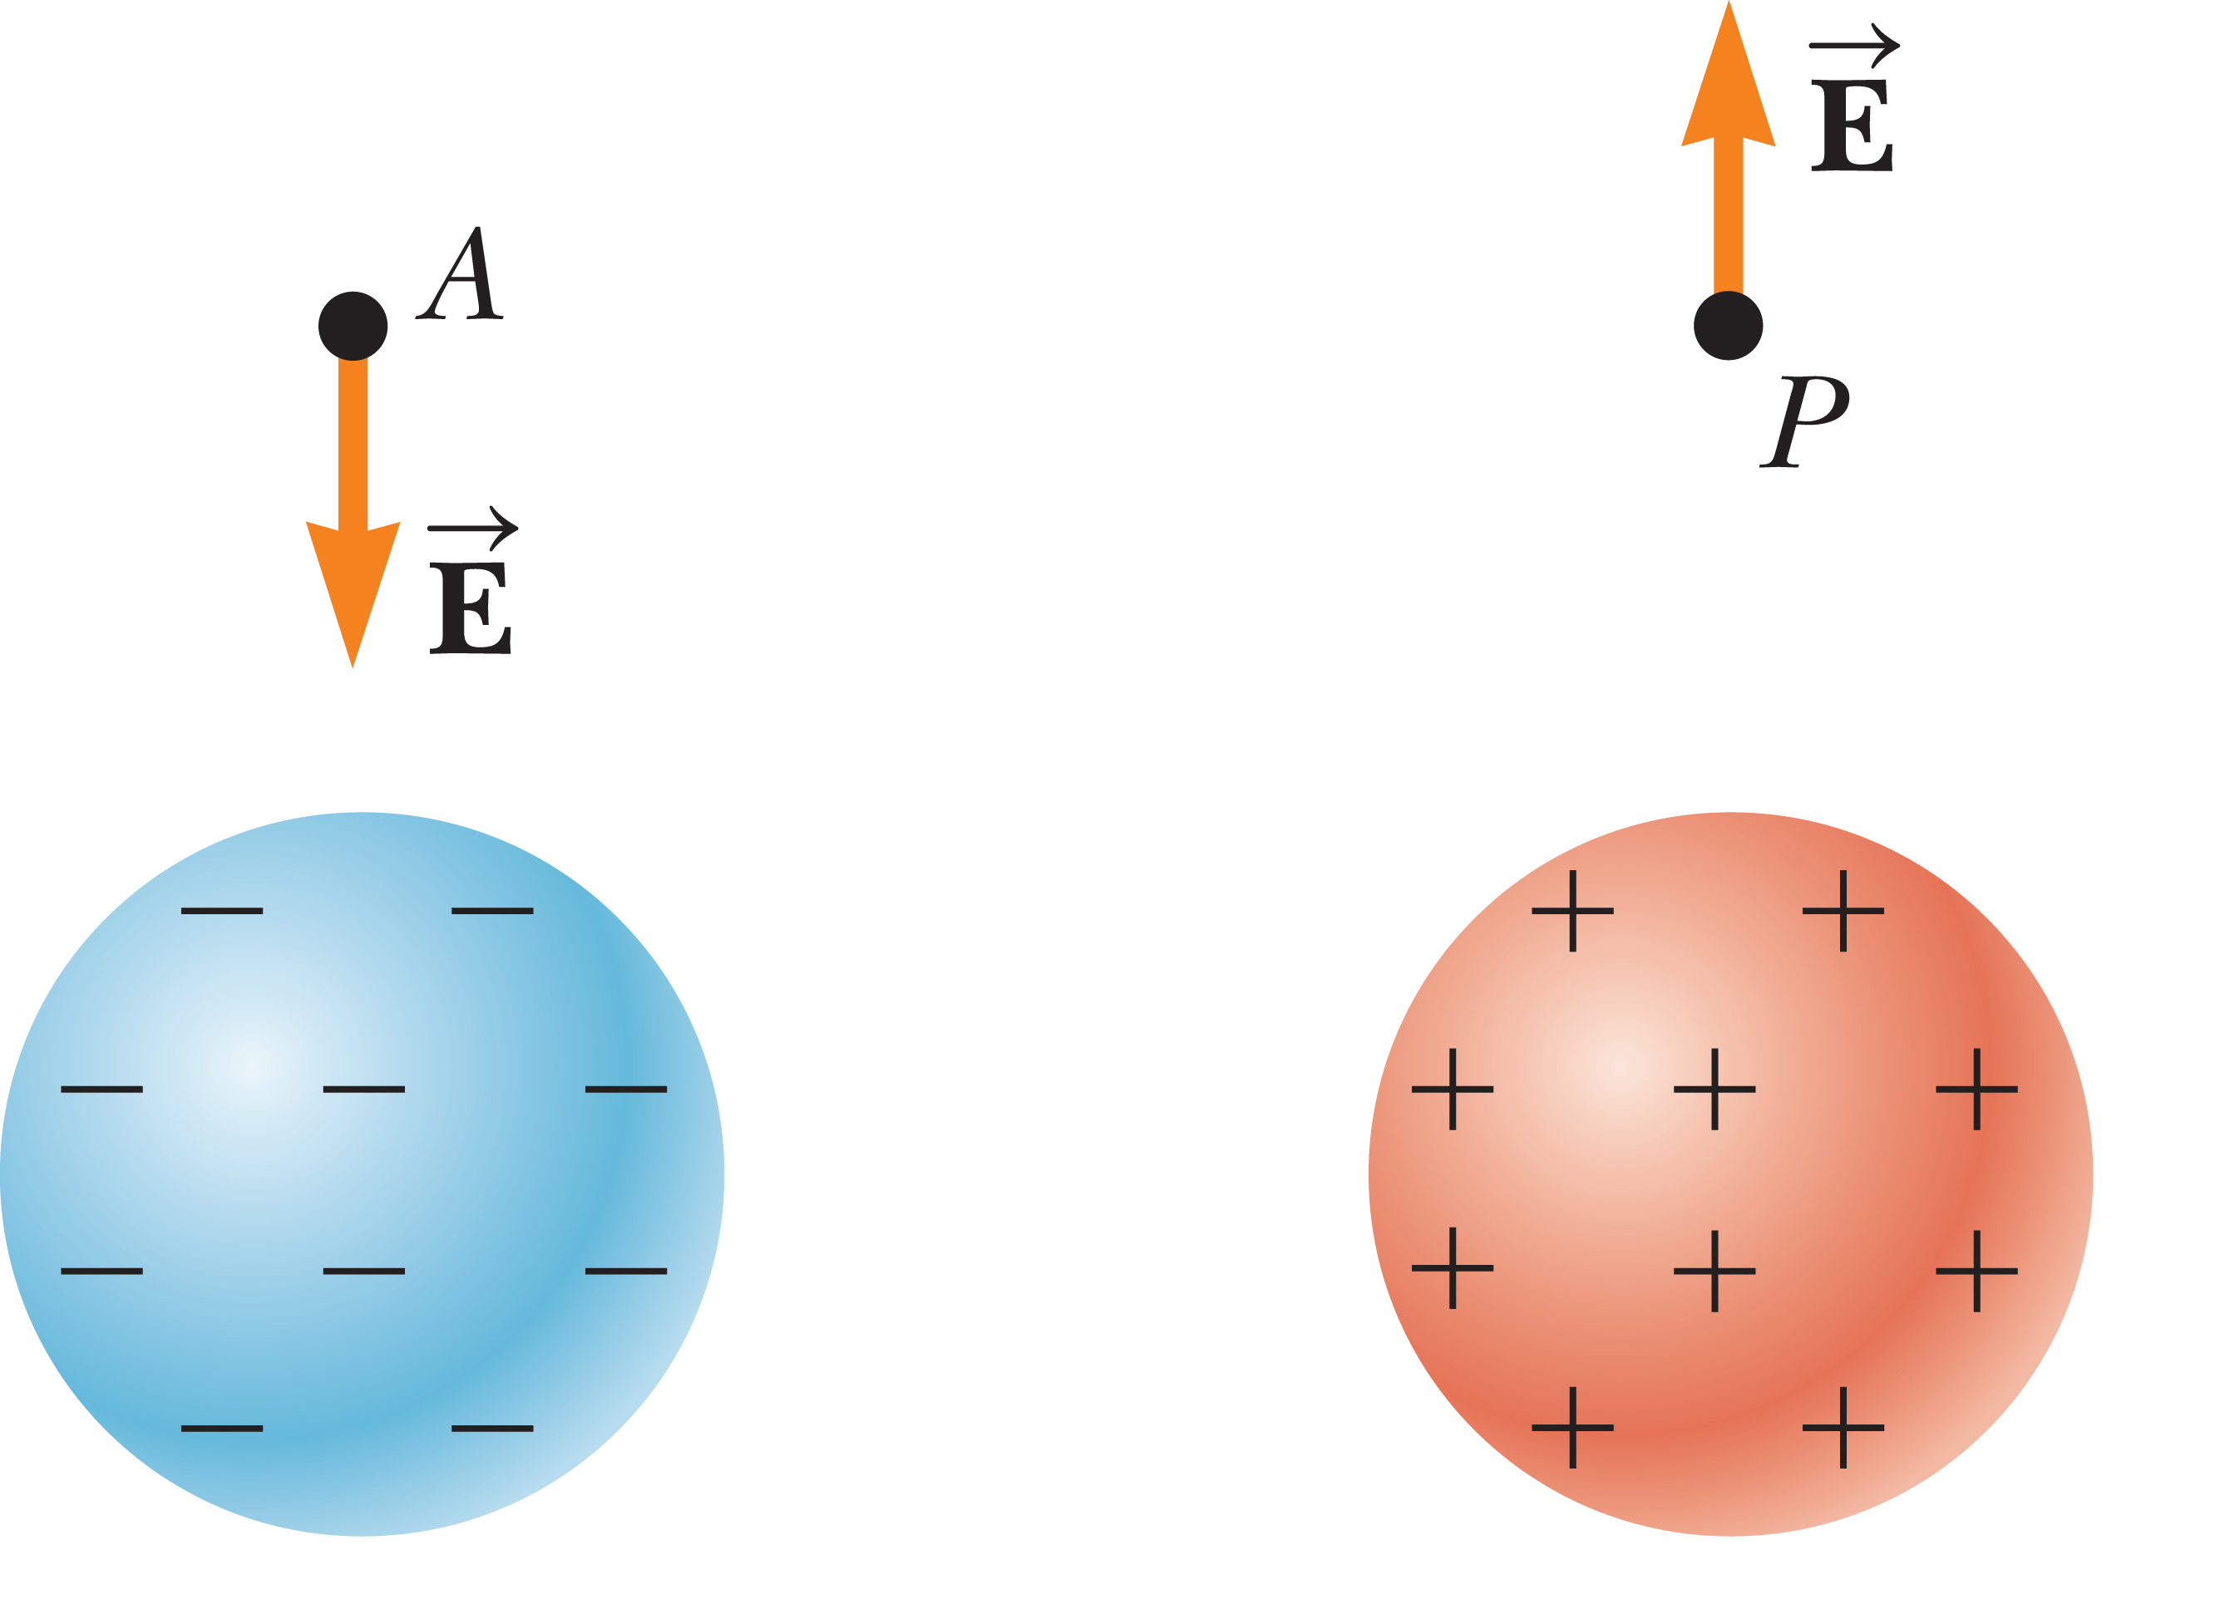
Electric Fields
The direction of the electric field always points to where the charge is moving. If A is a positive charge then the directions of the fields are as shown.

Slide 32
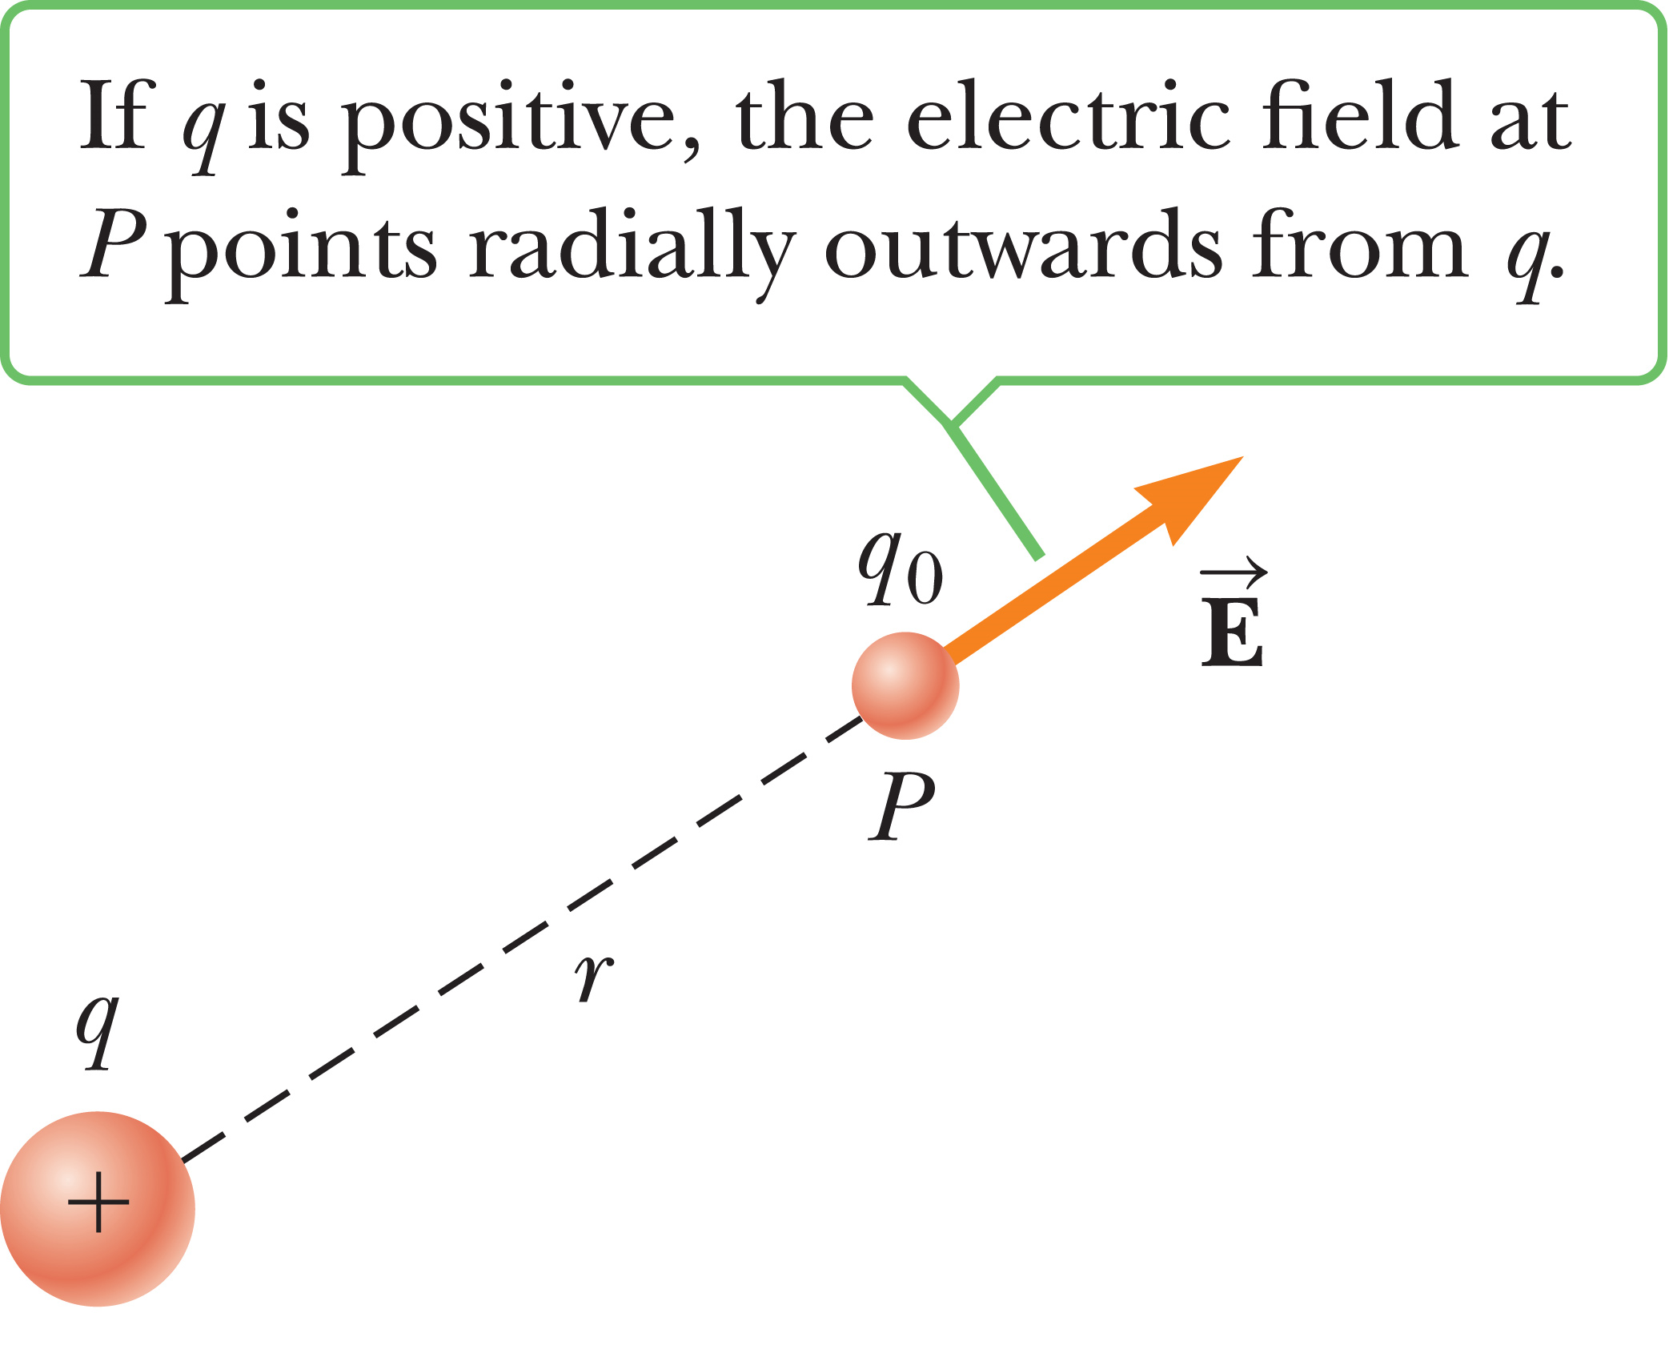
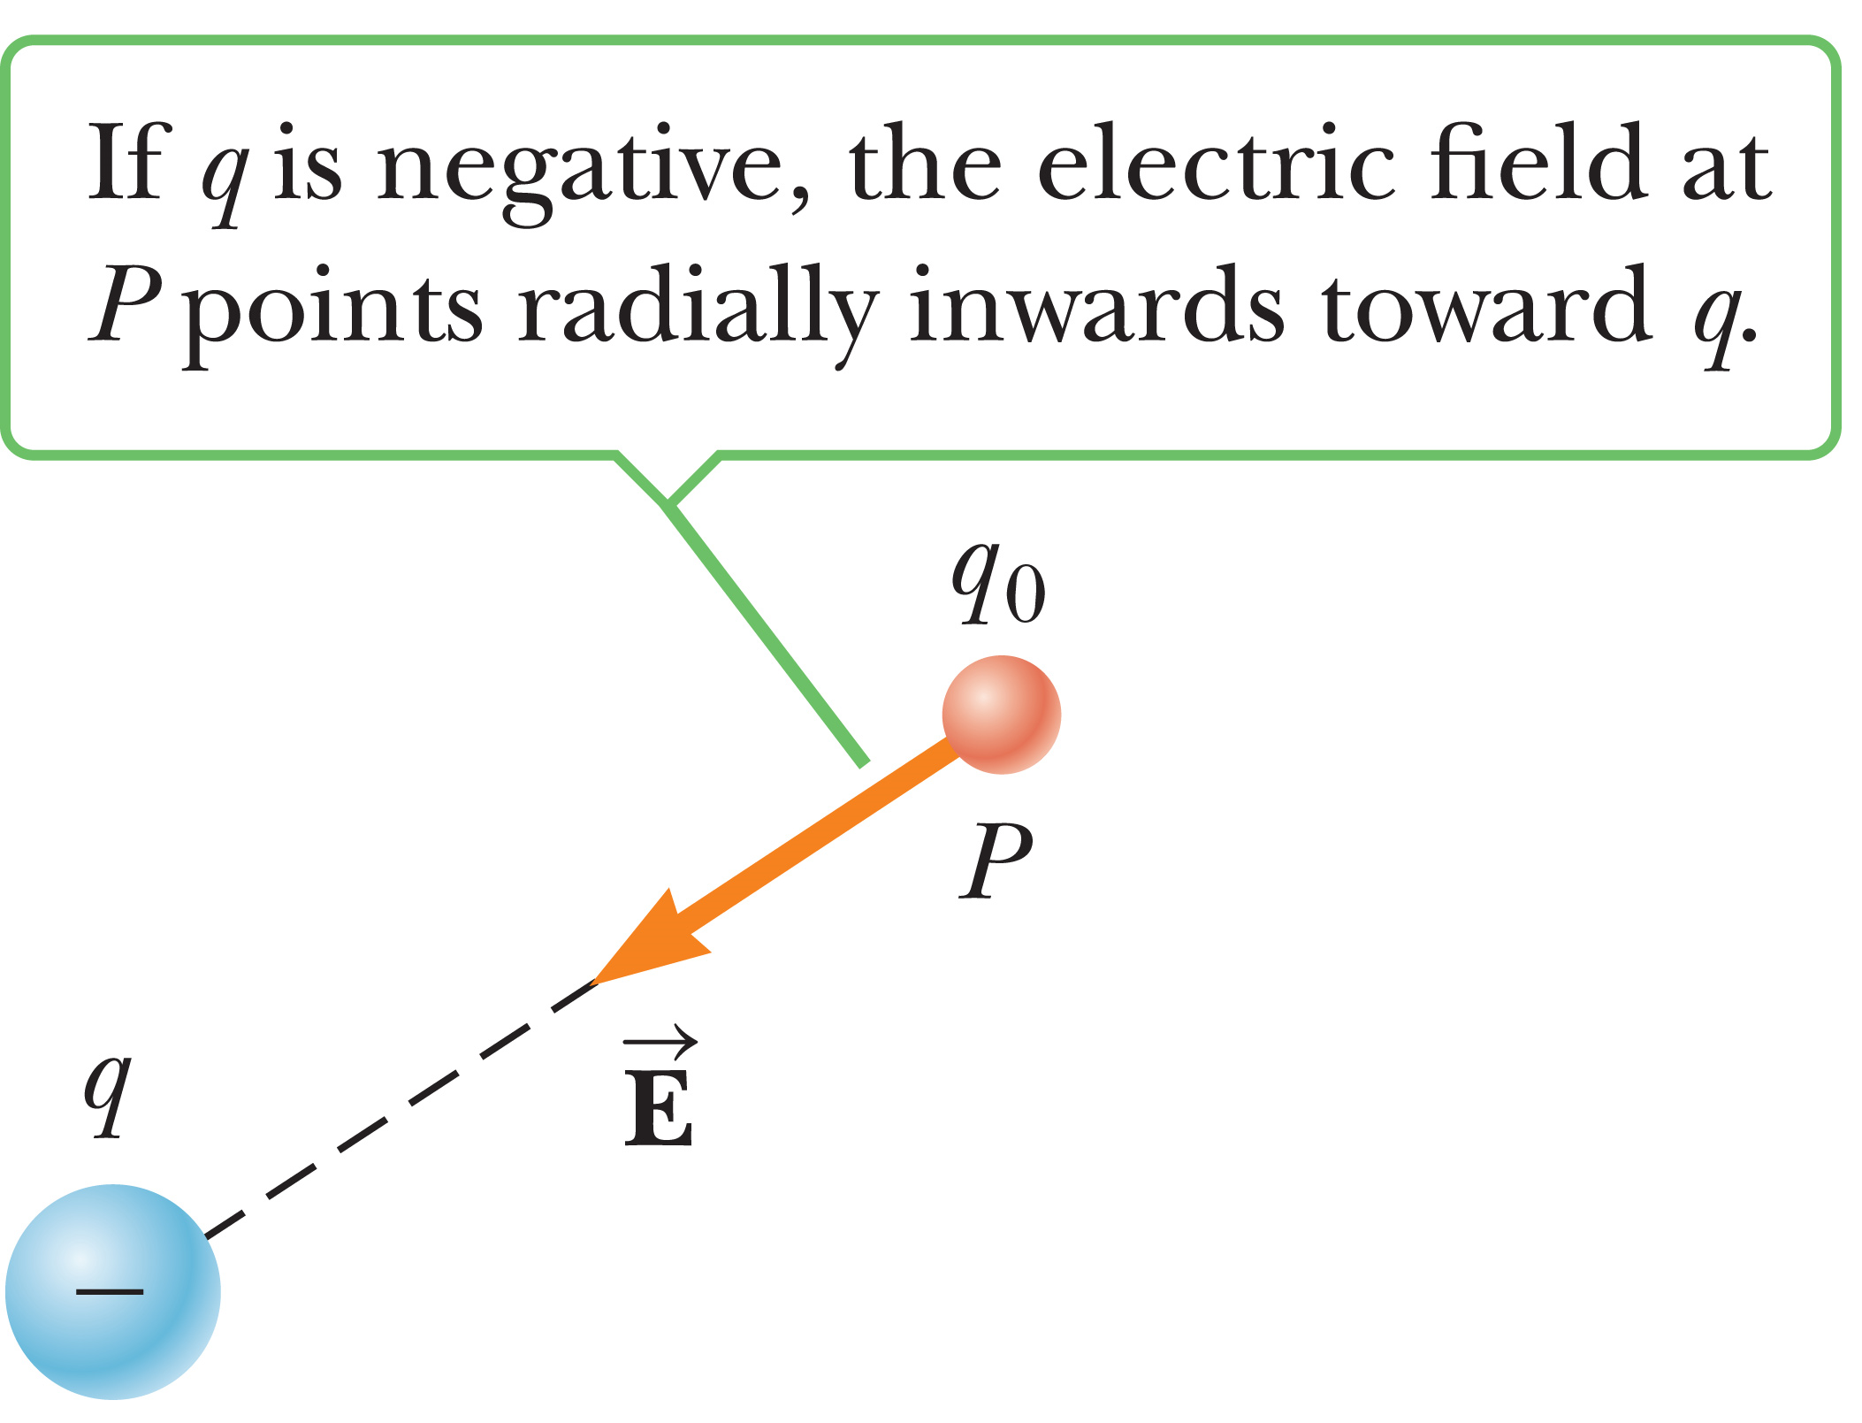
Electric Fields

Slide 33
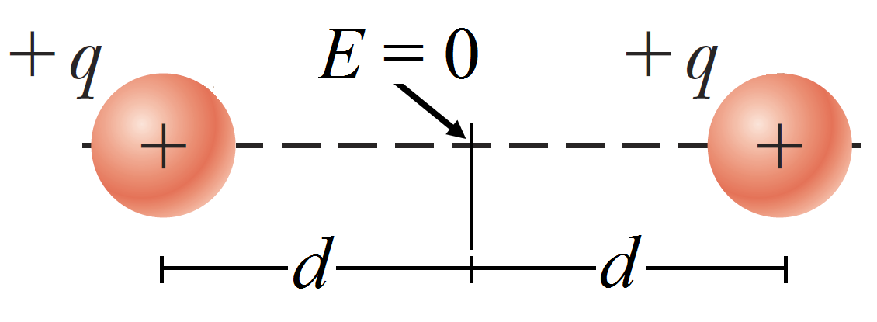
Electric Fields
Electric fields follow the superposition principle (CRAZY!)
Meaning in a system with multiple source charges we can calculate the electric field induced by each charge at a point to determine the net electric field.

Slide 34
Electric Fields
A test charge of +3 μC is at a point P where the electric field due to other charges is directed to the right and has a magnitude of 4 × 10⁶ N/C. If the test charge is replaced with a –3 μC charge, the electric field at P
has the same magnitude as before, but changes direction.
increases in magnitude and changes direction.
remains the same.
decreases in magnitude and changes direction.

Slide 35
Electric Fields
A circular ring of charge of radius b has a total charge q uniformly distributed around it. Choose the magnitude of the electric field at the center of the ring.
0
k_{e}q/b²
k_{e}q²/b²
k_{e}q²/b
None of these answer choices is correct.

Slide 36
Electric Fields
A “free” electron and a “free” proton are placed in an identical electric field. Is the following statement true or false?
Each particle is acted upon by equal-magnitude electric forces and both have the same magnitude of acceleration.
False
True

Slide 37
Strategy for solving Electric Field and Force problems
Draw
2. Identify charge
3. Convert all units
4. Apply Coulomb’s law
5. Sum all the x-components
6. Sum all the y-components
7. Use the Pythagorean theorem and trigonometry

Slide 38
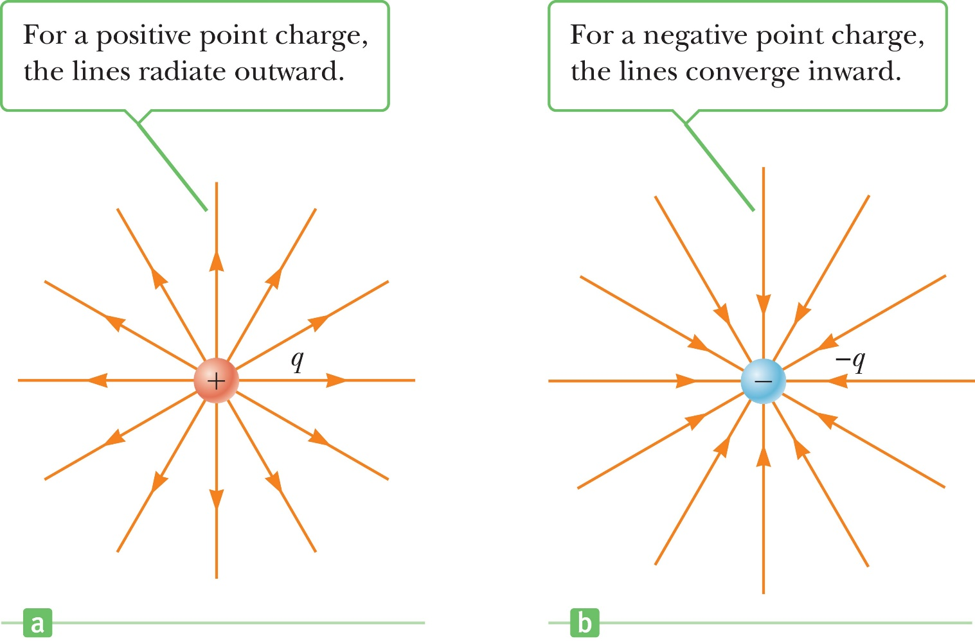
Electric Field Lines
E is tangent to the electric field lines at each point
The number of lines proportional to the field strength

Slide 39
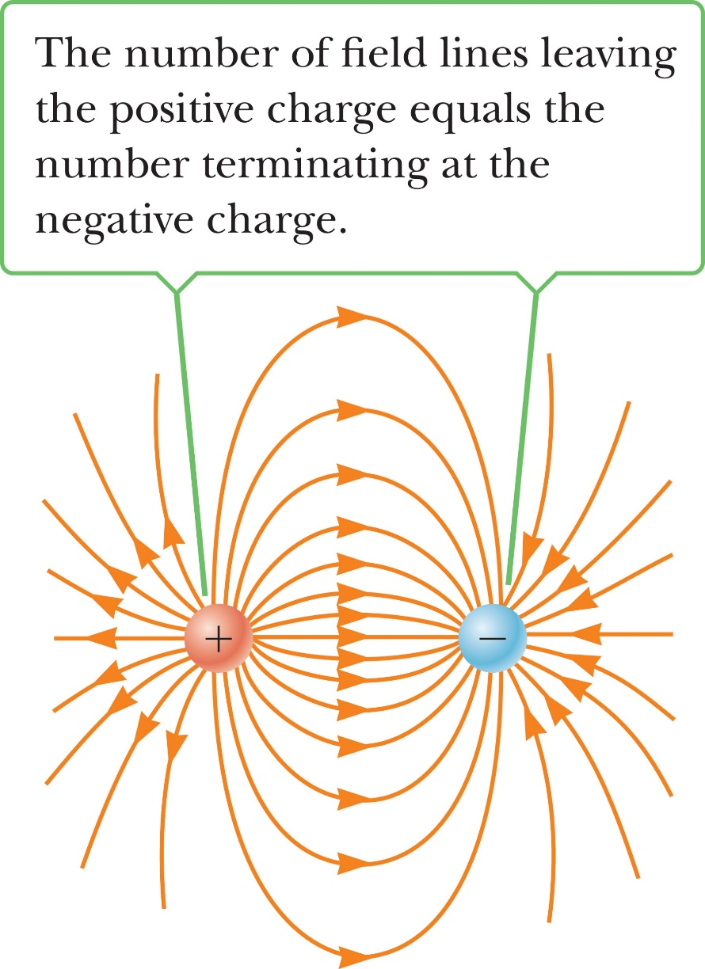
Electric Field Lines
Drawing Field Lines:
Lines begin on positive charges and end on negative charges
Number of lines is proportional to charge magnitude
Field lines cannot cross

Slide 40
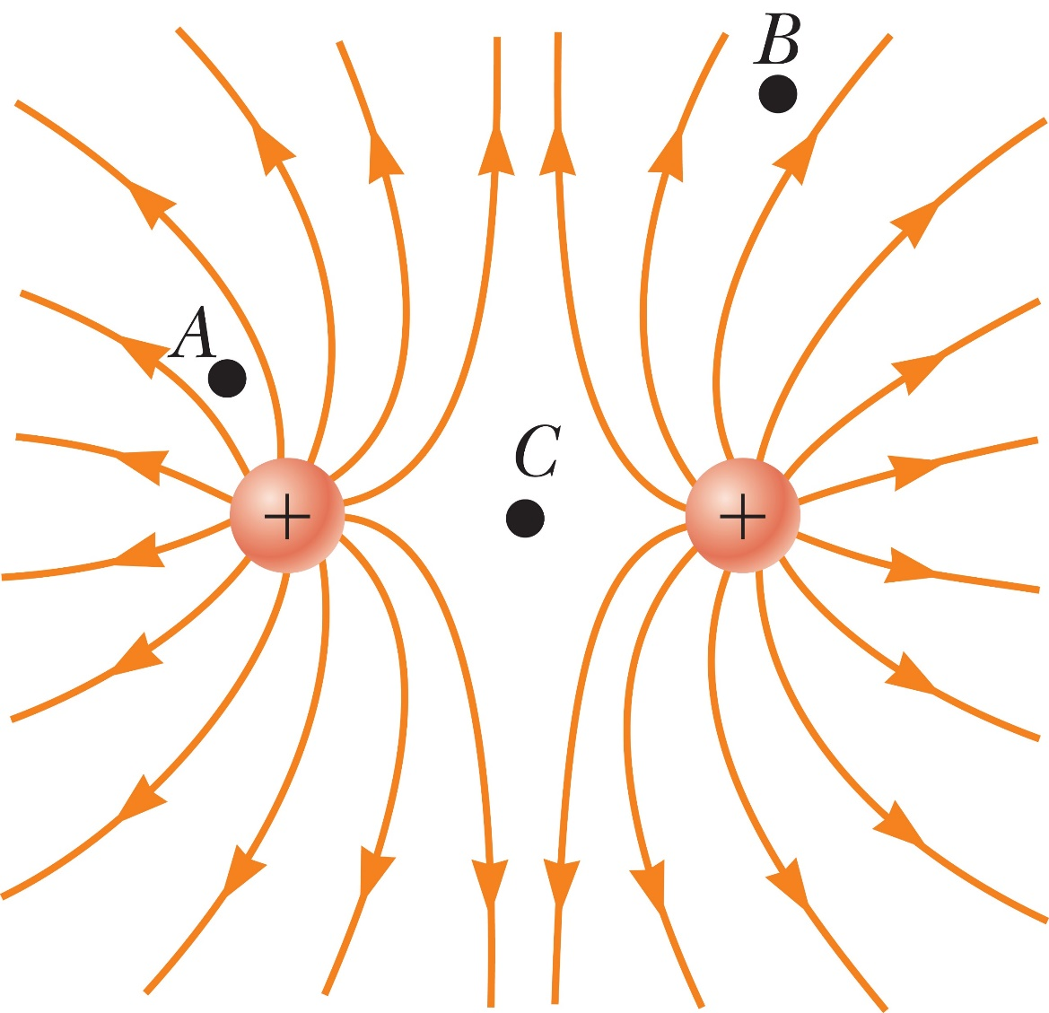
Electric Field Lines

Slide 41

Electric Field Lines
Rank the magnitude of the electric field at points A, B, and C in the figure below, largest magnitude first.
A, B, C
A, C, B
C, A, B
The answer can't be determined by visual inspection.

Slide 42
Conductors in Electrostatic Equilibrium
Simply put: If the electric field is zero at every point within your conducting material then the material is said to be in electrostatic equilibrium.

Slide 43
Electric Flux & Guass’s Law
Electric Flux is a means to describe the electric field that propagates through a surface.
It basically let’s us calculate the average electric field across a surface.
The electric flux is proportional to the number of field lines that pass through some area A oriented perpendicular to the field.
You multiply the Electric Field by the Area of the surface

Slide 44
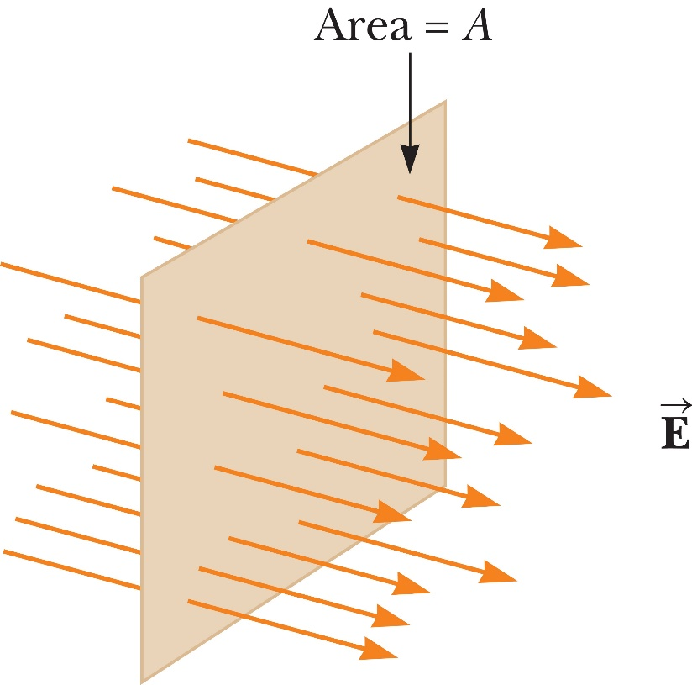
Electric Flux

Slide 45
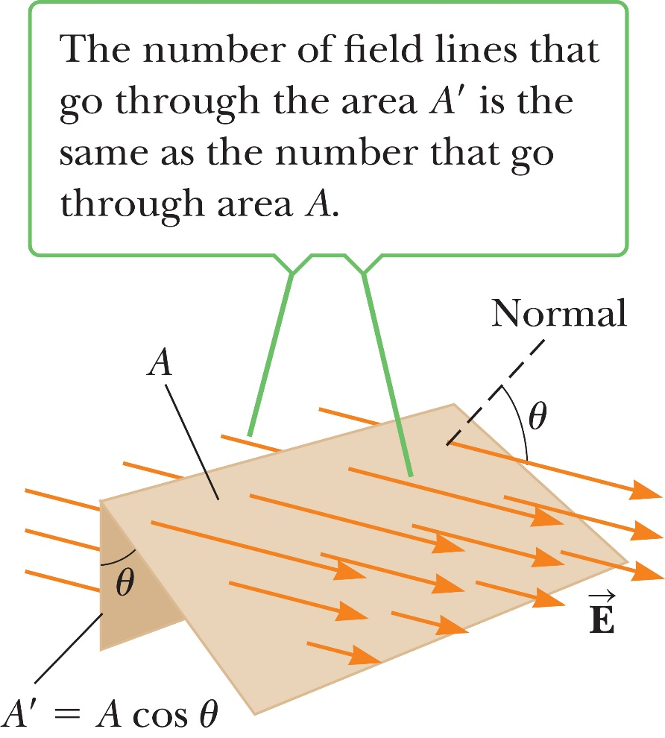
Electric Flux

Slide 46
Electric Flux
Calculate the magnitude of the flux of a constant electric field of 5.00 N/C in the z-direction, through a rectangle with area 4.00 m² in the xy-plane.

Slide 47
Electric Flux
Calculate the magnitude of the flux of a constant electric field of 5.00 N/C tilted 60° away from the positive z-direction, through a rectangle with area 4.00 m² in the xy-plane.

Slide 48
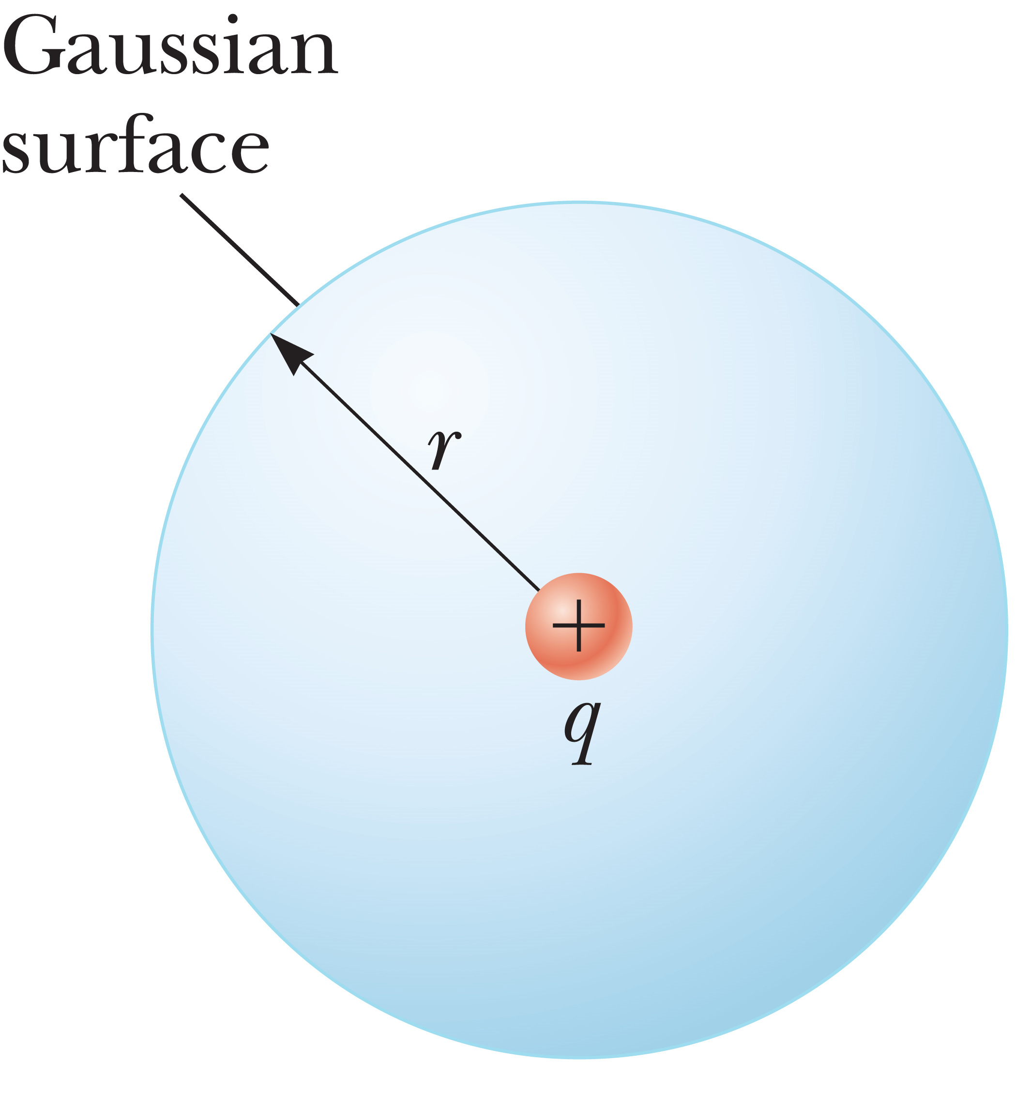
Guass’s Law
This is a law that describes the electric field that propagates through a spherical surface.

Slide 49
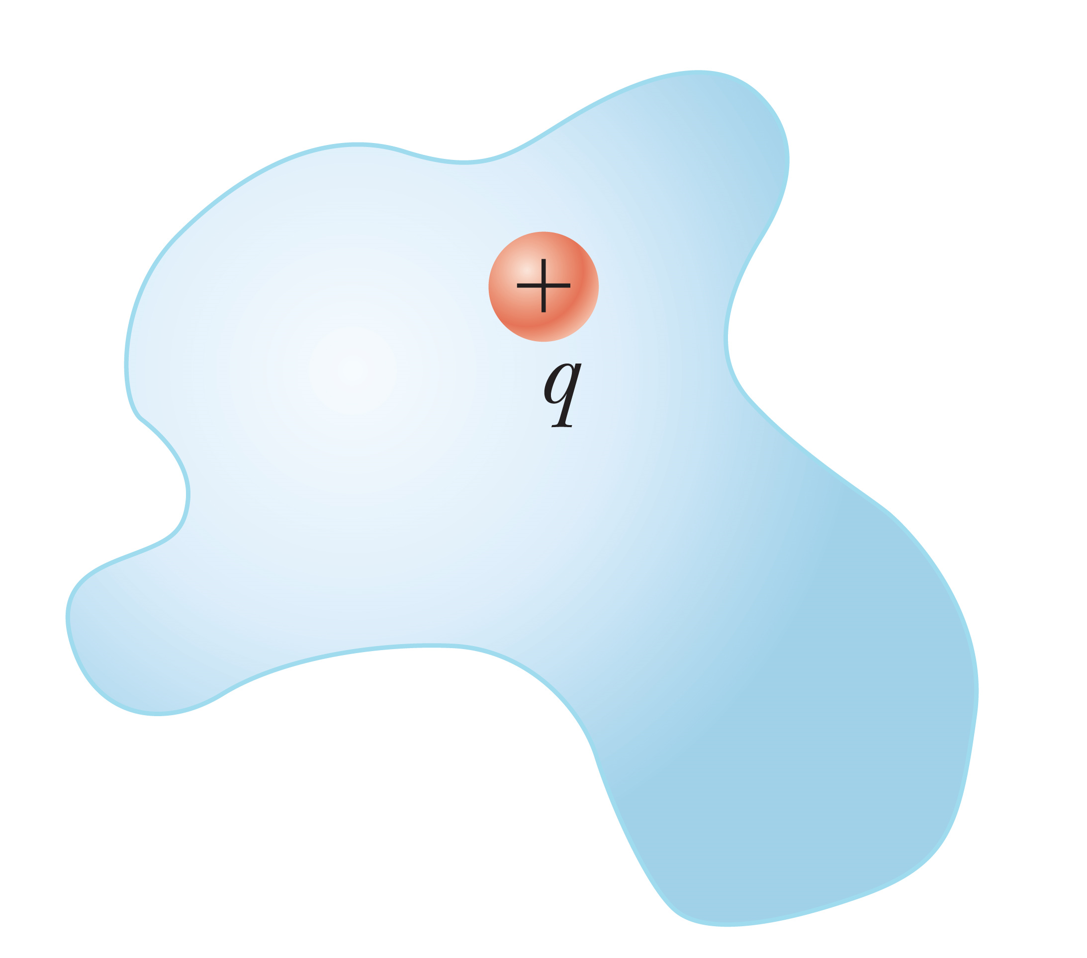
Guass’s Law
Main takeaway is that gauss’s Law only takes into account charges on the inside of our surface.

Slide 50
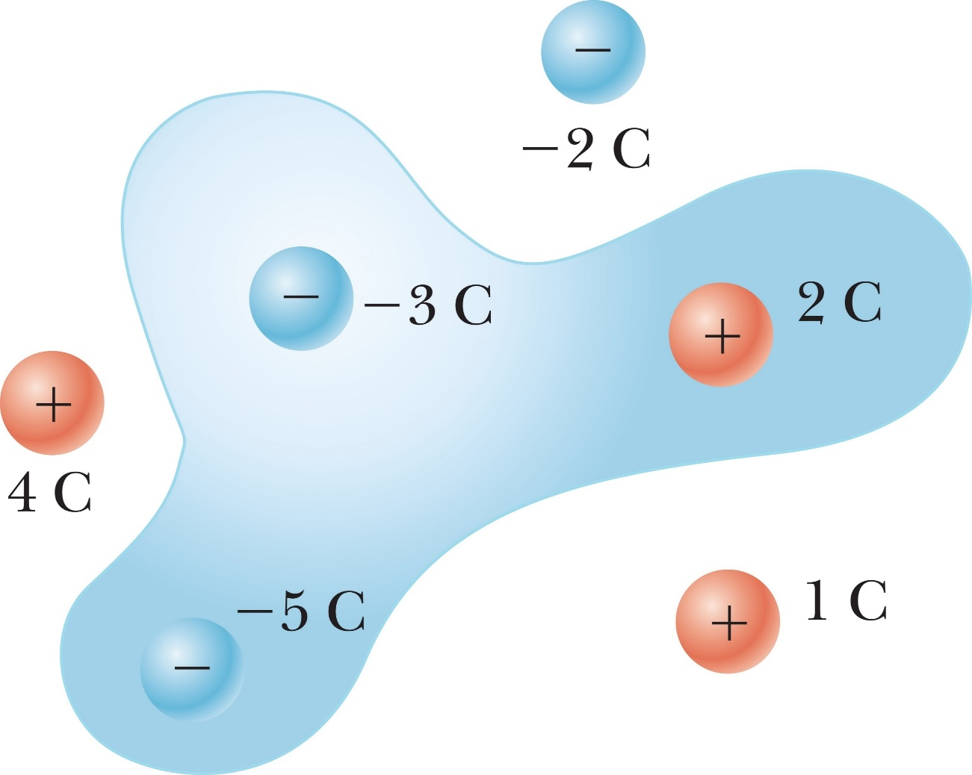
Guass’s Law
Find the electric flux through the surface in the figure below.

Slide 51
Guass’s Law
For a closed surface through which the net flux is zero, each of the following four statements could be true. Which of the statements must be true? (There may be more than one.)
(a) There are no charges inside the surface.
(b) The net charge inside the surface is zero.
(c) The electric field is constant everywhere on the surface.
(d) The number of electric field lines entering the surface equals the number leaving the surface.
(a) only 2. (b) only
3. (b) and (d) 4. (a) and (d)

Slide 52
Guass’s Law
For a closed surface through which the net flux is zero, each of the following four statements could be true. Which of the statements must be true? (There may be more than one.)
(a) There are no charges inside the surface.
(b) The net charge inside the surface is zero.
(c) The electric field is constant everywhere on the surface.
(d) The number of electric field lines entering the surface equals the number leaving the surface.
(a) only 2. (b) only
3. (b) and (d) 4. (a) and (d)

Slide 53
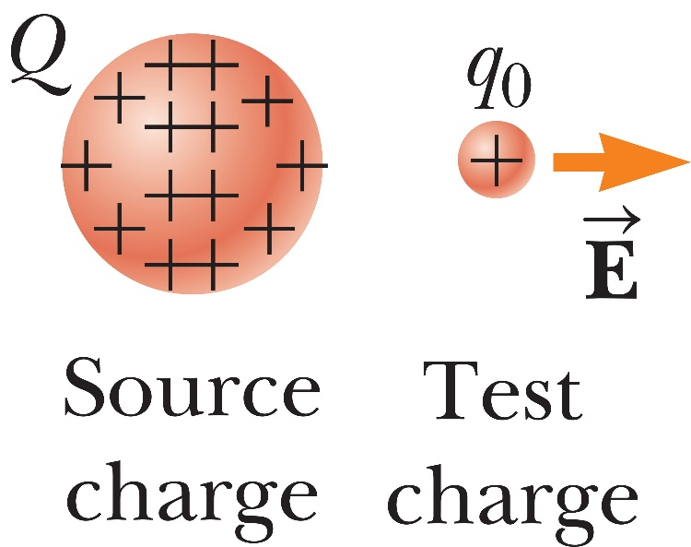
Summary
Electric Charges, Insulators, and Conductors
Coulomb’s Law
Electric Fields

Slide 54

Summary
Electric Field Lines
Conductors in Electrostatic Equilibrium
Electric Flux and Gauss’s Law

Slide 55
Applied Practice
A 7.50-nC charge is located 1.80 m from a 4.20-nC charge. (a) Find the magnitude of the electrostatic force that one particle exerts on the other. (b) Is the force attractive or repulsive?
Notes:
Ans: 8.74 x 10^-8 N

Slide 56
Applied Practice
A small sphere of mass m = 7.50 g and charge q₁ = 32.0 nC is attached to the end of a string and hangs vertically. A second charge of equal mass and charge q₂ = -58.0 nC is located below the first charge a distance d = 2.00cm below the first charge. (a) Find the tension in the string. (b) If the string can withstand a maximum tension of 0.180 N, what is the smallest value d can have before the string breaks?
Notes:
Ans: (a) T = 0.115 N (b) d = 1.25 cm

Slide 57
Applied Practice
Two small identical conducting spheres are placed with their centers 0.30 m apart. One is given a charge of 12 x 10⁻⁹ C and the other a charge of -18 x 10⁻⁹ C. (a) Find the electrostatic force exerted on one sphere by the other. (b) The spheres are connected by a conducting wire. Find the electrostatic force between the two after equilibrium is reached, where both spheres have the same charge.
Notes:
Ans: 2.2 x 10^-5N and 9.0 x 10^-7 N

Slide 58
Applied Practice
Who wants to bet?
Particle A of charge 2.00 x 10⁻⁴ C is at the origin. Particle B of charge -6.00 x 10⁻⁴ is at (4.00m, 0). Particle C of charge 1.00 X 10⁻⁴ C is at (0,3.00m). Find the resultant electrostatic force vector of Particle A.

Slide 59
Applied Practice
An electron is accelerated by a constant electric field of magnitude 300N/C. (a) Find the acceleration of the electron. (b) what is the velocity of the electron after 1.00 x 10⁻⁸ seconds, assuming it started from rest.
Mass of electron = 9.11 x 10⁻³¹ kg

Slide 60
Applied Practice
Three point charges are located on a circular arc as shown. What is the total electric field at P, The center of the arc?

Slide 61
Applied Practice
A uniform electric field of magnitude E = 435 N/C makes an angle of 65.0⁰ with a plane surface of area A = 3.50 m². Find the electric flux through the surface.
Notes:
Answer E = 1.38 x 10^3 N*m²/C

Slide 62
Applied Practice
Four closed surfaces, S₁ through S₄, together with the charges -2Q, Q, and -Q are sketched in the figure. Find the electric flux through each surface.
Notes:
Answer E = 1.38 x 10^3 N*m²/C

Slide 63
AP Physics
Chapter 15: Electric Forces and Fields
HW: Pg 521 – 525
Problems: 2,5,8,11,15,22,23,25,30,32,34,45
Win bet: Take away #8
Loose bet: Better do all the problems

