Slide 1
Chemistry
Chapter 9
Covalent Bonding –
Hybridization and Bonding Types
Chapters: 9.1 & 9.2

Slide 2
Hybridization – What is it?
The mixing of two or more native atomic orbitals to form special orbitals for bonding.
These special orbitals are referred to as molecular orbitals.
Orbitals mixing together to form hybrid bonds.

Slide 3
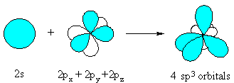
Example

Slide 4
Types of Hybridizations
sp
sp²
sp³
dsp³
d²sp³
You will need to know all of these!

Slide 5
sp hybridization orbital
The hybridization of a single s and a single p orbital
Note: Hybridized orbitals have the same energy

Slide 6
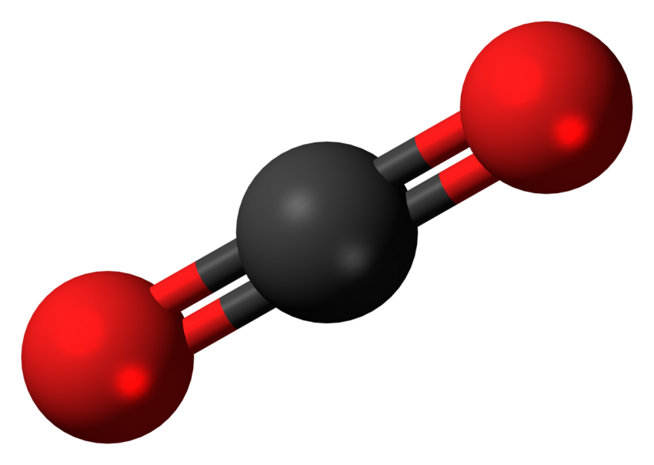
sp example for the carbon atom:
CO2
HCN
What do these have in common?

Slide 7
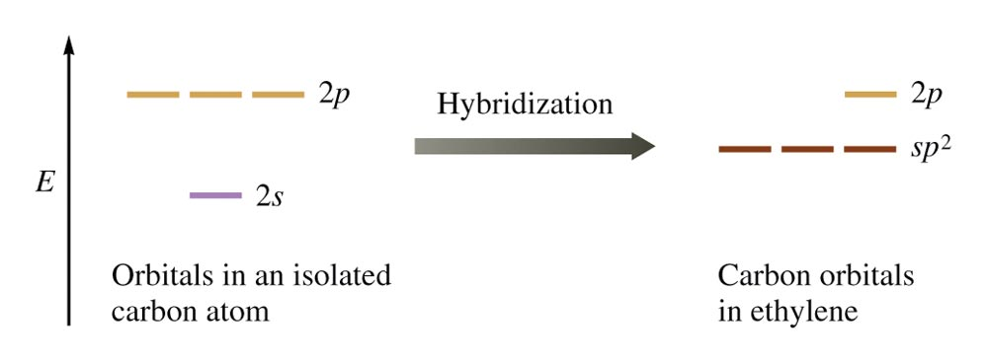
sp² hybridization orbital
The hybridization of a single s and two p orbitals

Slide 8
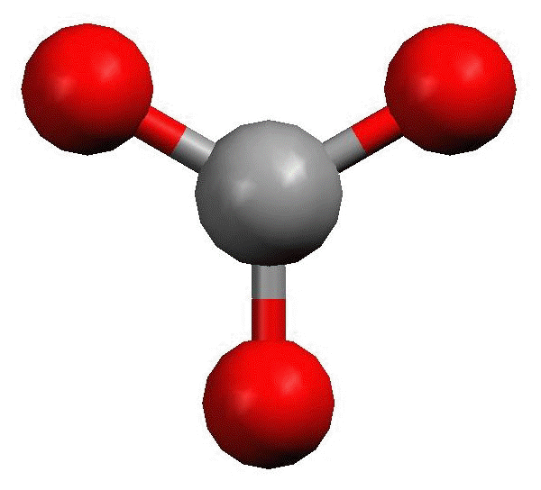
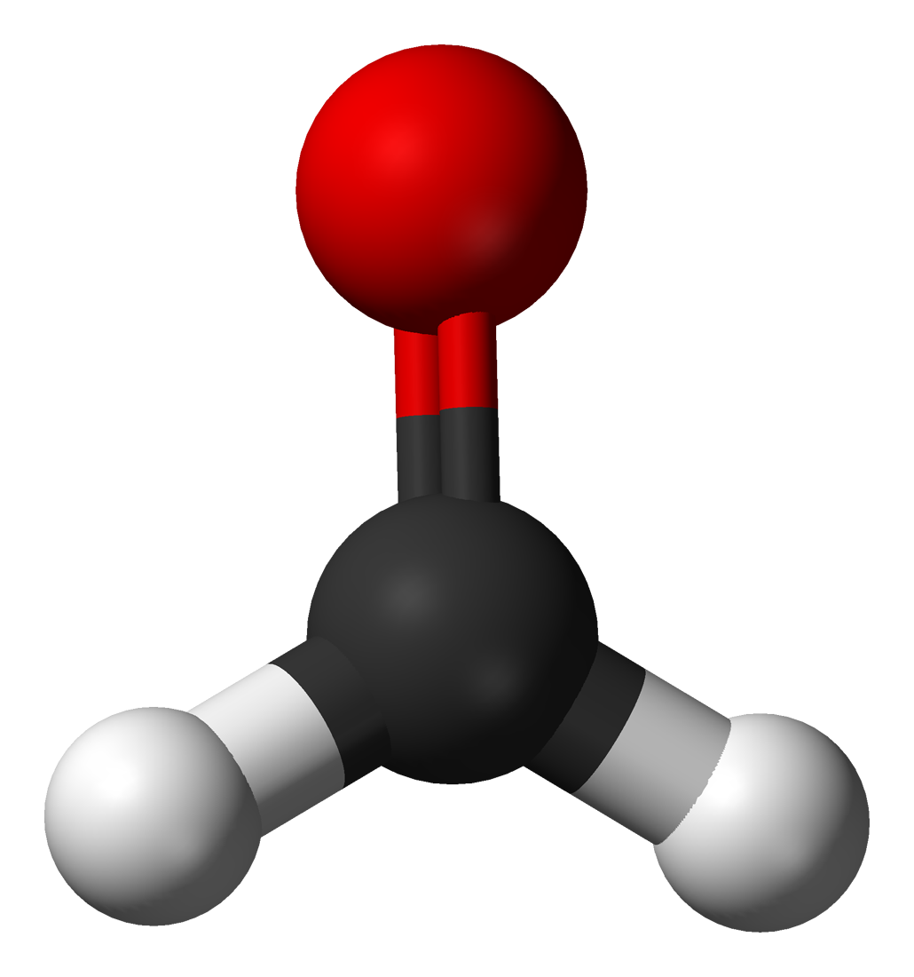
sp² Example:
BF₃
H₂CO
What do these have in common?

Slide 9
sp³ hybridization orbital
The hybridization of a single s and three p orbitals

Slide 10
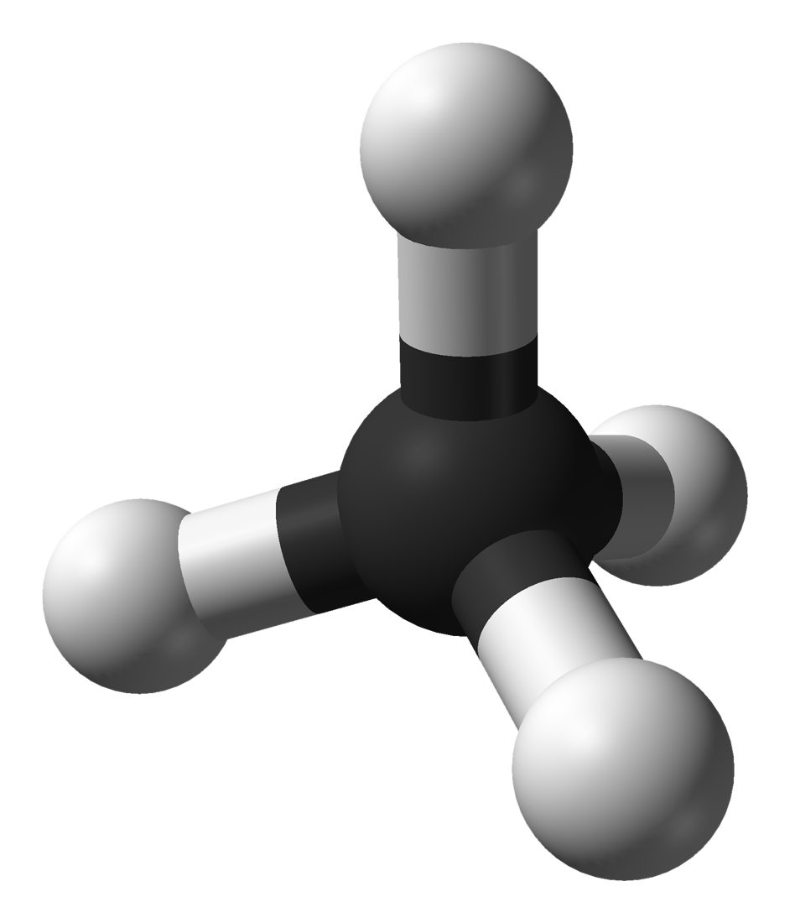
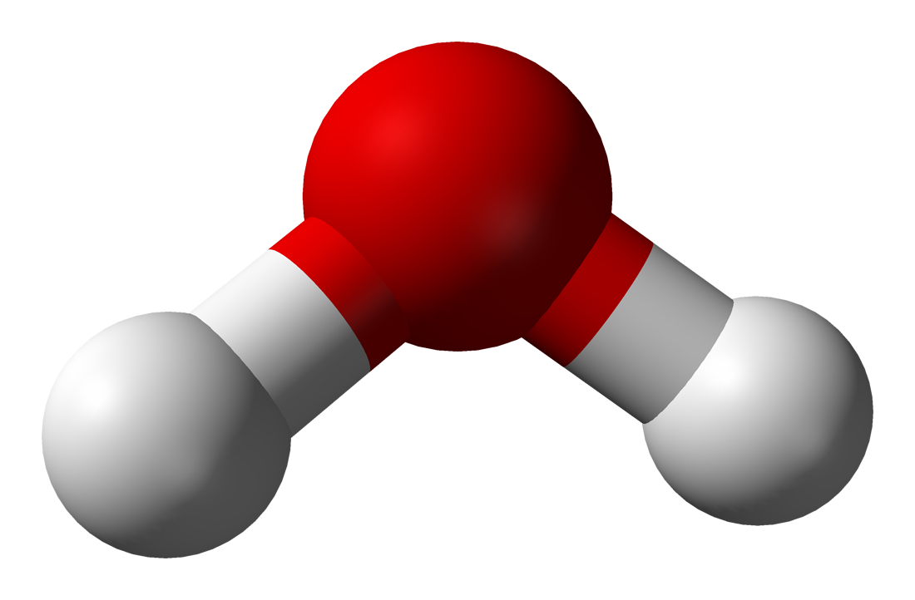
sp³ Example:
CH₄
H₂O
What do these have in common?

Slide 11
dsp³ hybridization orbital
The hybridization of a single s orbital, three p orbitals, and one d orbital

Slide 12
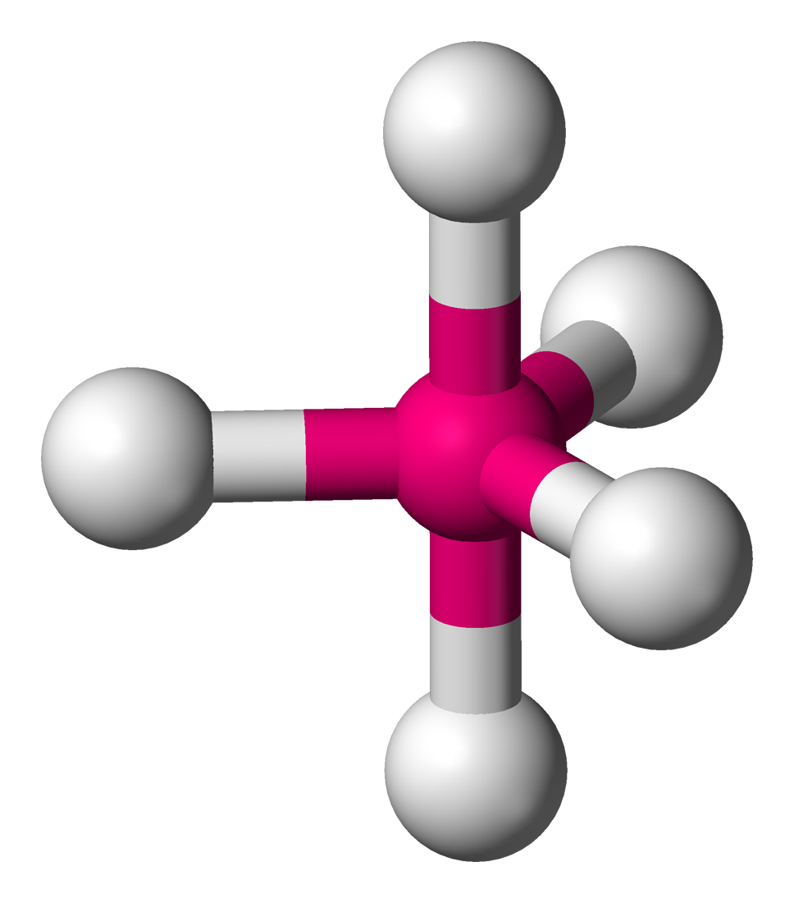
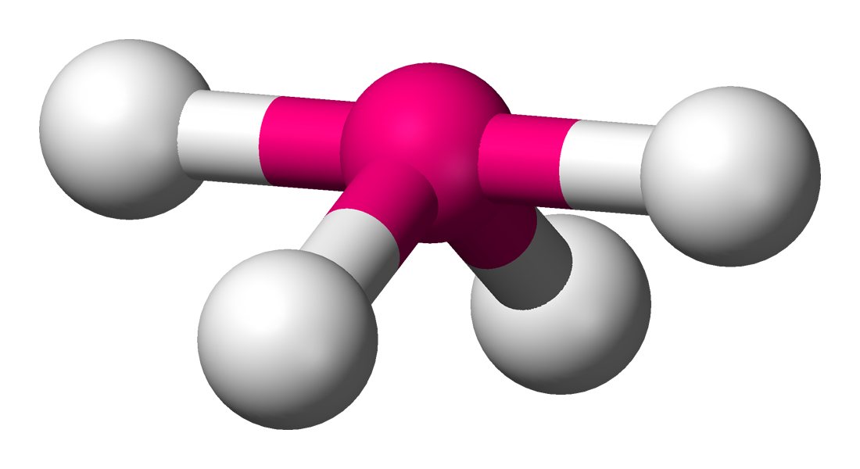
dsp³ Example:
PF₅
SF₄
What do these have in common?

Slide 13
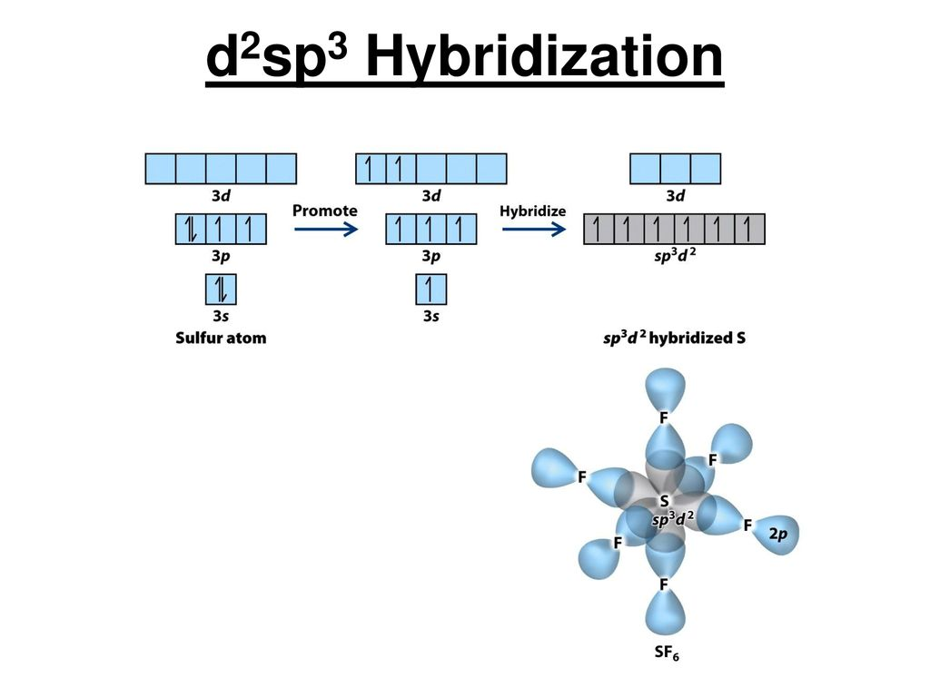
d²sp³ hybridization orbital
The hybridization of a single s orbital, three p orbitals, and two d orbitals.

Slide 14
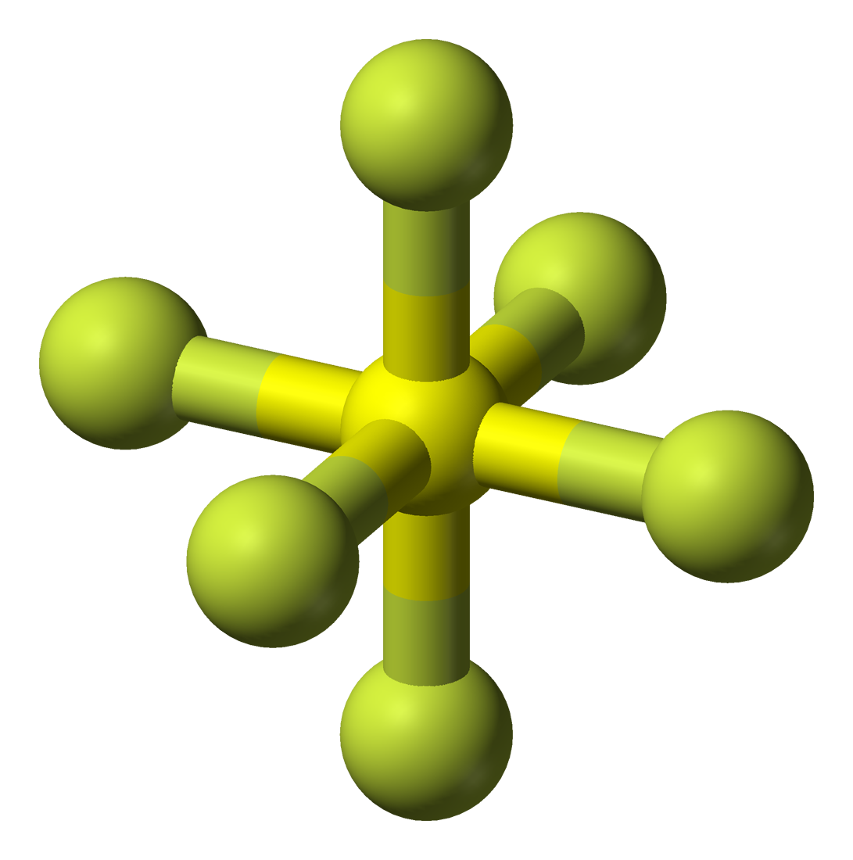
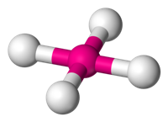
d²sp³ Example:
SF₆
XeF₄
What do these have in common?

Slide 15
Hybridization Continued
We have only been looking at the hybridization of the central atom so far.
In reality atoms within the same molecule can have different hybridizations.
It is important to keep in mind what atom we are looking at within the molecule.

Slide 16
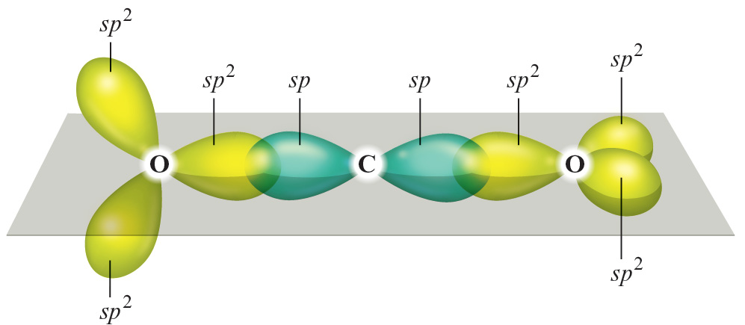
Multiple Hybridizations Example:
CO₂

Slide 17
Strategy for determining hybridizations
First draw the correct Lewis Dot structure of the molecule
2. Count the number of “Things” around the atom in question
All bonds count as one “Thing”
Electron pairs count as one “Thing”
3. The number of things equals the number of orbitals in the hybridization.

Slide 18
Strategy for determining hybridizations
sp = 2 things
sp² = 3 things
sp³ = 4 things
dsp³ = 5 things
d²sp³ = 6 things

Slide 19
A table that may or may not be helpful
Type Hybridization Example
AB₂ sp BeF₂
AB₃ sp2 BF₃
AB₄ sp3 CH₄
AB₃E sp3 NH₃
AB₂E₂ sp3 H₂O
AB₅ sp3d PCl₅
AB₆ sp3d2 SF₆

Slide 20
Example
Determine the hybridization of the carbon, nitrogen, and oxygen atoms for OCN⁻.
O = sp³
C = sp
N = sp
O
C
N

Slide 21
Your turn!
Determine the hybridization of the nitrogen atom in NH₃.
Determine the hybridization of the carbon atom in C₂H₄.

Slide 22
Let’s up the ante
Determine the hybridizations of the Xe atom, and O atom in XeOF₂.
Determine the hybridizations of the sulfur atom and each oxygen atom in SO₃.

Slide 23
Types of bonds
There are two main types of bonds we will discuss in this class. (There are actually three common ones but let’s just focus on the two.)
There are sigma bonds represented with σ.
There are also pi bonds represented with π.

Slide 24
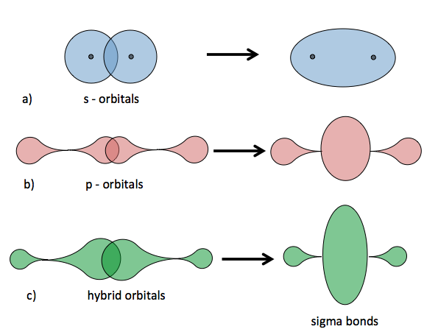
Sigma bonds (σ)
A bond that is similar to two bonding s orbitals. Every “single” bond is a sigma bond.

Slide 25
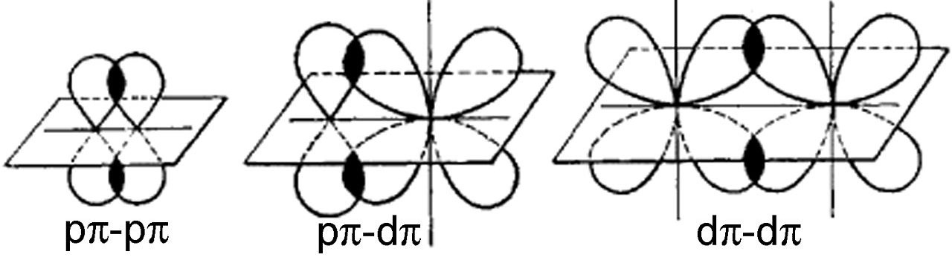
pi bonds (π)
A bond in which the orbitals overlap twice.
can only occur between p and d orbitals.
Every double bond consists of a sigma bond and a pi bond.

Slide 26
Bonding vs. Anti-Bonding
Every type of bond has a bonding and anti bonding form.
The bonding form is always lower in energy than the anti bonding form.
When the orbitals are in phase with one another we consider that bonding.
When they are out of phase we consider that anti-bonding.

Slide 27
Bonding vs. Anti-Bonding
Sigma = σ for bonding and σ* for anti bonding
Pi = π for bonding and π* for anti bonding

Slide 28
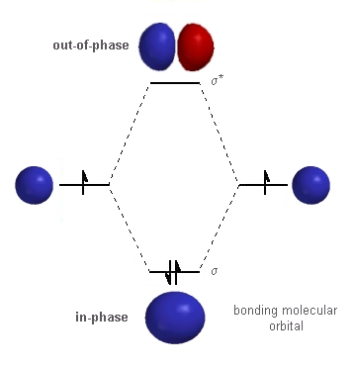
Bonding vs. Anti-Bonding Sigma (σ)

Slide 29
Bonding vs. Anti-Bonding Pi (π)

Slide 30
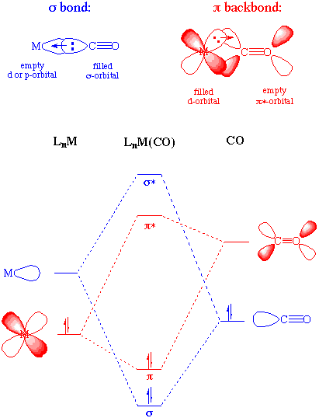
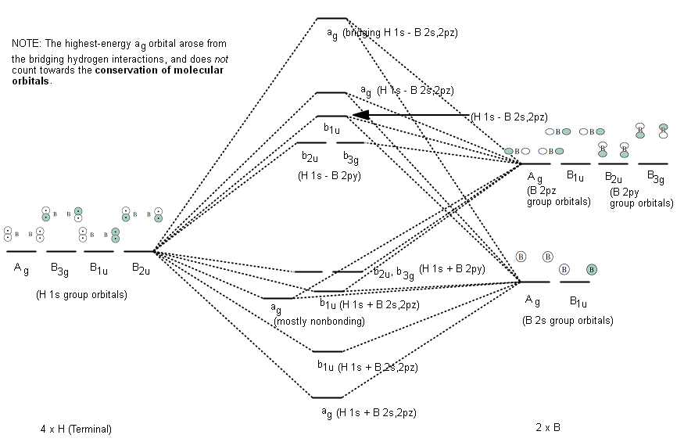
Why is this important?
Molecular Orbital Theory!

Slide 31
No
We will not be going into molecular orbital theory or diagrams.
While it is an important part of upper division chemistry we will not be going into it for the purposes of this class.
If you continue on in chemistry keep in mind that it will come up but they will be introduced to you there.

Slide 33
Chemistry
Chapter 9
Covalent Bonding –
Hybridization and Bonding Types
HW: pg 382 – 382h
Problems: 21 – 30, 33, 37, 42, 43, 45, 46, 70
Not collected for a grade but highly recommended

