Slide 1
Chemistry-
Introduction to Organic Chemistry
Chapter 22 -
Organic and Biological Molecules
Chapters: 22.1 & 22.3

Slide 2
What is Organic Chemistry?
It is the chemistry of carbon.
It is arguably the most relevant part of chemistry in terms of application. (Besides physical chemistry of course)

Slide 3
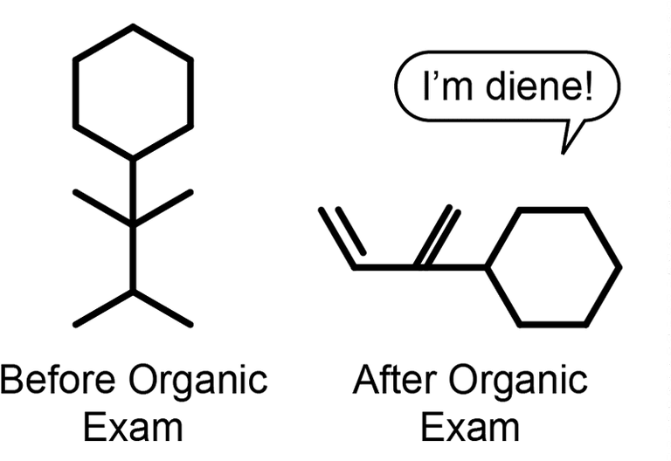
What is Organic Chemistry?

Slide 4
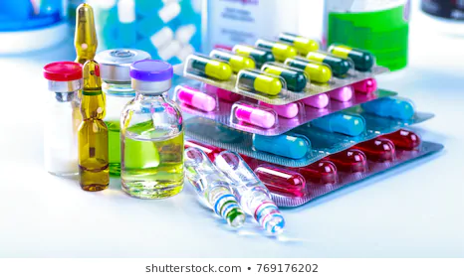
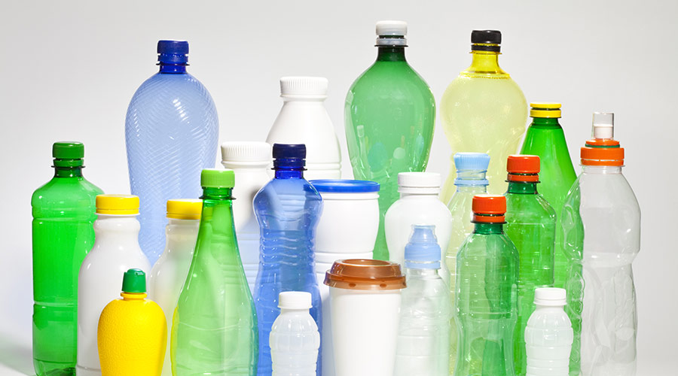
What is Organic Chemistry?
Applications
Medicine
Plastics
Agriculture

Slide 5
What is Organic Chemistry?
Literally everything and anything that you can think of that has to deal with carbon based molecules.

Slide 6
What is Organic Chemistry?
Quote: “Organic chemistry is enough to drive one mad. It gives me the impression of a primeval forest full of the most remarkable things, a monstrous and boundless thicket, with no way of escape, into which one may well dread to enter.”
- Friedrich Wohler

Slide 7
Introduction to Organic Chemistry
Scope for the introduction of organic chemistry:
Alkanes
Isomers
Naming/Nomenclature
Aromatic Compounds

Slide 8
Preloaded definitions
Hydrocarbon = A molecule made up of only hydrogen and carbon.
Saturated Hydrocarbon = Hydrocarbons whose carbon-carbon bonds are all single bonds.
Unsaturated Hydrocarbon = Hydrocarbons containing carbon-carbon multiple bonds.

Slide 9
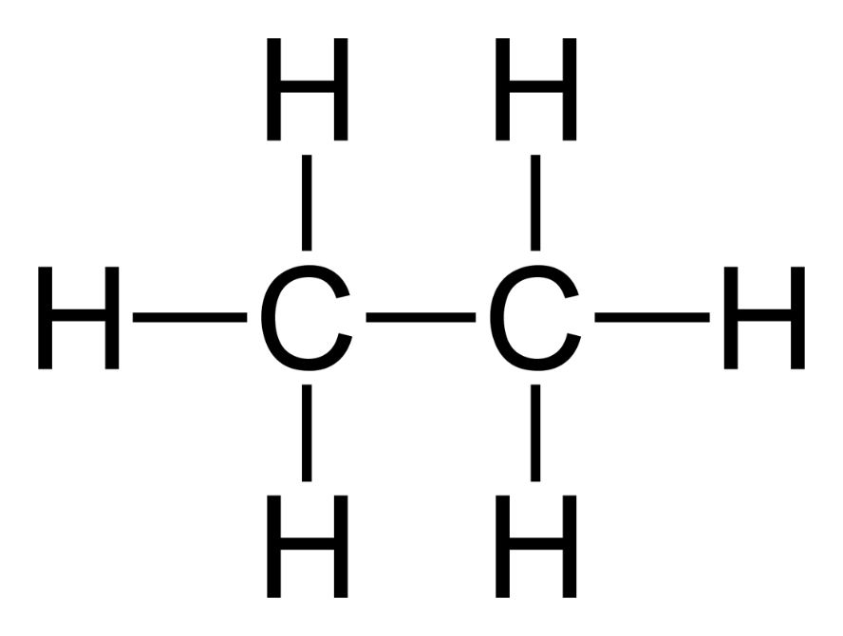
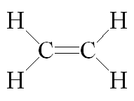
Preloaded definitions
Saturated Hydrocarbon
Ethane: C₂H₆
Unsaturated Hydrocarbon
Ethene: C₂H₆

Slide 10
Alkanes
Saturated hydrocarbons
Every carbon in alkanes are sp³ hybridized
Every carbon in alkanes has a tetrahedral shape
The type of alkane is determined by the number of carbons in the molecule.
All alkanes have the suffix -ane

Slide 11
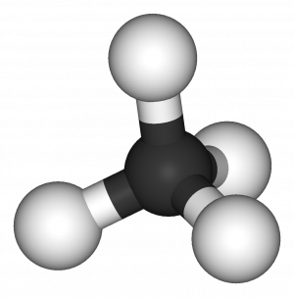
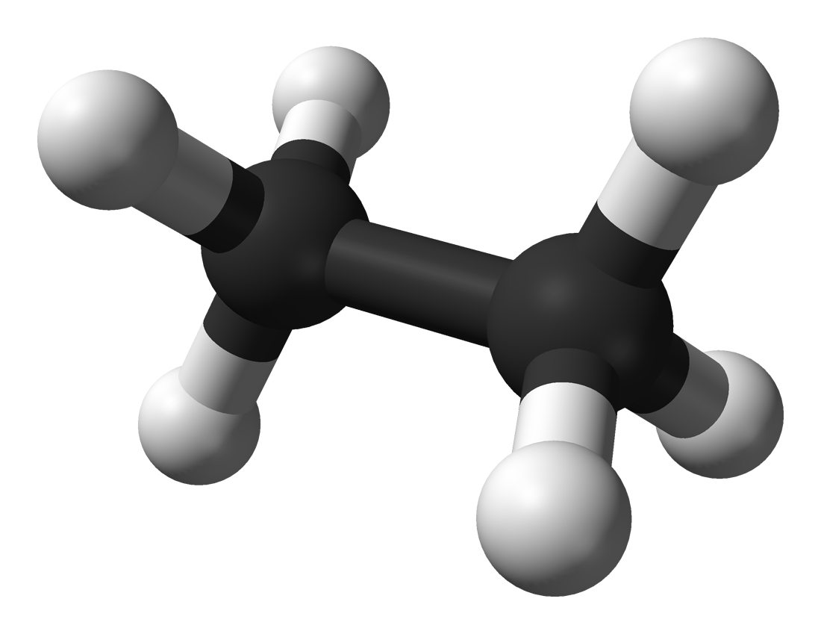
Alkanes
Methane: CH₄
Ethane: C₂H₆

Slide 12
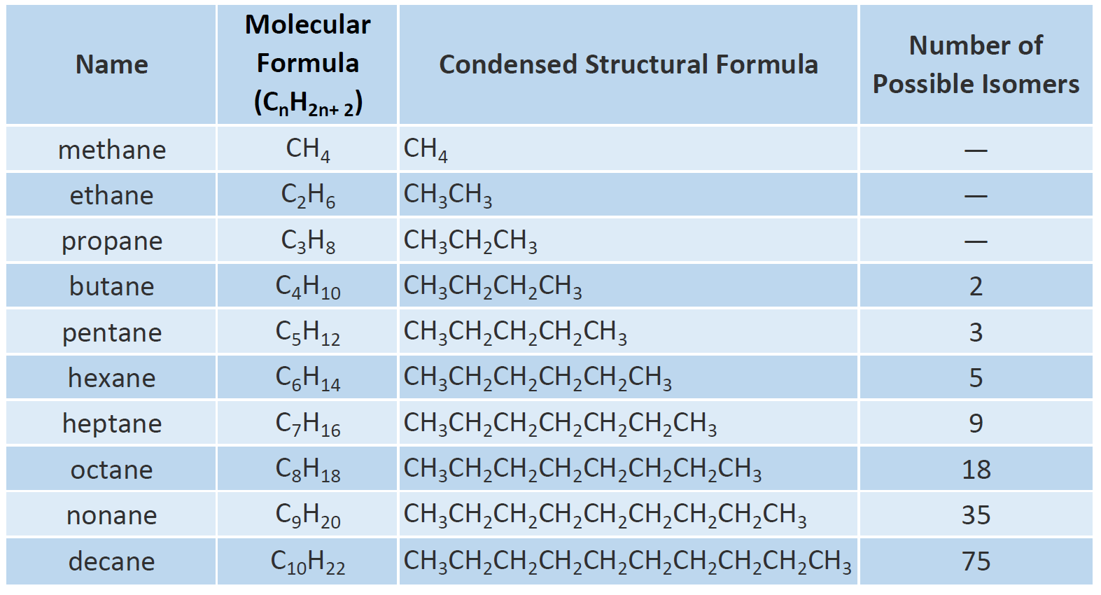
Alkanes

Slide 13
Alkanes

Slide 14
Alkanes
Notice: Number of Hydrogens = 2(Number of Carbons) + 2

Slide 15
Common drawings for hydrocarbons

Slide 16
Isomers
Different molecules with the same molecular formula are considered isomers.
There are different types of isomers but for now we are going to use this definition to define all isomers.

Slide 17
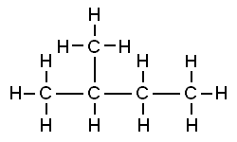
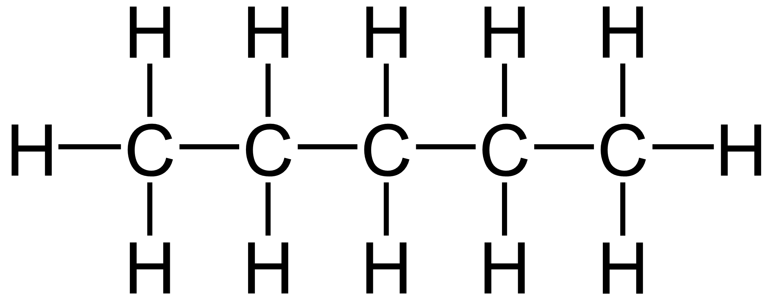
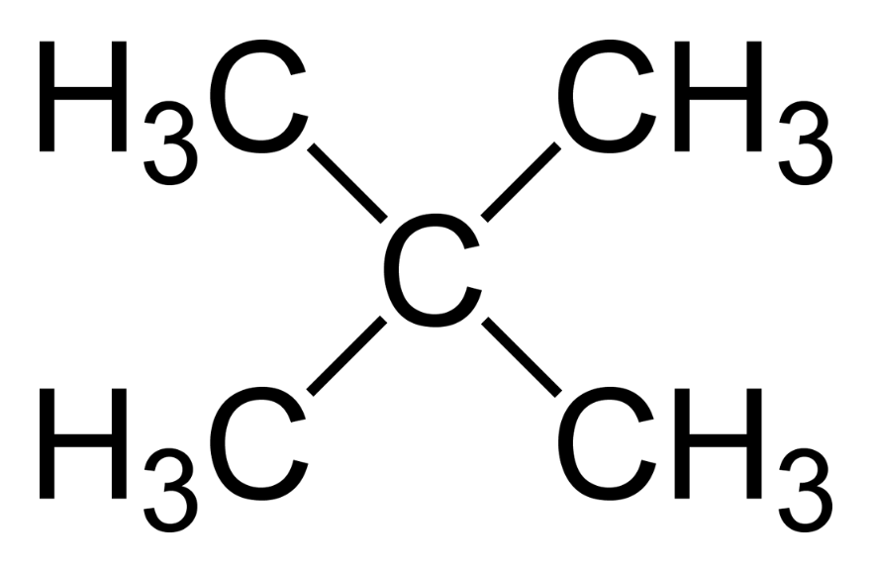
Isomers
Example: C₅H₁₂
Theses are completely different molecules with unique functions.

Slide 18
Naming/Nomenclature
Because isomers exist and there are literally millions of organic compounds, naming becomes incredibly important in the world of organic chemistry.
This will be semi-difficult and confusing at first but will get easier with practice.

Slide 19
Rules For Naming Alkanes
Count the longest ongoing carbon chain in your molecule.
Number the carbons in the longest chain
The number of carbons will tell you your based name for the alkane.
Next look for the location of the substituents.
Name the substituents by replacing the – ane suffix with a – yl and put that name in the front of the molecule.
Include the carbon number where the substituent is located at the front of the molecule.

Slide 20
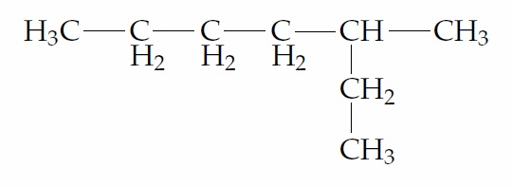
Example
1. Name this compound.
7
6
5
4
3
2
1
3-methylheptane

Slide 21
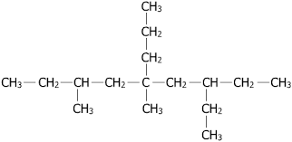
Another Example
Name this compound.
3-ethyl-5,7-dimethyl-5-propylnonane

Slide 22
Strategy for building Alkanes
1. Draw the main/biggest alkane compound from the name.
2. Add substituents to the compound where needed.
3. Victory

Slide 23
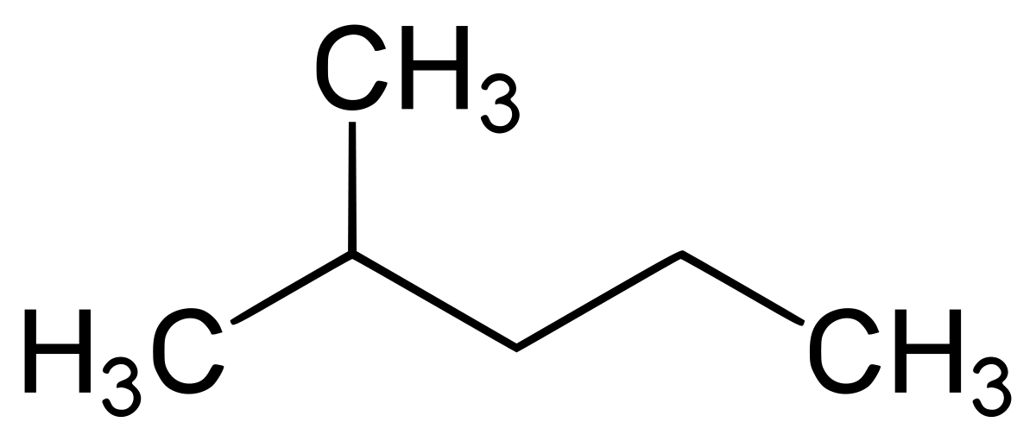
Examples Continued
Draw the compound 2-methylpentane.

Slide 24
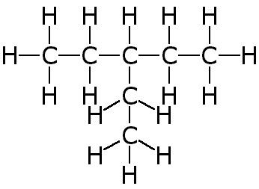
Your turn
Name the following compound.

Slide 25
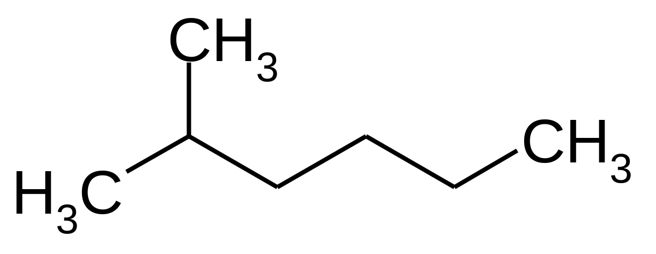
Your turn
Name the following compound.

Slide 26
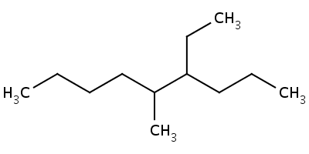
Your turn
Name the following compound.

Slide 27
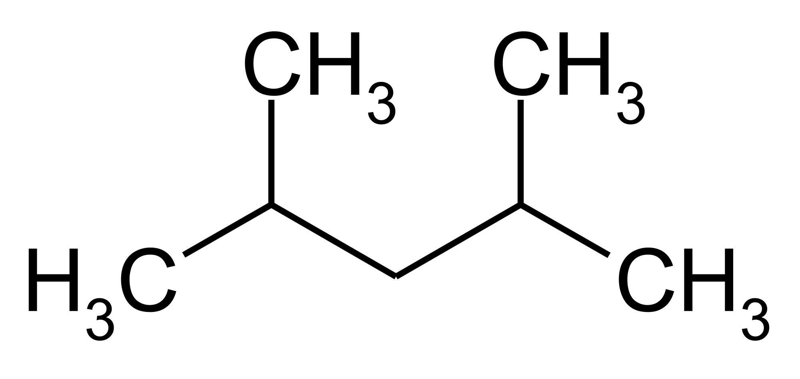
Your turn
Name the following compound.

Slide 28
Your turn
Draw 2-ethylheptane

Slide 29
Your turn
Draw 3,4-ethyloctane.

Slide 30
Your turn
Draw 2-ethyl-4-propylnonane.

Slide 31
Cyclic Alkanes
Alkanes that form a ring get a special name.
If the alkanes form a ring we add the prefix -cyclo to the front of their name.

Slide 32
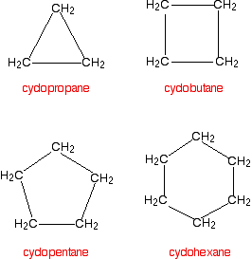
Cyclic Alkanes

Slide 33
Cyclic Alkanes
The same naming rules and drawing strategies apply to Cyclic Alkanes. With the exception that the cyclic structure will always take the base name.

Slide 34
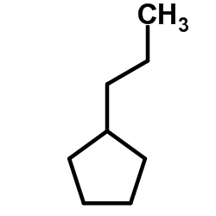
Example
Name the following compound.
propylcyclopentane

Slide 35
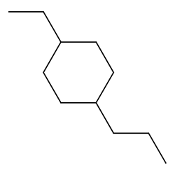
Example
Name the following compound.
1-ethyl-4propylcyclohexane

Slide 36
Example
Draw 1-butyl-3ethylcycloheptane

Slide 37
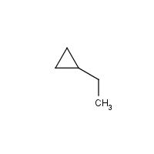
Your Turn
Name the following compound

Slide 38
Your Turn
Name the following compound

Slide 39
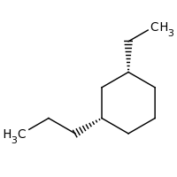
Your Turn
Name the following compound

Slide 40
Your Turn
Draw propylcycloheptane

Slide 41
Your Turn
Draw 1butyl-4ethyl-5methylcyclooctane

Slide 42
Your Turn
Draw 1butyl-4ethyl-5methylcyclooctane

Slide 43
Aromatic Rings
There is also a class of compounds in organic chemistry known as the aromatic rings.
They get their name “aromatic” from many of these rings being in many smells and flavors.
These rings probably exist in your cologne, the smell of flowers, perfume, etc.

Slide 44
Aromatic Rings
Definition: It must be a cyclic compound with the electrons having the ability to circulate throughout the entire molecule.
Real definition: Cyclic, planar molecules with a ring of resonance bonds that exhibits more stability than other geometric or connective arrangements with the same set of atoms.

Slide 45
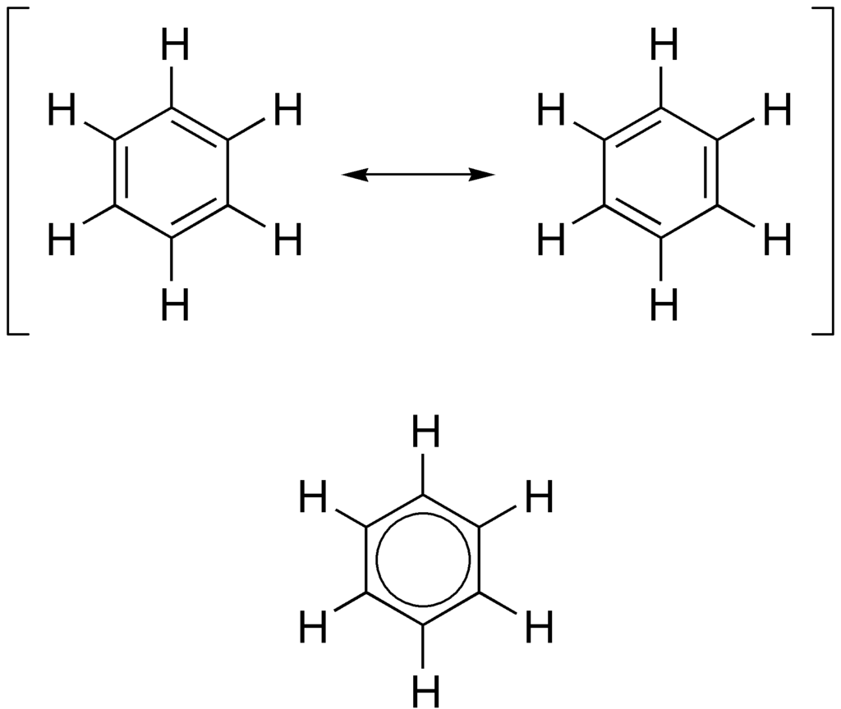
Aromatic Rings
This is benzene. I will only require you to know the name of this compound but keep in mind I may give you a cyclic compound and ask if it is aromatic.

Slide 46
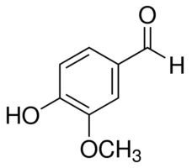
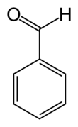
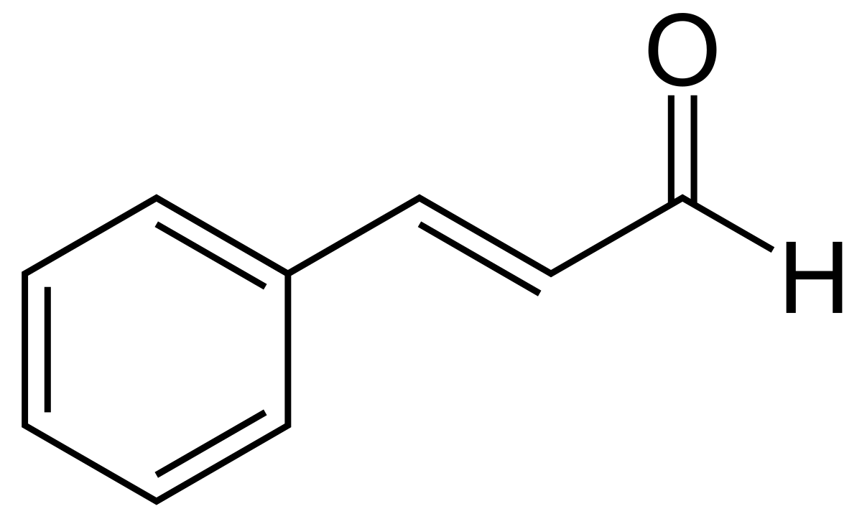
Aromatic Rings
Examples you may know
Benzaldehyde:
The almond smell/flavor
Vanillin:
Vanilla smell/flavor
cinnamaldehyde:
cinnamon smell/flavor

Slide 47
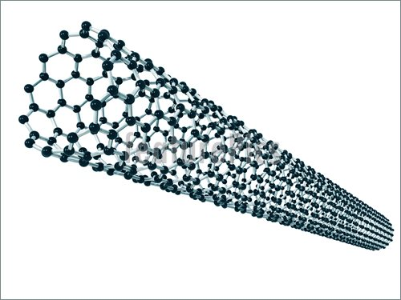
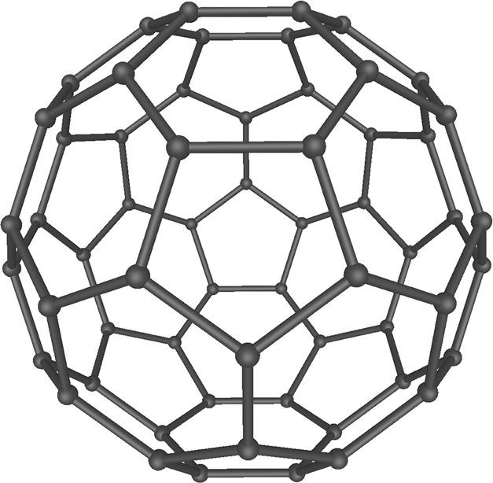
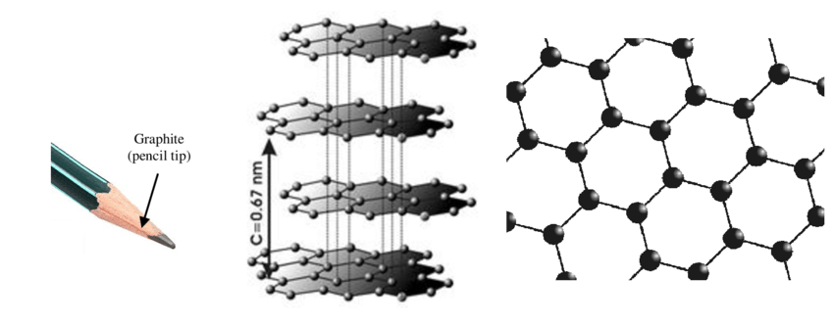
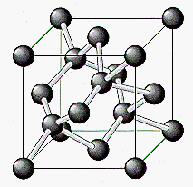
Carbon is Cool
Carbon Fiber
Carbon Bucky Ball
Graphite
Diamond

Slide 49
Chemistry-
Chapter 22
Organic and Biological Molecules –
Hybridization and Bonding Types
HW: pg 900 – 900o
Problems: 15,19,20,23,24,25,32,39,149
Not collected for a grade but highly recommended

