Slide 1
Chemistry
Chapter 13
Chemical Equilibrium
Section 2
Chapters:
13.5 Applications of the equilibrium constant
13.6 Solving equilibrium problems
13.7 La Chatlier’s principle

Slide 2
Applications of chemical equilibrium
What can we use the equilibrium constant for?
Helps in predicting features of reactions, which includes determining:
Tendency (not speed) of a reaction to occur
Whether a given set of concentrations represents an equilibrium condition
Equilibrium position that will be achieved from a given set of initial concentrations

Slide 3
Applications of chemical equilibrium
In most scenarios we actually only know the initial concentrations of our reaction
K is also known for most reactions at a given temperature.
https://www.nist.gov/srd
There is a ton of data on reactions that we can use to predict the equilibrium concentrations of species

Slide 4
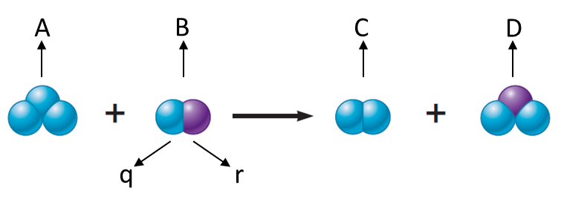
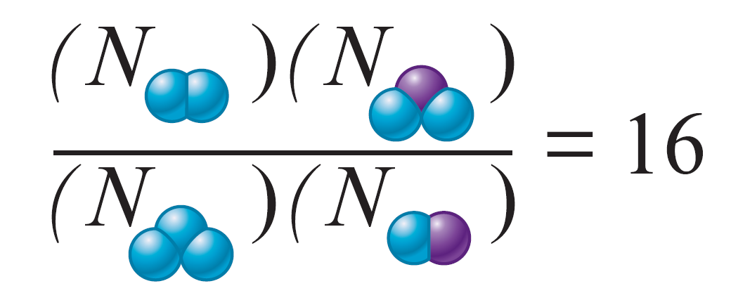
Applications of chemical equilibrium
Consider the following reaction:
q and r represent two different types of atoms
Assume that the equilibrium constant is 16

Slide 5
Applications of chemical equilibrium
Assume that five molecules of A disappear so that the system can reach equilibrium
To maintain equilibrium, 5 molecules of B will also disappear, forming 5 C and 5 D molecules

Slide 6
Applications of chemical equilibrium
The new conditions do not match the equilibrium position
Equilibrium can be achieved by increasing the numerator and decreasing the denominator
System moves to the right - More than 5 original reactant molecules disappear

Slide 7
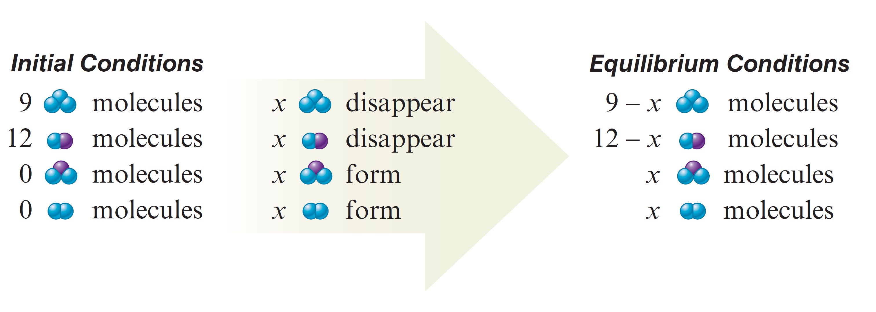
Applications of chemical equilibrium
Let x be the number of molecules that need to disappear so that the system can reach equilibrium

Slide 8
Applications of chemical equilibrium

Slide 9
Applications of chemical equilibrium
So obviously we are gunna have to do some serious algebra. I’m going to teach you a fail proof method on how to set up these problems, I will solve some problems and go through the algebra but at this point it is up to you to know the algebra. I can’t spend most of the time teaching algebraic manipulation.

Slide 10
Applications of chemical equilibrium
We are going to learn the all powerful rice table.
R - Reaction
I - Initial
C - Change
E - Equilibrium
Knowing how to build these and use them to solve chemical equilibrium problems can carry you a long way in college chemistry and even further into your chemistry career.

Slide 11
Applications of chemical equilibrium
Let’s say I have a reaction
$$A\left(g\right)+B\left(g\right) →C\left(g\right)+D(g)$$
For this scenario let’s say we are given K = 1.2 x 10⁻² and our initial concentrations are [A] = .5 M, [B] = .4 M, [C] = 0M and [D] = 0M and we need to find the equilibrium concentrations.

Slide 12
Applications of chemical equilibrium
Build the RICE TABLE!
R
$$A\left(g\right)+B\left(g\right) →C\left(g\right)+D(g)$$
I
.5 M
.4 M
0 M
0 M
C
-x
-x
+x
+x
E
.5 M -x
.4M-x
x
x
$$K= \frac{\left[x\right] \left[x\right]}{\left[.5 −x\right] \left[.4 −x\right]}$$

Slide 13
Applications of chemical equilibrium
And now comes the algebra
$$K= \frac{\left[x\right] \left[x\right]}{\left[.5 −x\right] \left[.4 −x\right]}$$
$$K=1.2 ∗ {10}^{−2}$$
1
$1.2 ∗ {10}^{−2}= \frac{\left[x\right] \left[x\right]}{\left[.5 −x\right] \left[.4 −x\right]} → 1.2 ∗{10}^{−2} \left(.5−x\right)\left(.4−x\right)= x^{2}$
2
$1.2 ∗{10}^{−2} \left(.5−x\right)\left(.4−x\right)= x^{2} →1.2 ∗{10}^{−2} \left(.20 − .9x+x^{2}\right)= x^{2}$
3
$1.2 ∗{10}^{−2} \left(.20 − .9x+x^{2}\right)= x^{2}→ 2.4 ∗ {10}^{−3} −.0108x+1.2 ∗ {10}^{−2}x^{2}= x^{2}$
4
$2.4 ∗ {10}^{−3} −.0108x+1.2 ∗ {10}^{−2}x^{2}= x^{2} →$ $2.4 ∗ {10}^{−3} −.0108x−.988x^{2}=0$

Slide 14
Applications of chemical equilibrium
We want to make that whole mess equal zero
$$2.4 ∗ {10}^{−4} −.0108x−.988x^{2}=0$$
Now we can use the quadratic formula.
a
b
c
$$−.988x^{2}−.0108x+2.4 ∗ {10}^{−3}=0$$
We always want the positive answer
$$x=\frac{−b± \sqrt{b^{2} − 4ac} }{2a}=\frac{.0108± \sqrt{{.0108}^{2} −(4∗−.988∗2.4∗{10}^{−3})} }{2(−.988)}= \frac{.0108 ±.0979}{−1.976}$$
$$x= .044 M$$

Slide 15
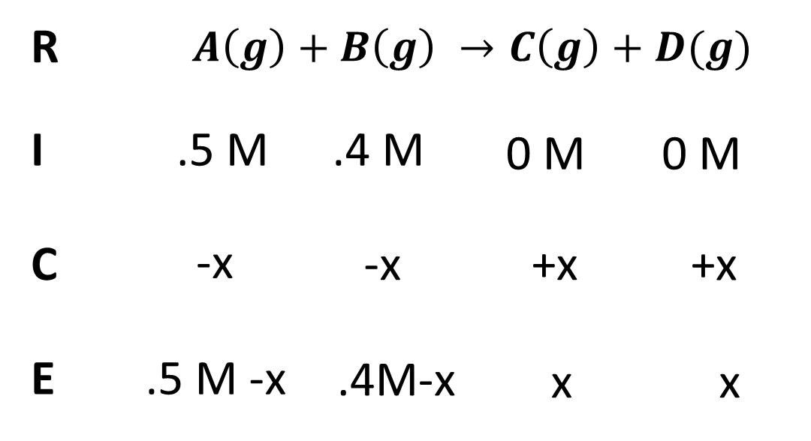
Applications of chemical equilibrium
Now we have x so lets solve for our equilibrium concentrations
$$x= .110 M$$
Final Answer:
[A(g)] = .5 - .044 = .456M
[B(g)] = .4 - .044 = .356 M
[C(g)] = 0 + .044 = .044 M
[D(g)] = 0 + .044 = .044 M

Slide 16
Applications of chemical equilibrium
Something to note to make our lives easier.
Let’s say K is extremely small compared to our initial concentrations meaning K < 10⁻⁴ factors of 10 smaller than our initial concentrations.
K = 1.2 x 10⁻⁵
We can assume that the initial concentration minus x is negligible
$$K= \frac{\left[x\right] \left[x\right]}{\left[.5 −x\right] \left[.4 −x\right]}≈ \frac{\left[x^{2}\right]}{\left[.5\right][.4]}$$
Which is way easier to solve than the quadratic

Slide 17
Applications of chemical equilibrium
What happens if it is not a 1:1 molar ratio though?

Slide 18
Applications of chemical equilibrium
Lets go back to our general problem but with coefficients
$$2A\left(g\right)+3B\left(g\right) →4C\left(g\right)+D(g)$$
We are still going to build our rice table but we need to take into account our molar ratios.

Slide 19
Applications of chemical equilibrium
R
$$2A\left(g\right)+3B\left(g\right) →4C\left(g\right)+D(g)$$
I
.5 M
.4 M
0 M
0 M
C
-x
-$\frac{3}{2}$x
+ 2x
+ $\frac{1}{2}$x
E
.5 - x M
.4 - $\frac{3}{2}$x M
2x M
$\frac{1}{2}$x M
$$K= \frac{{\left[2x\right]}^{4} \left[\frac{1}{2} x\right]}{{\left[.5 −x\right]}^{2} {\left[.4 −\frac{3}{2}x\right]}^{3}}$$

Slide 20
Applications of chemical equilibrium
Will I ever ask you to solve an expression like this?
$$K= \frac{{\left[2x\right]}^{4} \left[\frac{1}{2} x\right]}{{\left[.5 −x\right]}^{2} {\left[.4 −\frac{3}{2}x\right]}^{3}}$$
No, that is absurd and that is why we have computers. However, I will ask you to build me an expression to find the equilibrium constants for a reaction with varying coefficients.

Slide 21
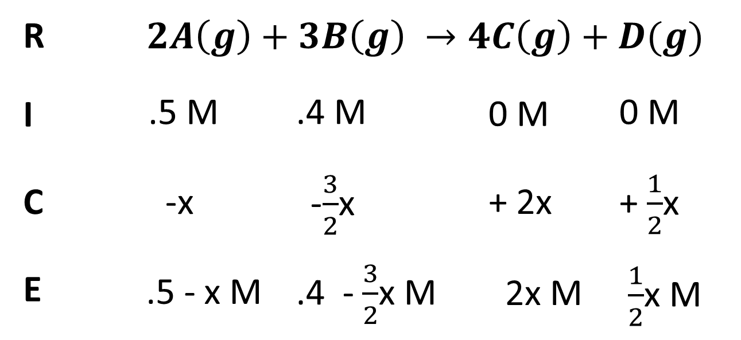
Applications of chemical equilibrium
So what is this actually telling us?
This is telling us that for every 2 mols of A that react 3 mols of B must react. For every 2 mols of A and 3 mols of B that react I generate 4 mols of C and 1 mol of D

Slide 22
Applications of chemical equilibrium
An easy way to figure out the coefficient on x
$$2A\left(g\right)+3B\left(g\right) →4C\left(g\right)+D(g)$$
If I pick [A] to host my x I will divide all my coefficients by A’s coefficient to determine the coefficient on x for each part.

Slide 23
Applications of chemical equilibrium
What happens when I’m given initial concentrations for all species?

Slide 24
Applications of chemical equilibrium
$$A\left(g\right)+B\left(g\right) →C\left(g\right)+D(g)$$
For this scenario let’s say we are given K = 1.2 x 10⁻² and our initial concentrations are [A] = .5 M, [B] = .4 M, [C] = .2M and [D] = .3M and we need to find the equilibrium concentrations.
How do we know which way the reaction will run?

Slide 25
Applications of chemical equilibrium
For these problems we need to use the reaction quotient Q
We solve for Q the exact same way we solve for K except we use initial concentrations.
So Q is for initial K is for equilibrium

Slide 26
Applications of chemical equilibrium
Back to our original problem
$$A\left(g\right)+B\left(g\right) →C\left(g\right)+D(g)$$
Initial = [A] = .5 M, [B] = .4 M, [C] = .2M, [D] = .3M
$$Q= \frac{\left[.2\right][.3]}{\left[.5\right][.4]}= .3$$

Slide 27
Applications of chemical equilibrium
We then compare Q to our given K value.
$$Q= \frac{\left[.2\right][.3]}{\left[.5\right][.4]}= .3$$
K = 1.2 x 10⁻²
If Q > K or Q is bigger than K then the reaction will run towards the reactants.
If Q < K or Q is less than K then the reaction will run towards the products.

Slide 28
Applications of chemical equilibrium
In this scenario Q is bigger than K so our RICE table will look like this
$$Q= \frac{\left[.2\right][.3]}{\left[.5\right][.4]}= .3$$
K = 1.2 x 10⁻²
R
$$A\left(g\right)+B\left(g\right) →C\left(g\right)+D(g)$$
I
.5 M
.4 M
.2 M
.3 M
$$K= \frac{\left[.2 −x\right] \left[.3 −x\right]}{\left[.5+x\right] \left[.4+x\right]}$$
C
+x
+x
-x
-x
E
.5 M +x
.4M+x
.2 -x
.3 - x

Slide 29
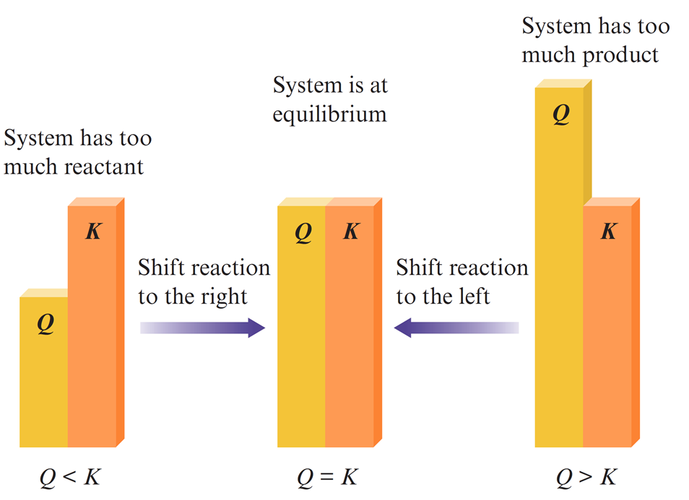
Applications of chemical equilibrium

Slide 30
Applications of chemical equilibrium
$${3H}_{2}+ N_{2} ↔2NH_{3}$$

Slide 31
Applications of chemical equilibrium

Slide 32
Applications of chemical equilibrium
$N_{2}O_{4}\left(g\right)→2NO_{2}$(g)

Slide 33
Applications of chemical equilibrium
$$P{Cl}_{5}(g) ↔P{Cl}_{3}(g)+{Cl}_{2}(g)$$

Slide 34
Applications of chemical equilibrium

Slide 35
Applications of chemical equilibrium

Slide 36
Here is the strategy for solving equilibrium problems in words
Write the balanced equation for the reaction
Calculate Q to determine which way the reaction will run when given a K
Build the RICE table!
Do the maths… (Solve for the unknown)
Use the unknown to find equilibrium concentrations

Slide 37
More Practice

Slide 38
More Practice

Slide 39
More Practice
$$2NOCl\left(g\right)↔2NO\left(g\right)+{Cl}_{2}(g)$$
Find the equilibrium concentrations

Slide 40
Le Chatelier’s Principle

Slide 41
Le Chatelier’s Principle
If a component is added to a reaction system at equilibrium, the equilibrium position will shift in the direction that lowers the concentration of that component
If a component is removed, the opposite effect occurs
System at equilibrium exists at constant T and P or constant T and V

Slide 42
Le Chatelier’s Principle
$${As}_{4}O_{6 }\left(s\right)+6C\left(s\right)→{As}_{4}(g)+6CO(g)$$

Slide 43
Le Chatelier’s Principle
$${As}_{4}O_{6 }\left(s\right)+6C\left(s\right)→{As}_{4}(g)+6CO(g)$$

Slide 44
Le Chatelier’s Principle

Slide 45
Le Chatelier’s Principle

Slide 46
Le Chatelier’s Principle

Slide 47
Le Chatelier’s Principle

Slide 48
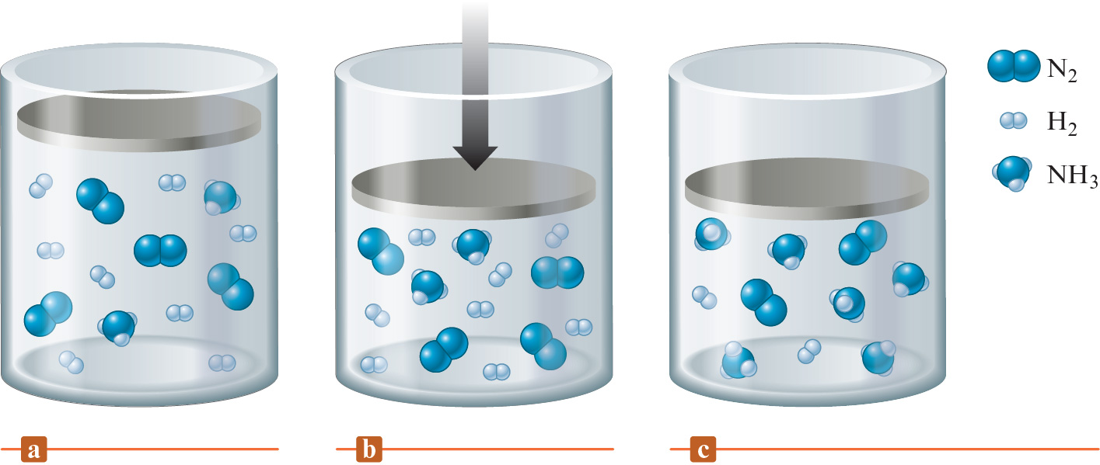
Le Chatelier’s Principle
A mixture of NH₃(g), N₂(g), and H₂(g) at equilibrium
The volume is suddenly decreased
The new equilibrium position for the system containing more NH₃ and less N₂ and H₂

Slide 49
Le Chatelier’s Principle
$$P_{4}(s)+6{Cl}_{2 }(g) ↔4P{Cl}_{3}(l)$$

Slide 50
Le Chatelier’s Principle
$$N_{2 }+3H_{2} →2NH_{3 }+92 kJ$$

Slide 51
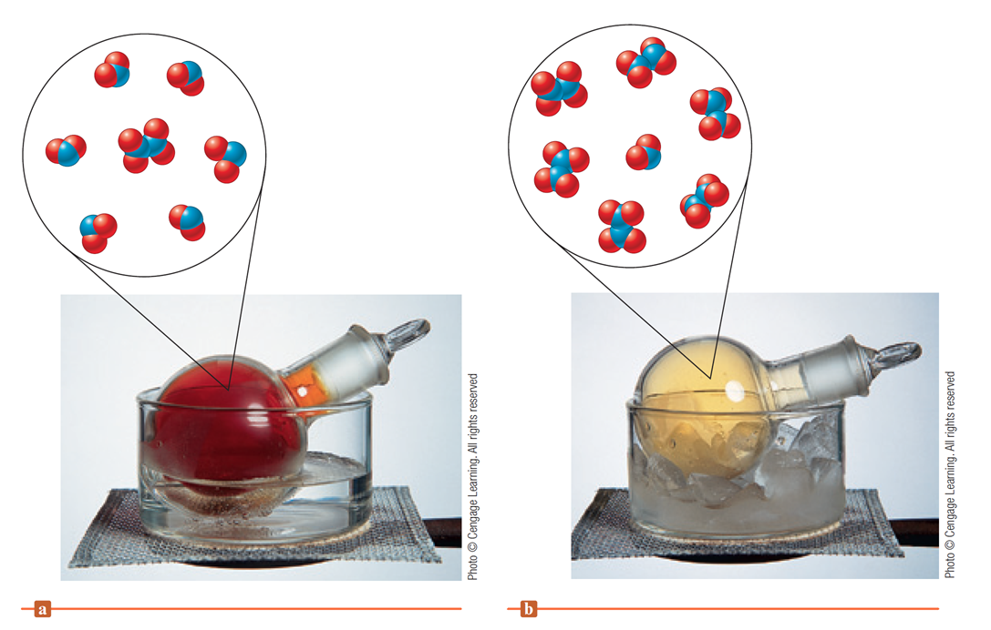
Le Chatelier’s Principle

Slide 53
Chemistry
Chapter 13
Chemical Equilibrium
Section 2
HW: Pg 547b – 547h
Problems: 55 – 129 Not Collected
Do as many as you feel like you need to in order to be successful for this section

