Slide 1
Chemistry
Chapter 13
Chemical Equilibrium
Section 1
Chapters:
13.1 The equilibrium condition
13.2 The equilibrium constant
13.3 Equilibrium – pressure
13.4 Heterogeneous equilibria

Slide 2

Review – Chemical Equations
$$CH_{4}+2O_{2} →CO_{2}+2H_{2}O$$
The number of atoms on the left must equal the right
The coefficients on each species represents the number of moles of each species.

Slide 3
The Equilibrium Condition
The equilibrium state is the point at which the concentration of the products and reactants remains constant with time.
This means that the rate of the forward reaction equals the rate of the reverse reaction.

Slide 4
The Equilibrium Condition
If the reactants are favoured then the equilibrium position of the reaction lies far to the left and vice versa.

Slide 5
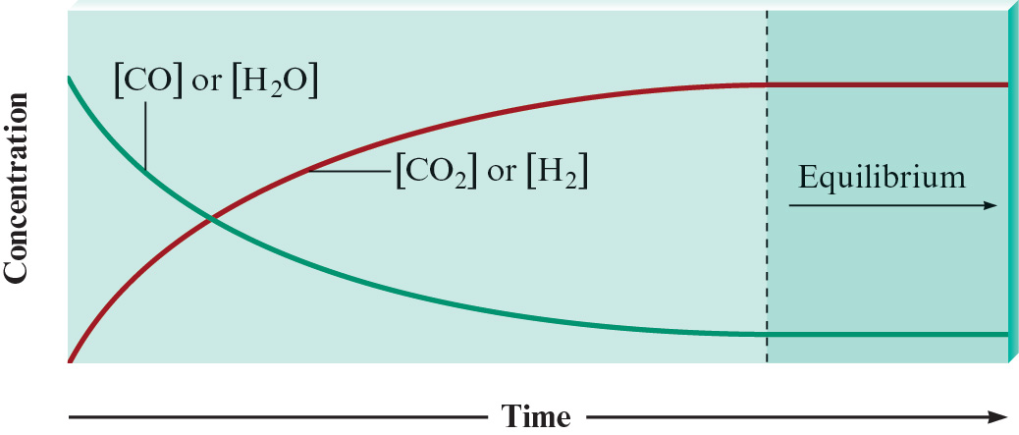

The Equilibrium Condition
$$CO+H_{2}O →CO_{2}+H_{2}$$

Slide 6
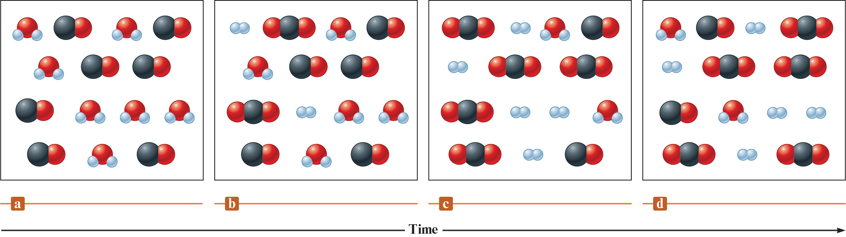
The Equilibrium Condition
$$CO+H_{2}O →CO_{2}+H_{2}$$

Slide 7
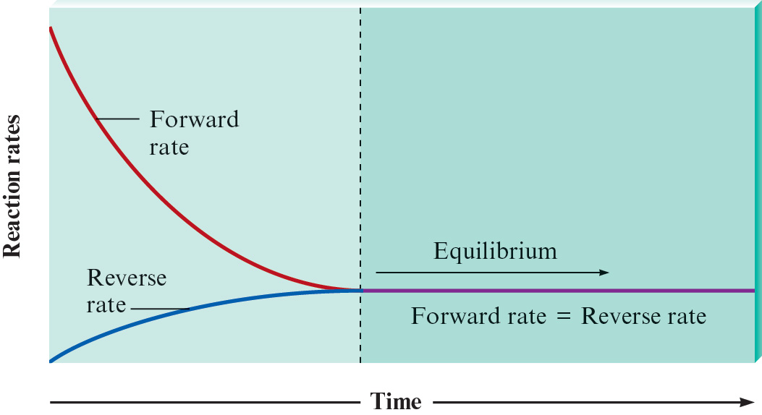
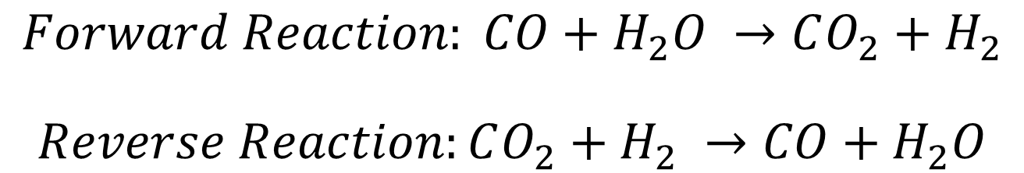
The Equilibrium Condition
$$Forward Reaction: CO+H_{2}O →CO_{2}+H_{2}$$
$$Reverse Reaction:CO_{2}+H_{2} →CO+H_{2}O$$

Slide 8
The Equilibrium Condition
There are a few factors that determine the equilibrium position of a reaction.
The initial concentrations
The relative energies of the reactants and products (I.E. Temperature, Pressure, etc.)
The relative degree of organization of reactants and products.

Slide 9
The Equilibrium Condition
When in chemical equilibrium the concentrations of the products and reactants do not change.
This is because the rate at which the products are being made equal the rate at which the reactants are being made.
Once this happens we say the system has reached chemical equilibrium.

Slide 10

The Equilibrium Condition
Consider the following reaction…
$$CO+H_{2}O →CO_{2}+H_{2}$$
Which of these statements must be true when the reaction reaches equilibrium?

Slide 11

The Equilibrium Condition
$$CO+H_{2}O →CO_{2}+H_{2}$$
[CO₂] = [H₂] because it’s a one to one molar ratio
The total concentration of the reactants equals the total concentration of the products.
The total concentration of the reactants is greater than the concentration of the products.
The rate of the forward reaction equals the rate of the reverse reaction.

Slide 12
The Equilibrium Constant
This is a number that tells us information about the equilibrium state of the reaction.
Very large numbers = a product favored equilibrium
Very small numbers = a reactant favored equilibrium
The constant is unit-less

Slide 13


The Equilibrium Constant
For a general chemical expression
$$jA+kB →lC+mD$$
Where A,B,C, and D are chemical species and j,k,l, and m are the coefficents.
The equilibrium constant K is
$$K= \frac{{[C]}^{l}{[D]}^{m}}{{[A]}^{j}{[B]}^{k}}$$

Slide 14
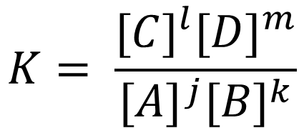
The Equilibrium Constant
$$K= \frac{{[C]}^{l}{[D]}^{m}}{{[A]}^{j}{[B]}^{k}}$$
The equilibrium constant is always found by taking the products divided by the reactants.
[A] = the concentration of the species in mols/liter
The superscripts represent the coefficients in the original chemical equation.
Remember K is the equilibrium constant!

Slide 15
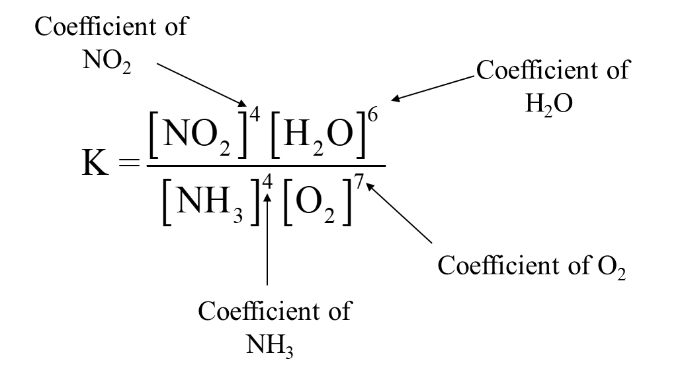
The Equilibrium Constant
Write the chemical equilibrium expression for the following reaction.
$$4NH_{3}(g)+7O_{2}(g) →4NO_{2}(g)+6H_{2}O(g)$$

Slide 16
The Equilibrium Constant
Let’s do it again but this time we will have initial concentrations to actually calculate K.

Slide 17
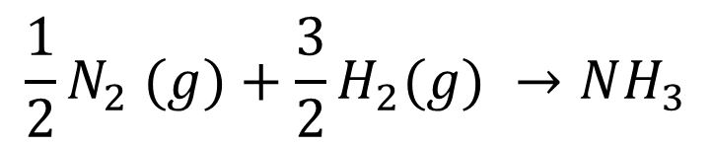
The Equilibrium Constant
Given the chemical equation below and the initial concentrations, calculate the chemical equilibrium constant.
$${\frac{1}{2}N}_{2} (g)+\frac{3}{2}H_{2}(g) →NH_{3}$$
Hint: Balance the reaction first! Make sure all the coefficients are whole numbers.

Slide 18

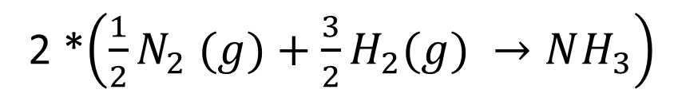
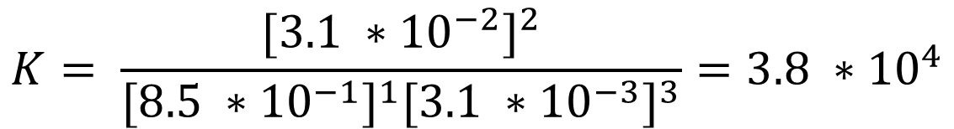
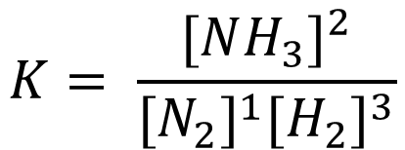
The Equilibrium Constant
2 *$\left({\frac{1}{2}N}_{2} (g)+\frac{3}{2}H_{2}(g) →NH_{3}\right)$
$$N_{2} (g)+3H_{2}(g) →2NH_{3}$$
$$K= \frac{{[NH_{3}]}^{2}}{{[N_{2}]}^{1}{[H_{2}]}^{3}}$$
$$K= \frac{{[3.1 ∗{10}^{−2}]}^{2}}{{[8.5 ∗{10}^{−1}]}^{1}{[3.1 ∗{10}^{−3}]}^{3}}=3.8 ∗{10}^{4}$$
We always write K without units.

Slide 19


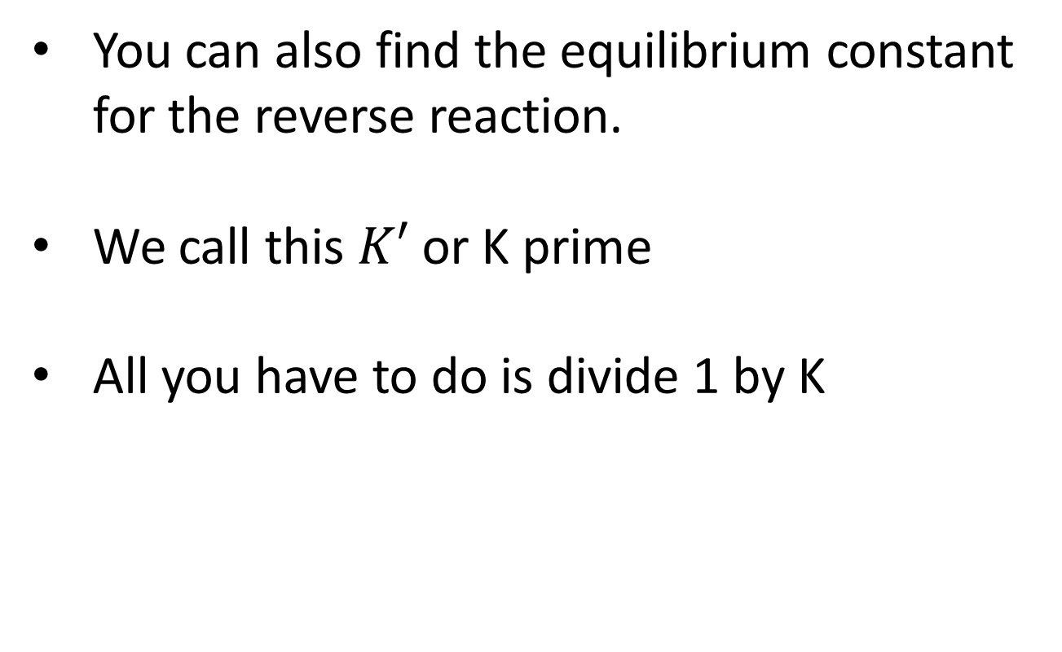
The Equilibrium Constant
You can also find the equilibrium constant for the reverse reaction.
We call this $K′$ or K prime
All you have to do is divide 1 by K
$$K^{′}=\frac{1}{K}= \frac{1}{3.8 ∗{10}^{4}}=2.6 ∗{10}^{−5}$$
$$2NH_{3} → N_{2} (g)+3H_{2}(g)$$

Slide 20
The Equilibrium Constant
There is also a way to calculate the equilibrium constant using the law of mass action. This only works if we have the equilibrium constant determined for an ideally balanced equation.

Slide 21
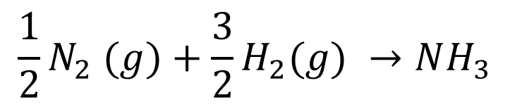
The Equilibrium Constant
Let’s go back to our last example.
$${\frac{1}{2}N}_{2} (g)+\frac{3}{2}H_{2}(g) →NH_{3}$$
If the problem wants us to use the law of mass action to calculate the equilibrium constant then we leave the equation balanced with fraction coefficients.

Slide 22
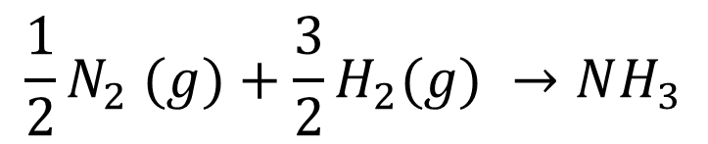
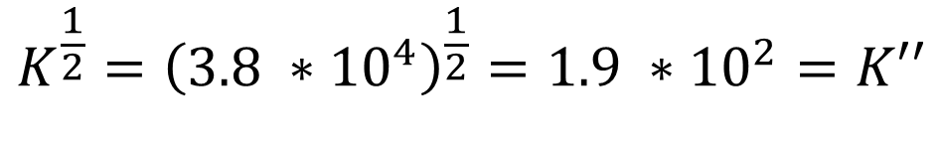
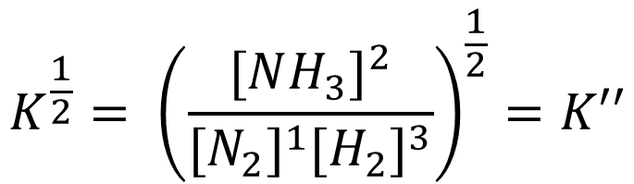
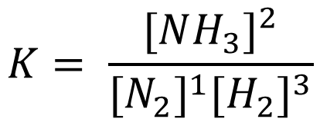
The Equilibrium Constant
$${\frac{1}{2}N}_{2} (g)+\frac{3}{2}H_{2}(g) →NH_{3}$$
$$K= \frac{{[NH_{3}]}^{2}}{{[N_{2}]}^{1}{[H_{2}]}^{3}}$$
$$K^{\frac{1}{2}}= {\left(\frac{{[NH_{3}]}^{2}}{{[N_{2}]}^{1}{[H_{2}]}^{3}}\right)}^{\frac{1}{2}}=K′′$$
$$K^{\frac{1}{2}}={\left(3.8 ∗{10}^{4}\right)}^{\frac{1}{2}}=1.9 ∗{10}^{2}=K′′$$

Slide 23

The Equilibrium Constant
Simply put for a general chemical equation
$$njA+nkB →nlC+nmD$$
Where n is some constant being multiplied to each species in our equation.

Slide 24
The Equilibrium Constant
The chemical equilibrium constant we calculate only holds true for a specific temperature and pressure in the system. At a certain temperature and pressure though, K will always be the same for a reaction. No matter what.

Slide 25
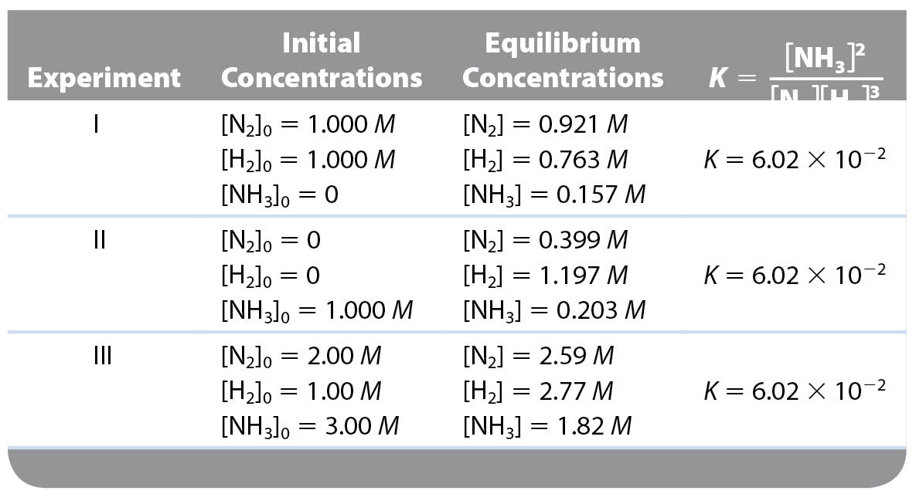
The Equilibrium Constant

Slide 26
The Equilibrium Constant
Equilibrium position
Refers to each set of equilibrium concentrations
There can be infinite number of positions for a reaction
Depends on initial concentrations
Equilibrium constant
One constant for a particular system at a particular temperature
Remains unchanged
Depends on the ratio of concentrations

Slide 27
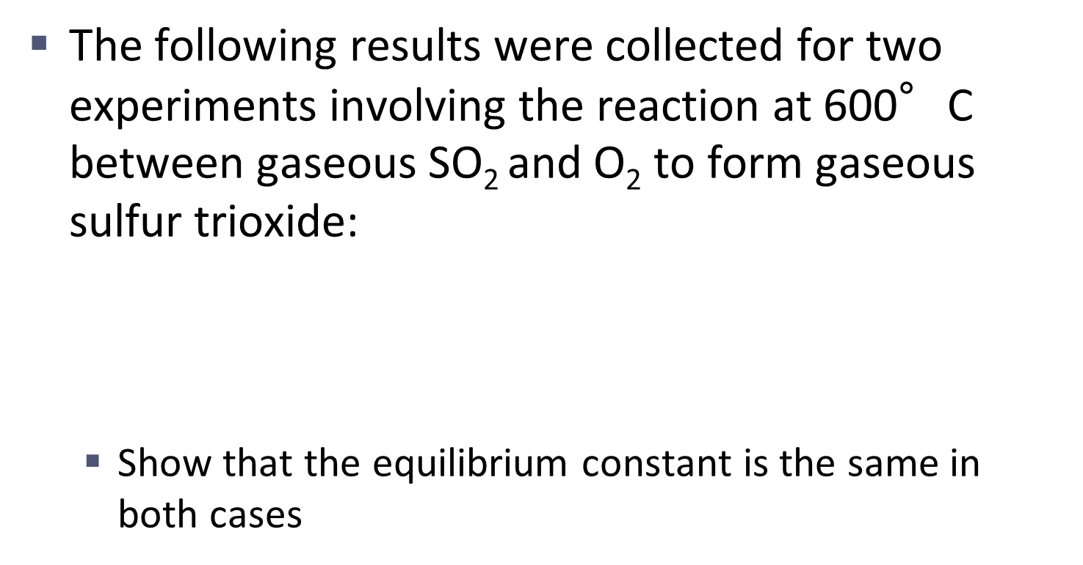
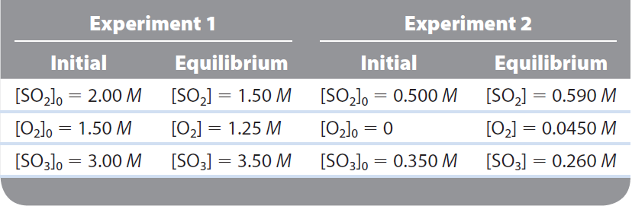
The Equilibrium Constant

Slide 28
The Equilibrium Constant
First we need to determine the balanced reaction.
We have SO₂ reacting with O₂ to form SO₃
$$2SO_{2}(g)+ O_{2}(g) →2SO_{3}(g)$$

Slide 29
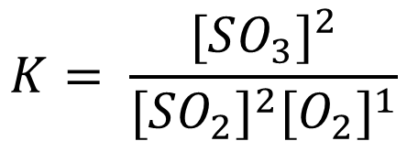
The Equilibrium Constant
Now we are going to build our general equilibrium expression
$$2SO_{2}(g)+ O_{2}(g) →2SO_{3}(g)$$
$$K= \frac{{[SO_{3}]}^{2}}{{[{SO}_{2}]}^{2}{[O_{2}]}^{1}}$$

Slide 30
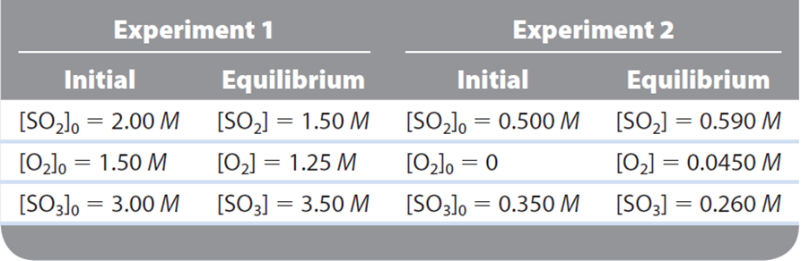
The Equilibrium Constant
Now we are going to plug in our concentrations at equilibrium

Slide 31
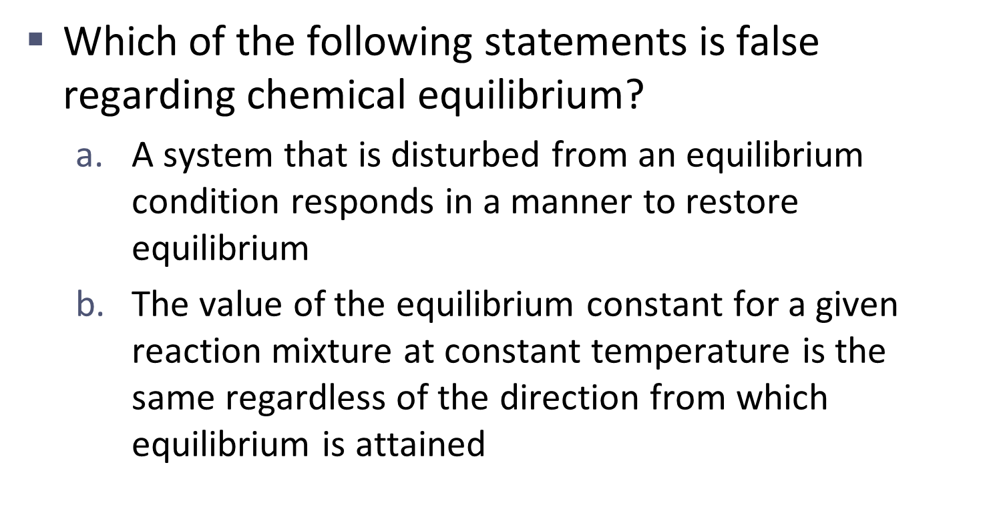
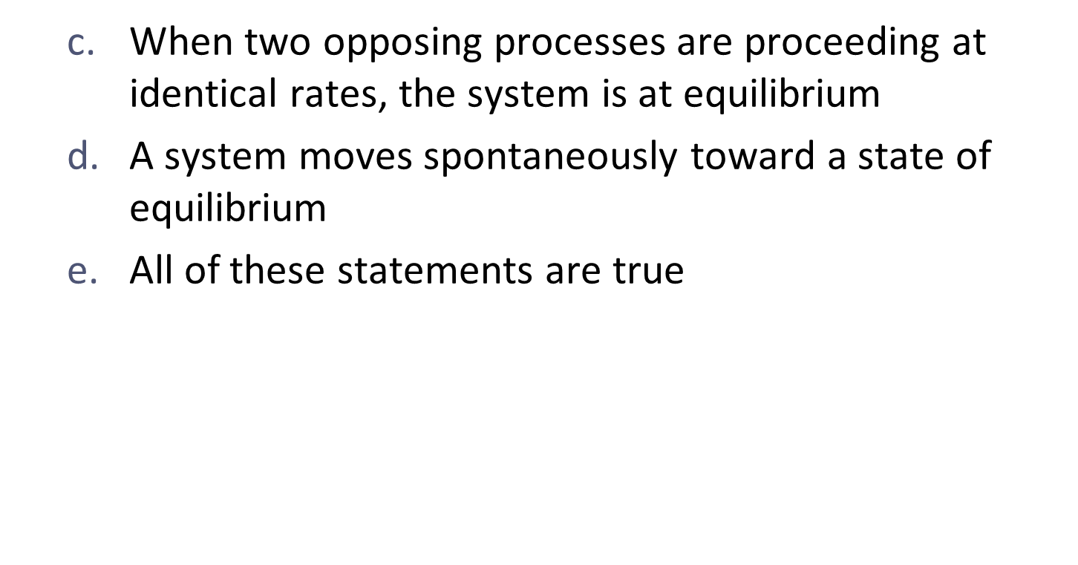
The Equilibrium Constant

Slide 32
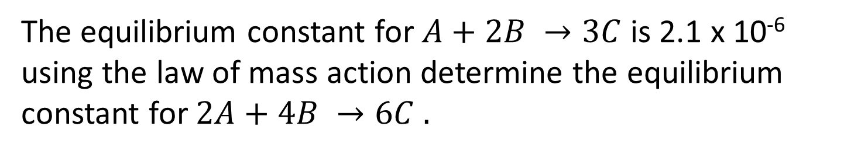
The Equilibrium Constant
The equilibrium constant for $A+2B →3C$is 2.1 x 10⁻⁶ using the law of mass action determine the equilibrium constant for $2A+4B →6C .$
$$K^{′′}=K^{n}= {\left(2.1 x {10}^{−6}\right)}^{2}=4.4 x {10}^{−12}$$

Slide 33
The Equilibrium Constant
The equilibrium constant for $A+2B →3C$is 2.1 x 10⁻⁶ using the law of mass action determine the equilibrium constant for $2A+4B →6C .$
$$K^{′′}=K^{n}= {\left(2.1 x {10}^{−6}\right)}^{2}=4.4 x {10}^{−12}$$

Slide 34
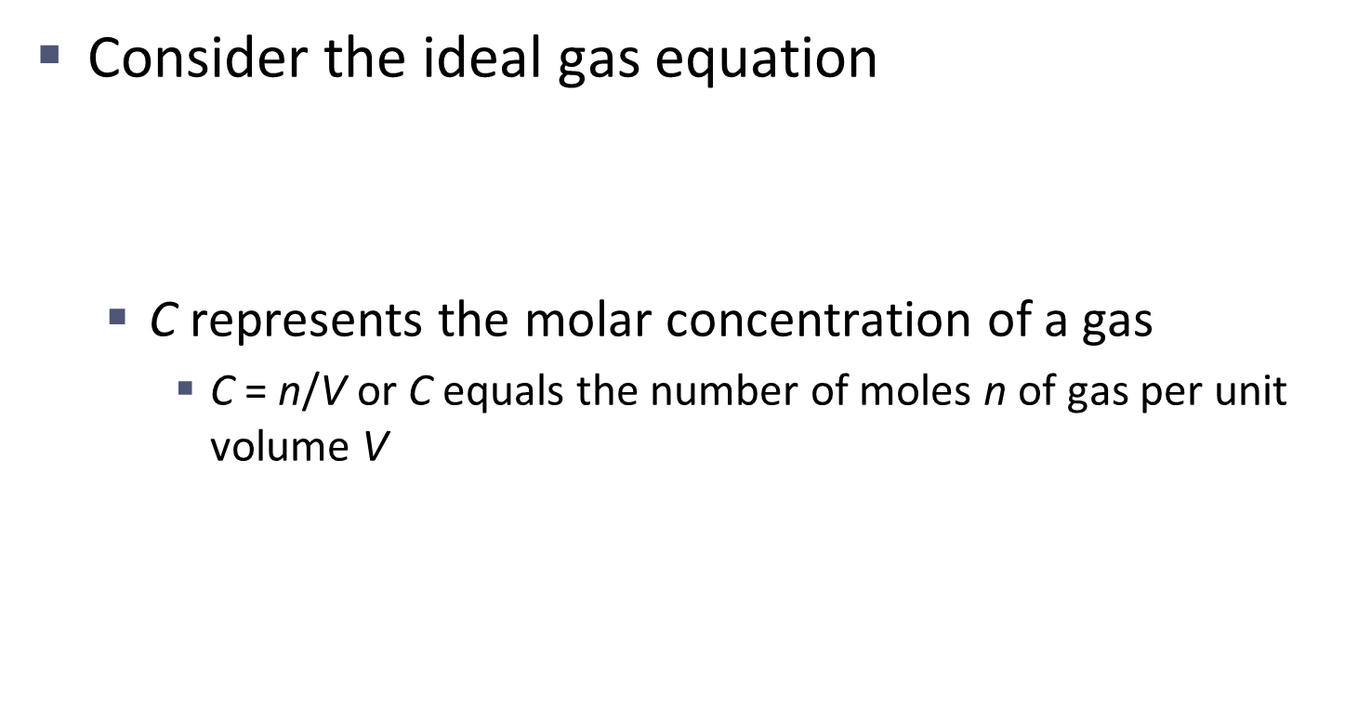
The Equilibrium Expression Involving Pressures

Slide 35
The Equilibrium Expression Involving Pressures

Slide 36
The Equilibrium Expression Involving Pressures
In terms of concentration:
In terms of equilibrium partial pressures of gases:

Slide 37
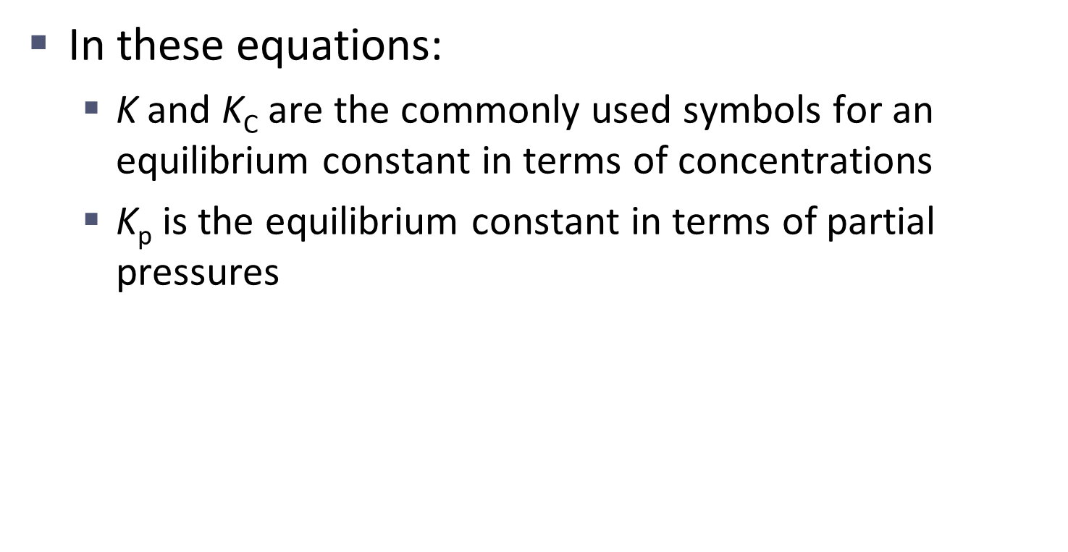
The Equilibrium Expression Involving Pressures

Slide 38
The Equilibrium Expression Involving Pressures

Slide 39
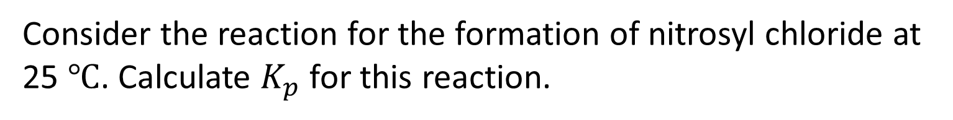
The Equilibrium Expression Involving Pressures
Consider the reaction for the formation of nitrosyl chloride at 25 $℃$. Calculate $K_{p}$ for this reaction.
$$2NO\left(g\right)+{Cl}_{2}\left(g\right)→2NOCl(g)$$
The pressures at equilibrium were found to be

Slide 40
The Equilibrium Expression Involving Pressures
$$2NO\left(g\right)+{Cl}_{2}\left(g\right)→2NOCl(g)$$

Slide 41
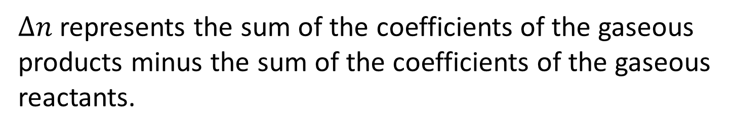
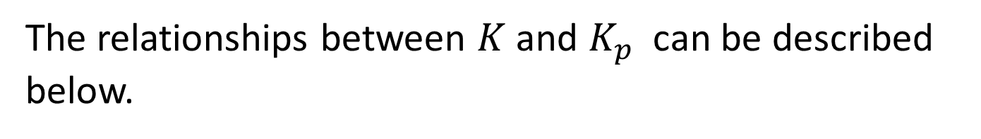
The Equilibrium Expression Involving Pressures
The relationships between $K$ and $K_{p}$ can be described below.
$∆n$represents the sum of the coefficients of the gaseous products minus the sum of the coefficients of the gaseous reactants.

Slide 42
The Equilibrium Expression Involving Pressures
For a general reaction,
  Δn = (l + m) – (j + k)
    Difference in the sums of the coefficients for the gaseous products and reactants

Slide 43
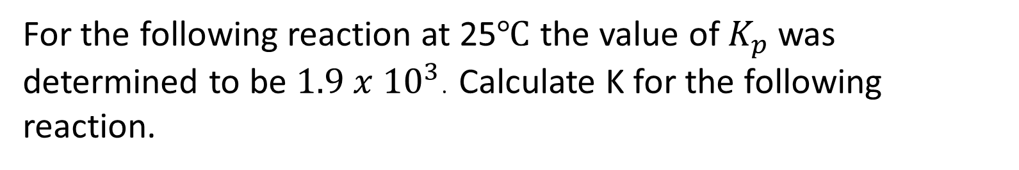
The Equilibrium Expression Involving Pressures
For the following reaction at 25$℃$ the value of $K_{p}$was determined to be $1.9 x {10}^{3}$. Calculate K for the following reaction.

Slide 44
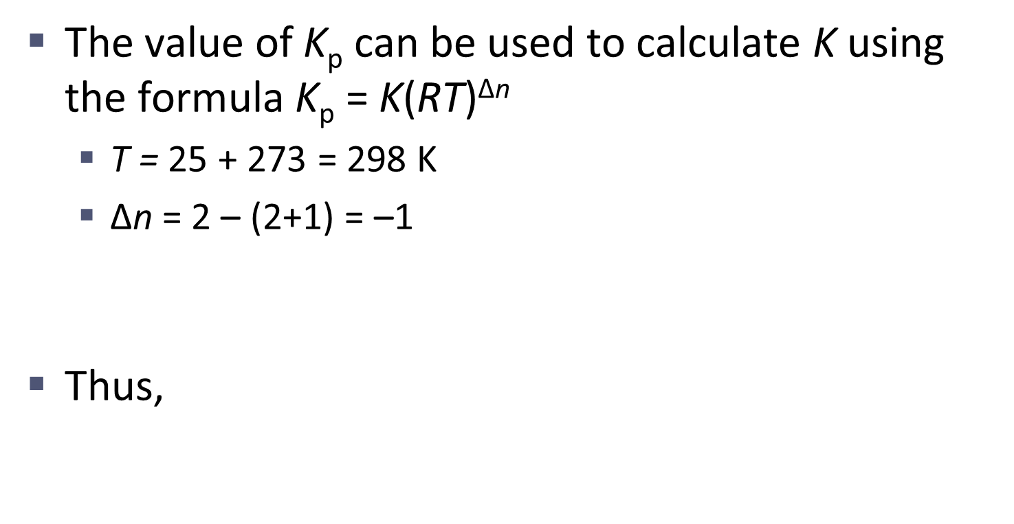
The Equilibrium Expression Involving Pressures
Sum of product coefficients
Sum of reactant coefficients
Δn

Slide 45
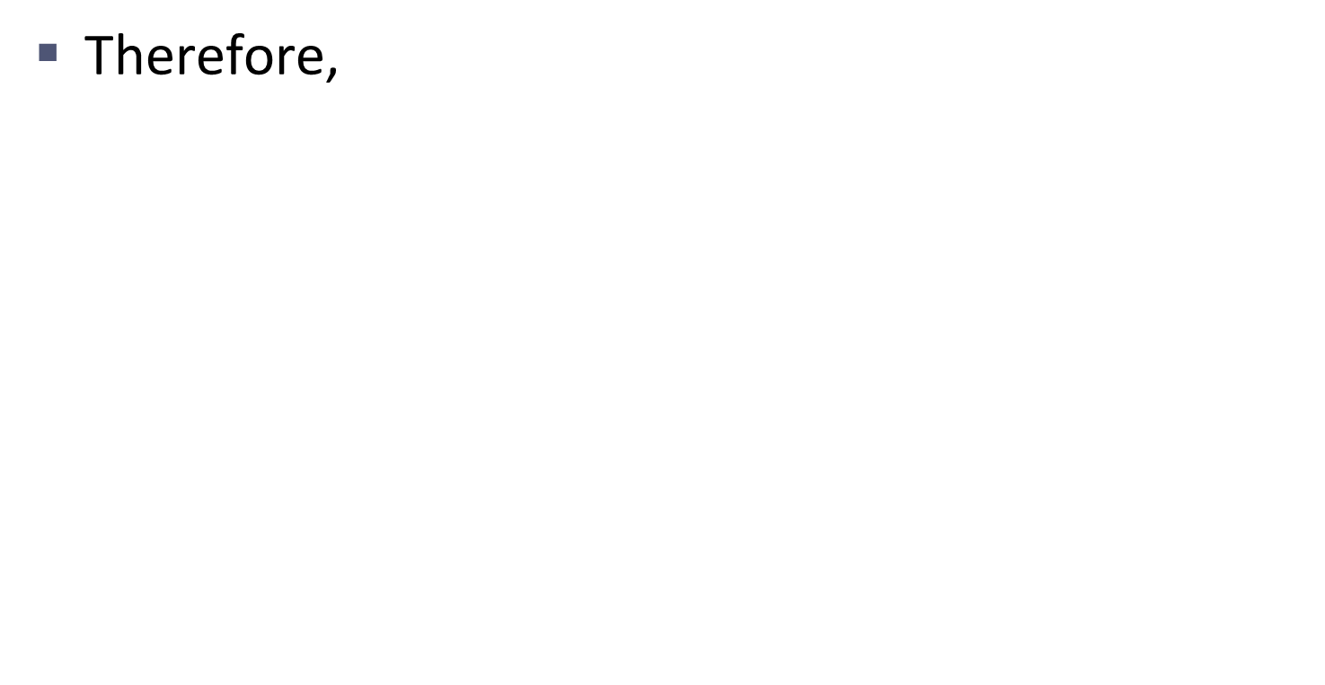
The Equilibrium Expression Involving Pressures

Slide 46
Heterogeneous + Homogenous Equilibria
Homogenous equilibria is what we’ve been seeing this whole time. It occurs when all species in our chemical equation are in the same state.
Heterogeneous occurs when some species in our chemical equation are not in the same state.
$$CaCO_{2}\left(s\right)→CaO\left(s\right)+CO_{2}(g)$$

Slide 47

Heterogeneous + Homogenous Equilibria
Simply put, we do not count solids or liquids in our chemical equilibrium expression. We only count gases and aqueous solutions.
$$CaCO_{2}\left(s\right)→CaO\left(s\right)+CO_{2}(g)$$
$$K=\left[CO_{2}\right]$$

Slide 48
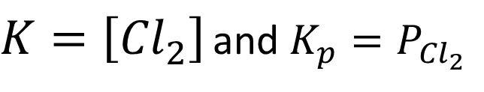
Heterogeneous + Homogenous Equilibria
Write the general equilibrium expression for the following reaction.
$$P{Cl}_{5}\left(s\right)→P{Cl}_{3}\left(l\right)+{Cl}_{2}(g)$$
$K=\left[{Cl}_{2}\right]$ and $K_{p}=P_{{Cl}_{2}}$

Slide 49
Chemistry
Chapter 13
Chemical Equilibrium
Section 1
HW (Not Collected, for reals): Pg 546 – 547b
Problems: 12 – 18, 25, 27, 29 – 45, 48, 49, 50

