Slide 1
Chemistry
Chapter 10
Liquids and Solids
Section 2
Chapters:
10.2 The Liquid State
10.9 Phase Diagrams

Slide 2
Review
What are the three types of intermolecular forces?

Slide 3
Review
Rank the three types of intermolecular forces from strongest to weakest.

Slide 4
Review
Which intermolecular force will (most of the time) exhibit the highest boiling point?

Slide 5
Review
Which intermolecular force will (most of the time) exhibit the highest vapor pressure?

Slide 6
Review
What is the requirement for hydrogen bonding to occur between molecules?

Slide 7
Review
Name a few molecules with the strongest intermolecular force being London-Dispersion Forces.

Slide 8
Liquids
defined volume; takes shape of the container
Liquids are fluids
Particles are closer together than gases
Higher density than gases
Relative incompressibility (low compressibility)
Liquids diffuse (if it can dissolve)
Viscosity – measure of a liquid’s resistance to flow:
Liquids with large intermolecular forces or molecular complexity tend to be highly viscous.

Slide 9
Liquids
Surface tension – resistance of a liquid to an increase in its surface area:
Liquids with large intermolecular forces tend to have high surface tensions.
Capillary action – spontaneous rising of a liquid in a narrow tube:
Cohesive forces – intermolecular forces among the molecules of the liquid.
Adhesive forces – forces between the liquid molecules and their container.

Slide 10
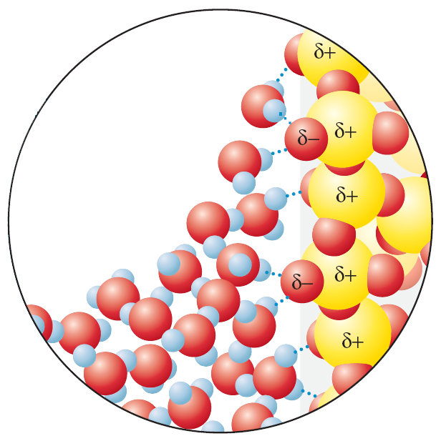
Liquids
Which force dominates alongside the glass tube – cohesive or adhesive forces?
adhesive forces

Slide 11
Solids
defined shape and volume
Particles are closely packed (intermolecular forces)
Higher density than liquids (some exceptions)
Incompressible
Very low rate of diffusion

Slide 12
Solids
Amorphous Solids:
Disorder in the structures
Glass
Crystalline Solids:
Ordered Structures
Unit Cells

Slide 13
Phase Diagrams
A convenient way of representing the phases of a substance as a function of temperature and pressure

Slide 14
Phase Diagrams
Phase equilibrium lines - lines that mark conditions under which multiple phases can coexist at equilibrium; phase transitions (changes) occur along lines of equilibrium
Triple point - the temperature and pressure at which the three phases coexist in thermodynamic equilibrium
Critical point - the end point of a phase equilibrium curve

Slide 15
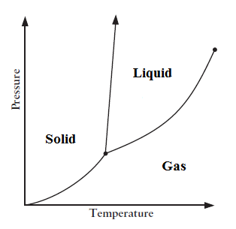
Phase Diagrams
Phase Equilibrium Line
Critical Point
Triple Point

Slide 16
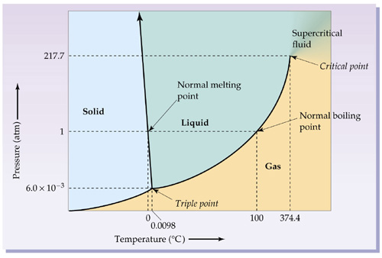
Phase Diagrams
For H₂O

Slide 17
Phase Diagrams

Slide 18
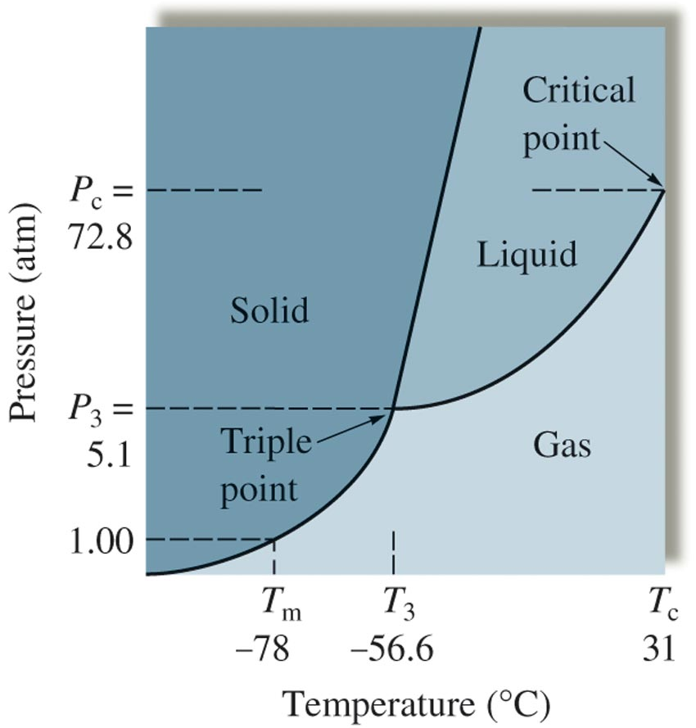
Phase Diagrams
For Carbon Dioxide

Slide 19
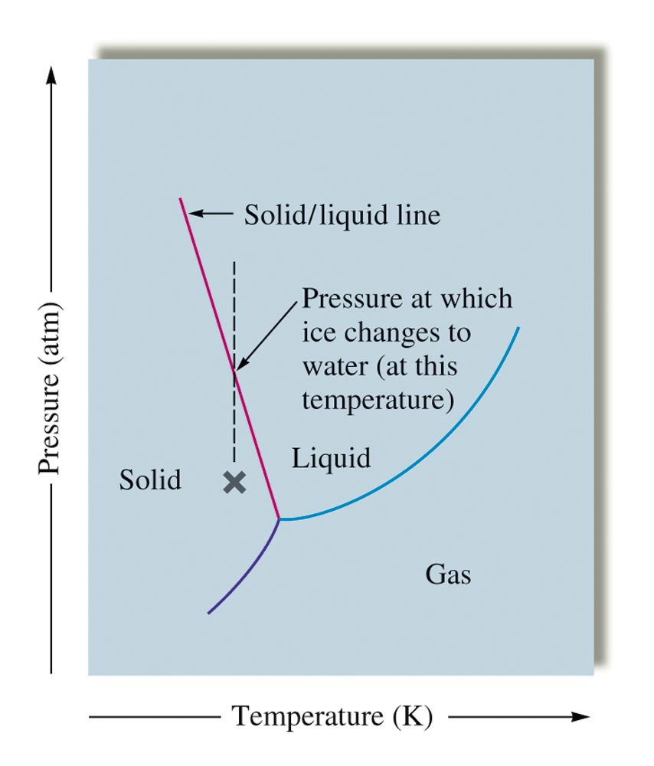
Phase Diagrams

Slide 20
Chemistry
Chapter 10
Liquids and Solids
Section 2
Homework: Pg 432h – 432i
Problems: Not Collected
131,132,138,140

