Slide 1
Chemistry
Chapter 10
Liquids and Solids – but mostly liquids
Section 1
Chapters:
10.1 Intermolecular Forces
10.8 Changes in State

Slide 2
Bonding Forces in molecules
There are two types of bonding forces in molecules
Intramolecular forces
Intermolecular forces

Slide 3
Intramolecular Forces
Intramolecular forces occur when electrons are shared between atoms
Intra meaning “Within”
These are forces we are most familiar with
They include:
Ionic Bonding
Polar + Nonpolar Covalent Bonding

Slide 4
Intermolecular Forces
Intermolecular forces are forces between molecules.
There are three types of intermolecular forces that we will talk about.
Hydrogen Bonding
Dipole-Dipole
London Dispersion Forces
Important: Intramolecular bonds are stronger than inter molecular forces.
Strength of Force

Slide 5
Intermolecular Forces – Hydrogen Bonding
These are intermolecular forces that occur between molecules where the molecules have polar covalent bonds that involve hydrogen.
The negative pole of the electronegative atom is attracted to the positive pole of the hydrogen atom.
This is the strongest intermolecular force.

Slide 6
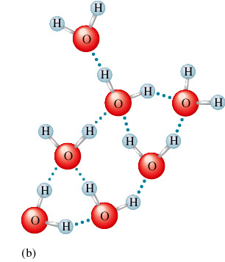
Intermolecular Forces – Hydrogen Bonding
Example: Hydrogen Bonding in Water
Note: The dotted lines represent the intermolecular forces between the molecules.

Slide 7
Intermolecular Forces – Dipole-Dipole Forces
This is similar to hydrogen bonding with the exception that there is no hydrogen atom.
This can only occur when the molecule possesses polar covalent bonds.
The negative pole of the electronegative atom is attracted to the positive pole of the less electronegative atom.
This is the second strongest intermolecular force.

Slide 8
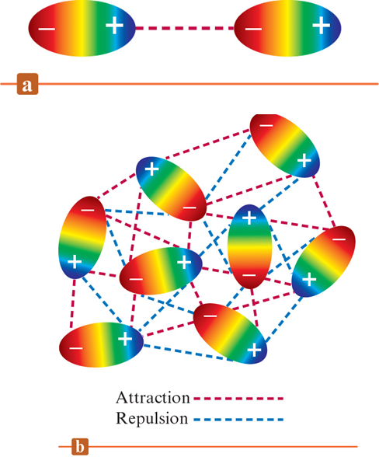
Intermolecular Forces – Dipole-Dipole Forces
Example: Dipole-Dipole Interactions
Note: This intermolecular force is present in all molecules that have polar covalent bonds.

Slide 9
Intermolecular Forces – London Dispersion Forces
These are intermolecular forces that exist between Nobel Gases and nonpolar molecules
These are forces that occur when instantaneous dipoles can occur within the molecule.
The polarizability of the molecule will affect the London Dispersion Force
In general – The higher the molecular weight = strong London dispersion force
These are the weakest intermolecular forces.

Slide 10
Intermolecular Forces – London Dispersion Forces
Demonstration

Slide 11
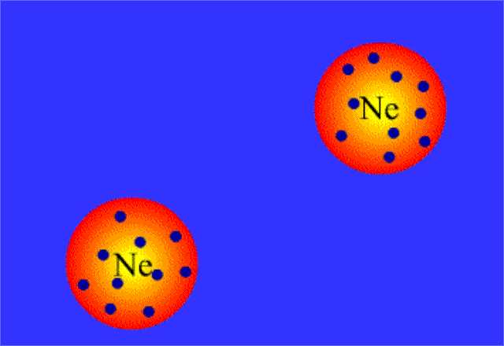
Intermolecular Forces – London Dispersion Forces
Example: London Dispersion Forces
Note: This intermolecular force is the main force keeping molecules together with nonpolar molecules and Nobel gases.

Slide 12
Intermolecular Forces – London Dispersion Forces
Common molecules that exhibit London Dispersion Forces as the strongest intermolecular force.
Nobel Gases
All Hydrocarbons
Any other nonpolar molecules

Slide 13
Intermolecular Forces – London Dispersion Forces
The reality of the world is that all molecules have London Dispersion Forces.
The only force we care about when looking at a molecule however is the strongest force.
If a molecule has hydrogen bonding, we consider that is the main intermolecular force and we disregard the London Dispersion Force.
Same with Dipole-Dipole.

Slide 14
Intermolecular Forces
Why do we care?
These forces can tell us certain properties of molecules
The stronger the intermolecular force the higher the boiling point will be, the more viscous a liquid will be, and the lower the vapor pressure will be.

Slide 15
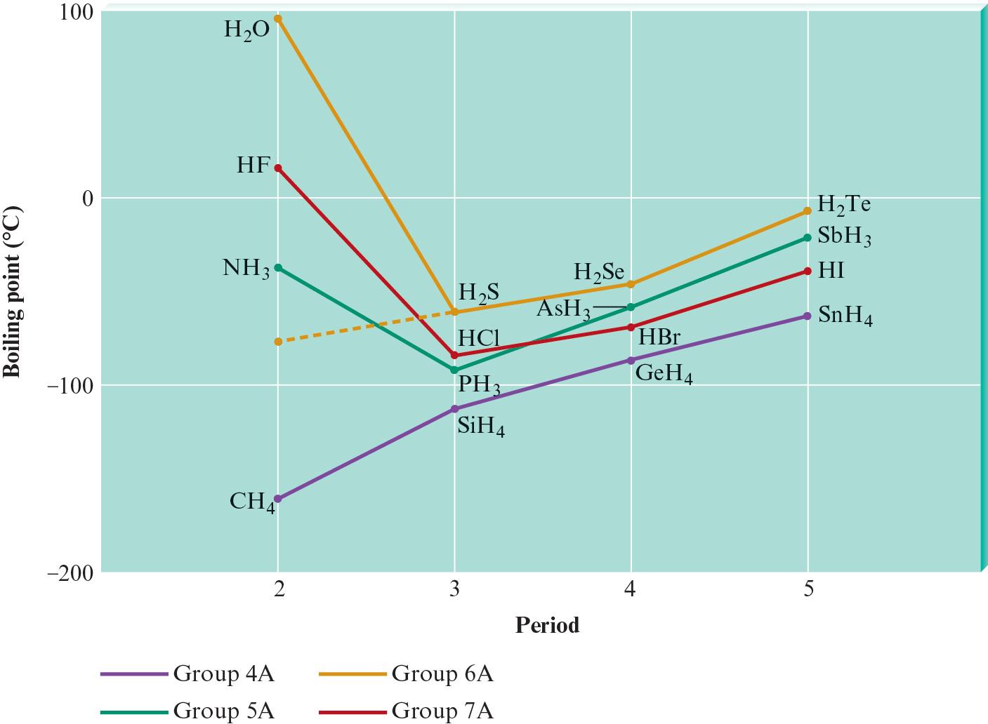
Intermolecular Forces - Trends

Slide 16
Intermolecular Forces
Strategy for determining which molecule has the strongest intermolecular force.
Look to see which molecule exhibits hydrogen bonding
Next look for Dipole-Dipole interactions
Finally look for London Dispersion Forces
$LD<DD<HB$
When two molecules have London dispersion forces the “bigger” molecule will have stronger intermolecular forces

Slide 17
Intermolecular Forces Questions
Which one of the following is the strongest intermolecular force experienced by noble gases?
London dispersion forces
Dipole–dipole attraction
Hydrogen bonding
Ion–ion interactions

Slide 18
Intermolecular Forces Questions
Methane (CH₄) is a gas, but carbon tetrachloride (CCl₄) is a liquid at room conditions
Which of the following statements explains this phenomenon?
CCl₄ is a polar molecule and CH₄ is not
CCl₄ and CH₄ have different geometries and shapes
CH₄ exhibits hydrogen bonding and CCl₄ does not
Cl is more electronegative than H
None of these statements is correct

Slide 19
Intermolecular Forces Questions
Which of the following species exhibits the strongest intermolecular forces?
CH₄
H₂O
N₂
CO
He

Slide 20
Intermolecular Forces Questions
What type(s) of intermolecular forces is (are) exhibited by methane (CH₄)?
Hydrogen bonding and London dispersion forces
Hydrogen bonding
Dipole–dipole and London dispersion forces
London dispersion forces

Slide 21
Intermolecular Forces Questions
When a water molecule forms a hydrogen bond with another water molecule, which atoms are involved in the interaction?
A hydrogen atom from one water molecule with a hydrogen atom from another.
An oxygen atom from one water molecule with an oxygen atom from another.
A hydrogen atom from one water molecule with an oxygen atom from another
A hydrogen atom and an oxygen atom from the same water molecule

Slide 22
Intermolecular Forces Questions
Which of the following has the highest boiling point?
H₂O
HF
NH₃
N₂

Slide 23
Intermolecular Forces Questions
Which of the following compounds has the lowest boiling point?
C₂H₆
C₃H₈
CH₄
C₅H₁₂
C₄H₁₀

Slide 24
Intermolecular Forces Questions
Which of the following is the correct order of boiling points for CH₃OH, C₂H₆, and Ne?
CH₃OH < C₂H₆ < Ne
CH₃OH < Ne < C₂H₆
Ne < C₂H₆ < CH₃OH
C₂H₆ < Ne < CH₃OH

Slide 25
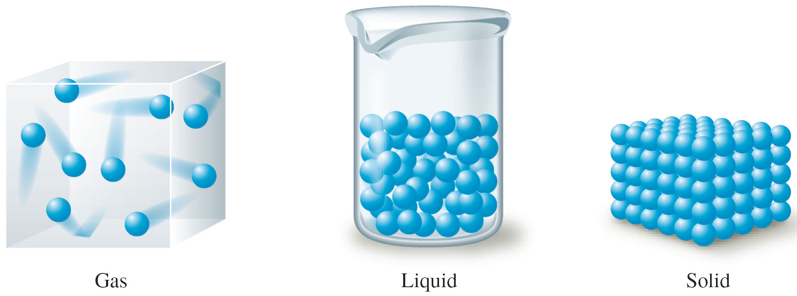
States of Matter
The three states of matter.

Slide 26
Phase Changes
When a substance changes from one State of Matter into another State of Matter
When the substance changes States of Matter, the molecules remain intact
The changes in state are due to changes in the forces among molecules rather than in those within the molecules
Phase -part of a system that has uniform composition and properties

Slide 27
Phase Changes
Phase Change
Solid  Liquid
Solid  Gas
Liquid  Solid
Liquid  Gas
Gas  Liquid
Gas  Solid
Process
Melting
Sublimation
Freezing
Vaporization
Condensation
Deposition

Slide 28
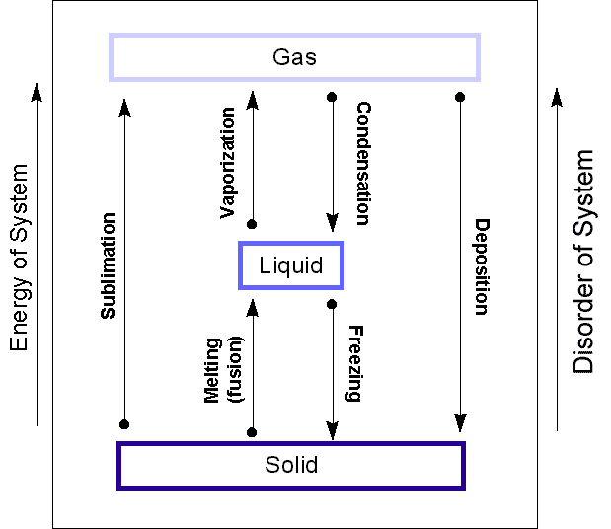
Phase Changes

Slide 29
Phase Changes
Solid to Liquid
As energy is added, the motions of the molecules increase, and they eventually achieve the greater movement and disorder characteristic of a liquid
Liquid to Gas
As more energy is added, the gaseous state is eventually reached, with the individual molecules far apart and interacting relatively little

Slide 30
Phase Changes
Boiling Point
the temperature at which the equilibrium vapor pressure of the liquid enters the atmospheric pressure
same as the condensation point
Freezing Point
the temperature at which the solid and liquid are in equilibrium at 1 atm
same as the melting point

Slide 31
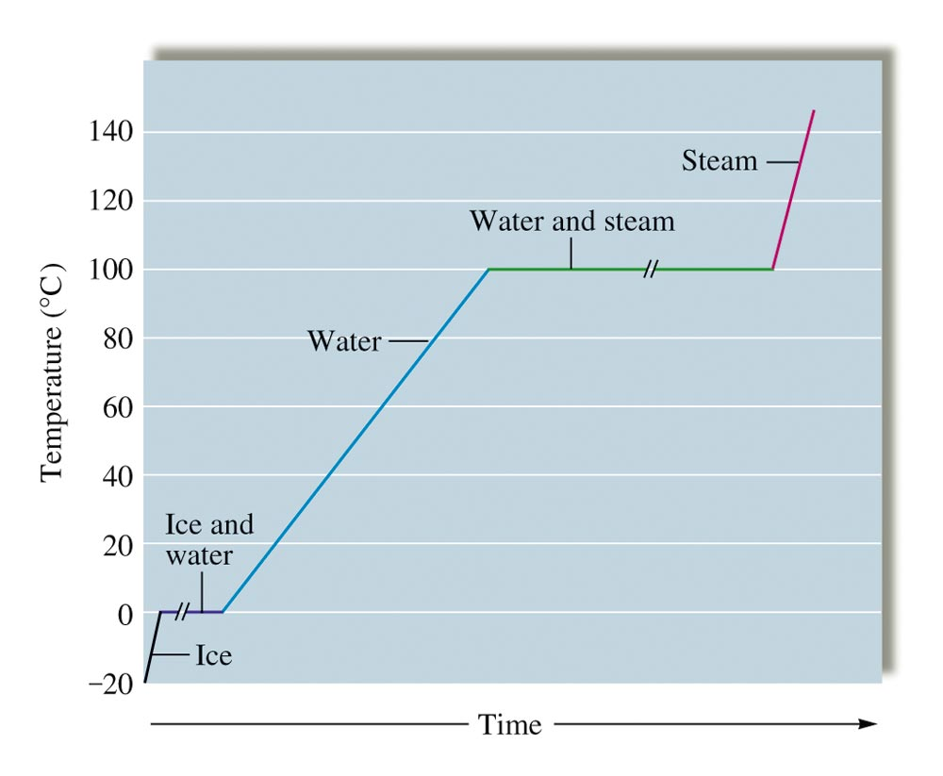
Phase Changes – Heating Curves

Slide 32
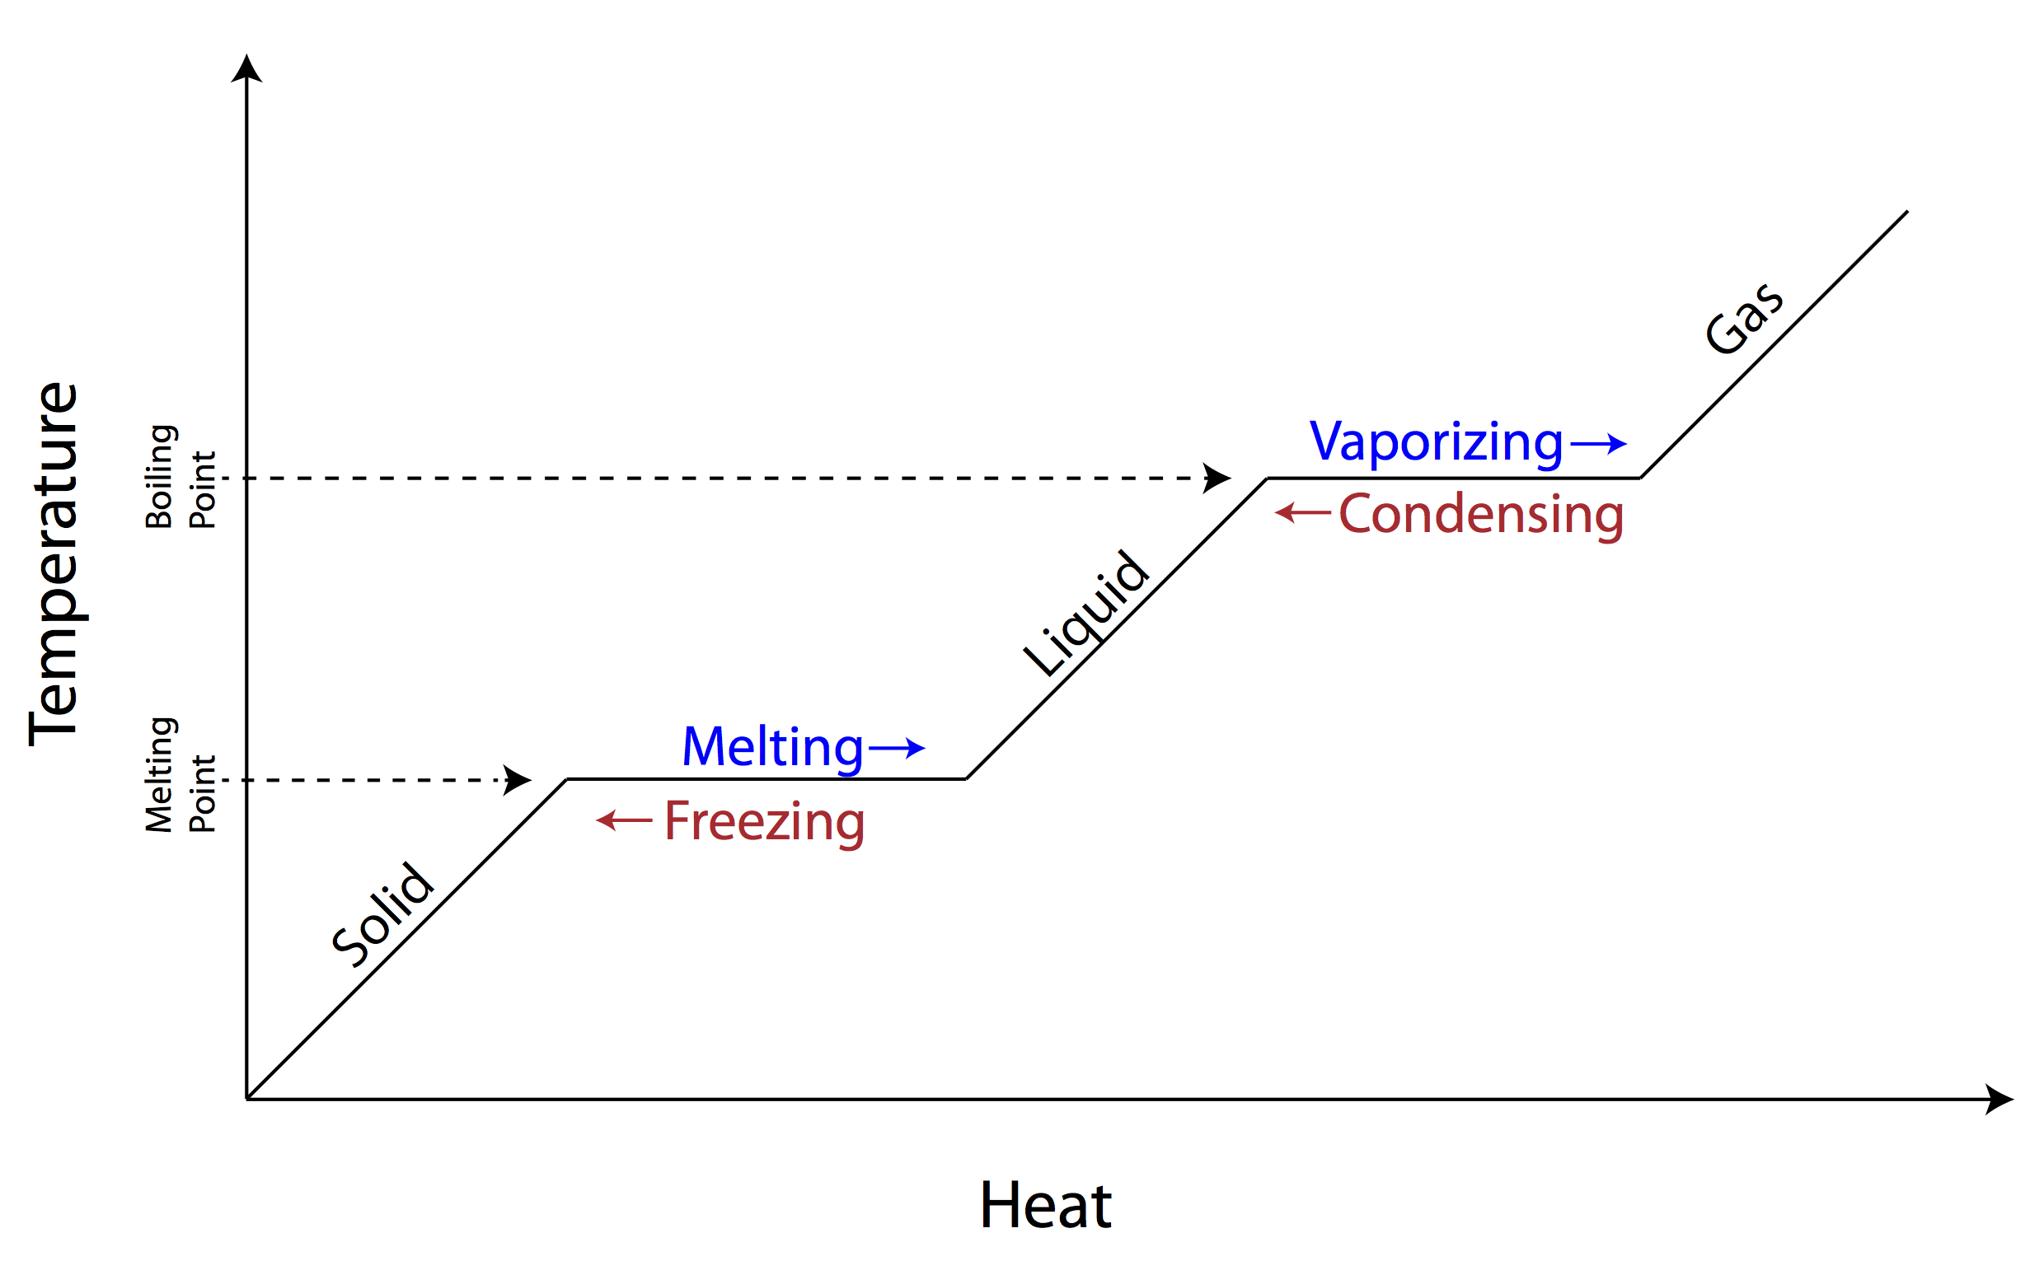
Phase Changes – Heating Curves

Slide 33
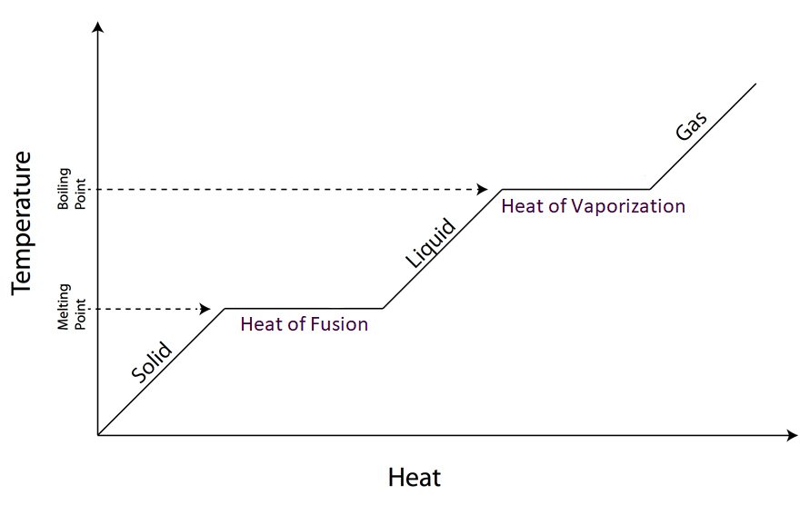
Phase Changes – Heating Curves

Slide 34
Phase Changes – Heating Curves
The amount of Heat or Energy it takes to change a substance from a solid to a liquid is known as the heat of fusion. Units ($\frac{J}{g} or \frac{J}{mol})$
The amount of Heat or Energy it takes to change a substance for a liquid to a gas is called the heat of vaporization. Units ($\frac{J}{g} or \frac{J}{mol})$

Slide 35
Phase Changes – Heating Curves
How to read this curve.

Slide 36
Phase Change Calculations
It is important to be able to calculate the amount of heat energy required to raise the temperature of a substance through a phase change.
Do we remember this expression?
$$Q=m∗C∗(T_{f} −T_{i})$$
Q = Specific Heat
m = mass (g) or mol (depending on C)
C is the specific heat (either $\frac{J}{g ∗℃}$ or $\frac{J}{mol ∗℃}$)
$T_{f}$ is temperature final
$T_{i}$ is temperature initial

Slide 37
Phase Change Calculations
We are going to modify this equation slightly.
Now it is going to be….
Solid To Liquid
$$Q=m∗C_{s}∗\left(T_{fs} −T_{is}\right)+m ∗Heat of Fushion+m∗C_{l}∗\left(T_{fl} −T_{il}\right)$$
Liquid to Gas
$$Q=m∗C_{l}∗\left(T_{fl} −T_{il}\right)+m ∗Heat of Vaporization+m∗C_{g}∗\left(T_{fg} −T_{ig}\right)$$
OR Solid to Gas
$$Q=Solid to Liquid Equation+Liquid to Gas Equation$$

Slide 38
Phase Change Calculations
Example: How much heat is required to change 15 g of ice at -15$℃$ into 15 g of water vapor?
The Specific Heat of water is $4.186 \frac{J}{g ∗ ℃}$
The Specific Heat of Ice is 2.03 $\frac{J}{g ∗ ℃}$
The heat of fusion for ice is 6.01 $\frac{kJ}{mol }$
The heat of vaporization for water is 40.7 $\frac{kJ}{mol }$

Slide 39
Phase Changes – Heating Curves
Which scenario would cause more damage and why?
Getting burned by steam
Getting burned by boiling water

Slide 40
Phase Changes – Heating Curves
What would happen to the phase change diagram if my intermolecular forces increased?

Slide 41
Phase Changes – Heating Curves
An ice cube tray contains enough water at $10.0 ℃$ to make 18 ice cubes that each has a mass of 30.0g. The tray is placed in a freezer that uses CF₂Cl₂ as a refrigerant. The heat of vaporization of CF₂Cl₂ is $158\frac{J}{g}$. What mass of CF₂Cl₂ must be vaporized in the refrigeration cycle to convert all the water to ice? The heat capacities for H₂O_{(s)} and H₂O_{(l)} are $2.03 \frac{J}{g ∗ ℃}$ and $4.18 \frac{J}{g ∗ ℃}$ respectively. The enthalpy of fusion for ice is $6.02 \frac{kJ}{mol}.$

Slide 42
Chemistry
Chapter 10
Liquids and Solids – but mostly liquids
Section 1
Homework: Pg 431 – 432j
Problems: Not Collected 14,15,16,17,37,38,39,40,41,42,43,44, 99,100,101,102,103
The challenge problem: 104

